Slide 1
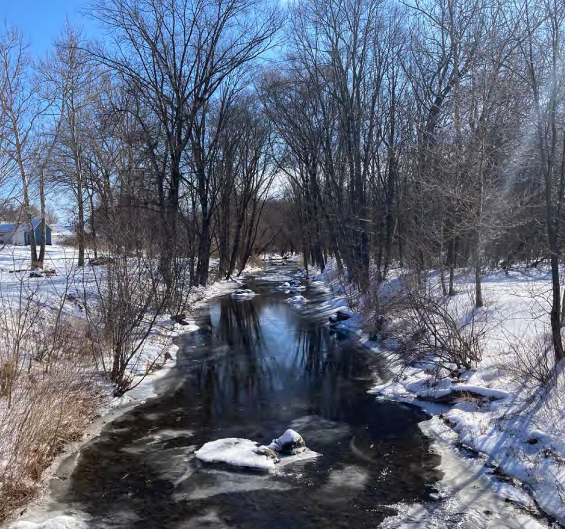
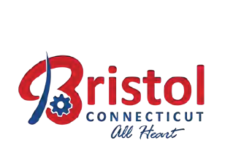
Project Update: Climate Resiliency/Flooding/Storm Drainage Tuesday September 9th, 2025

Slide 2
Agenda
Grant Overview
Project Scope
Schedule + Budget
Site Visit
Upcoming Work:
Engineering Task Overview
Interdisciplinary Solutions
Policy Interventions and Education
Engagement Program
Notes:
Add space on left and top of text.

Slide 3
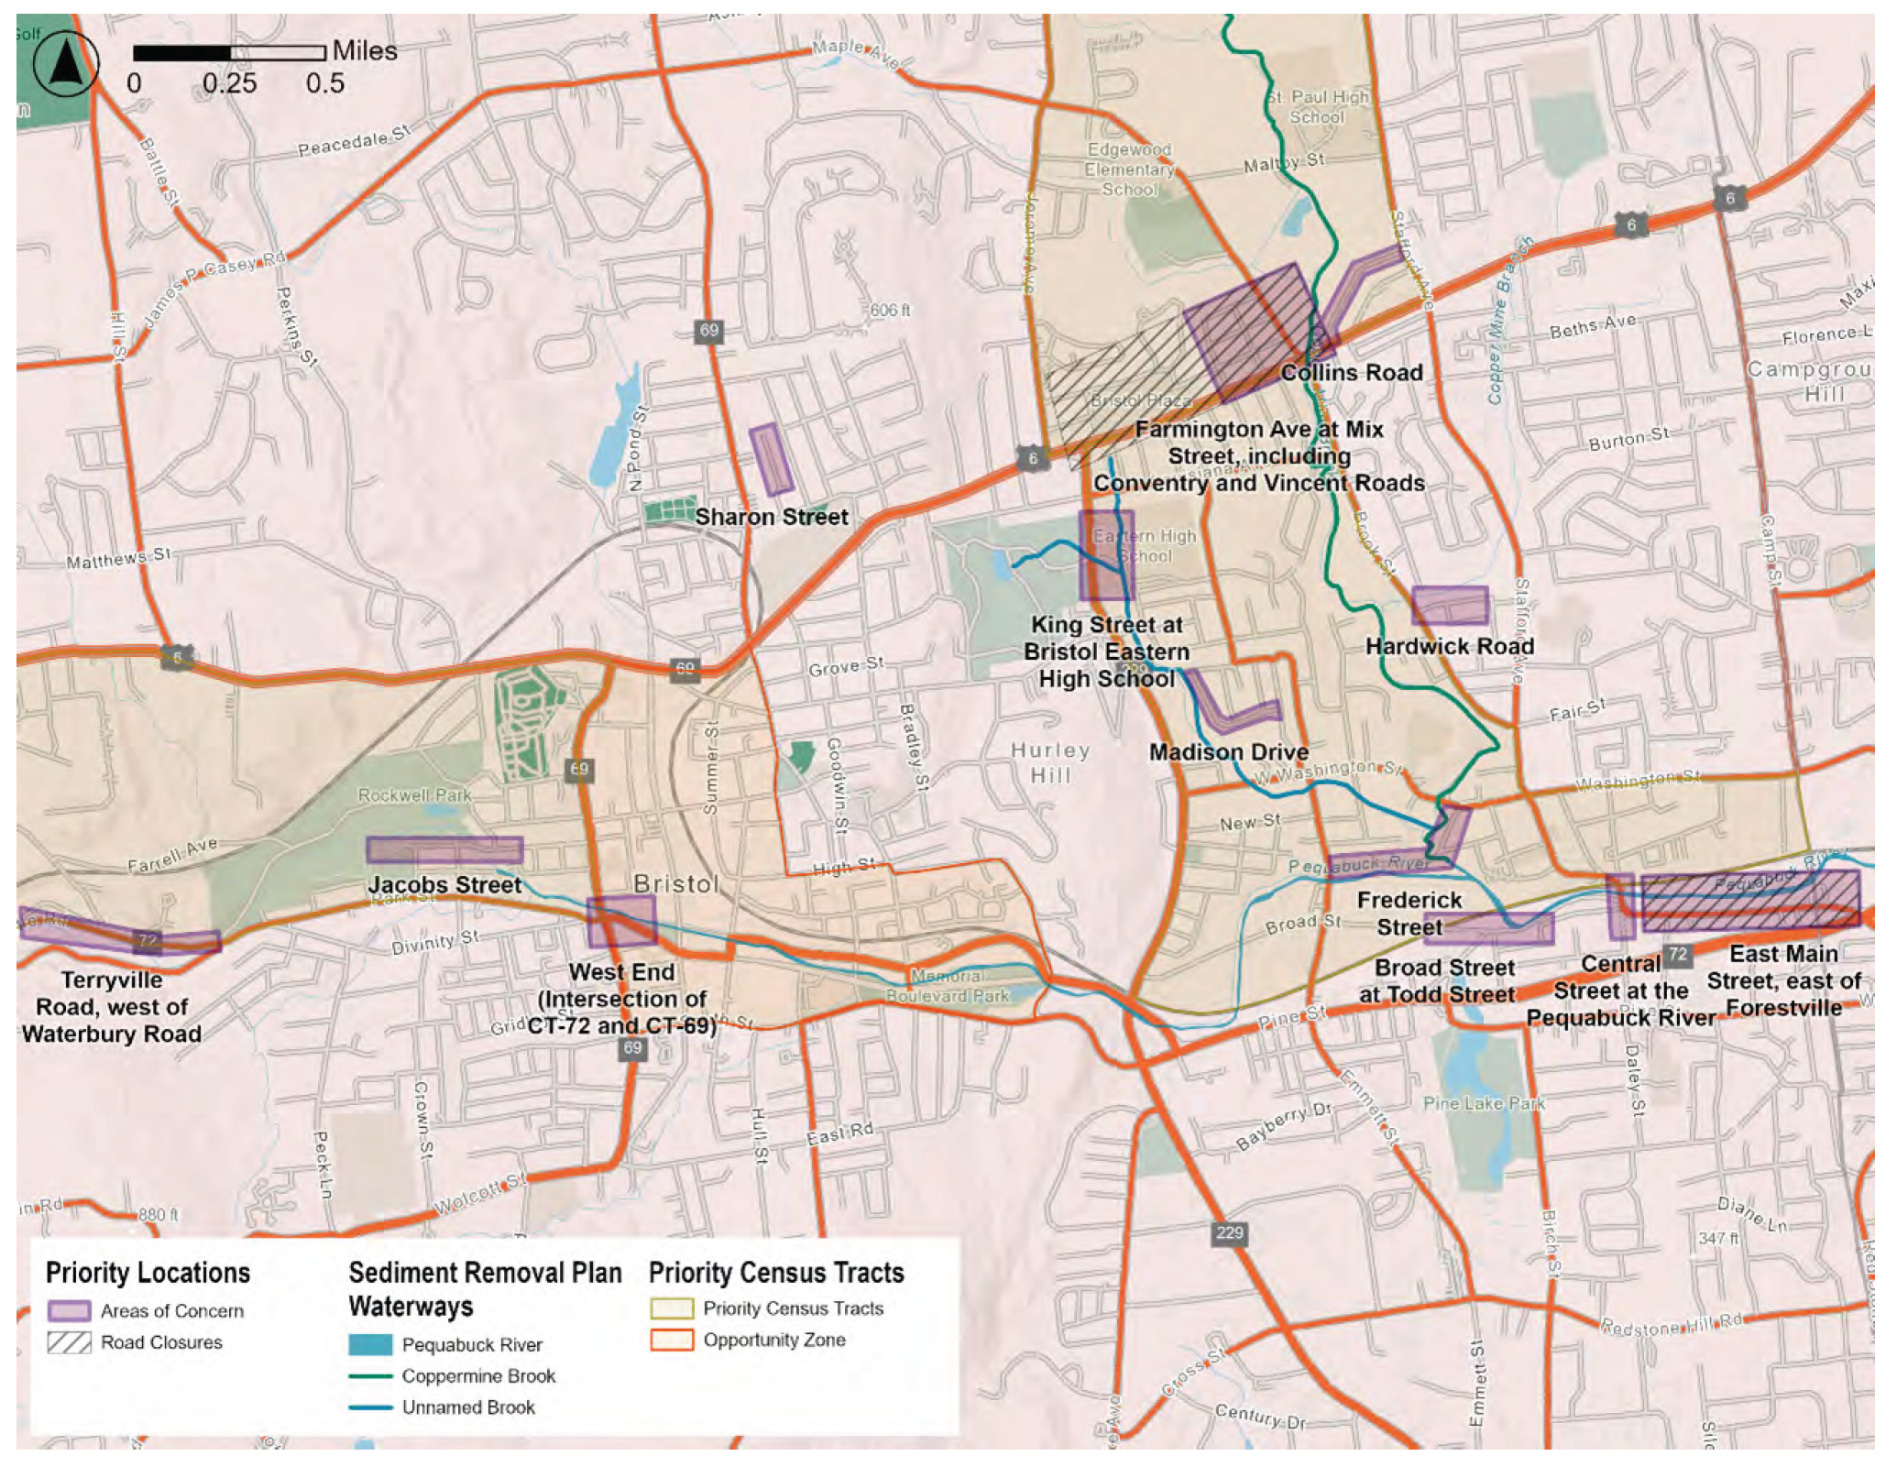
1) Grant Overview
Bristol received a $250,000 CT DEEP Resilience Fund Grant.
Intended to identify engineering solutions to mitigate flooding within the City.
Community outreach and public education around flooding preparedness are also key components.

Slide 4
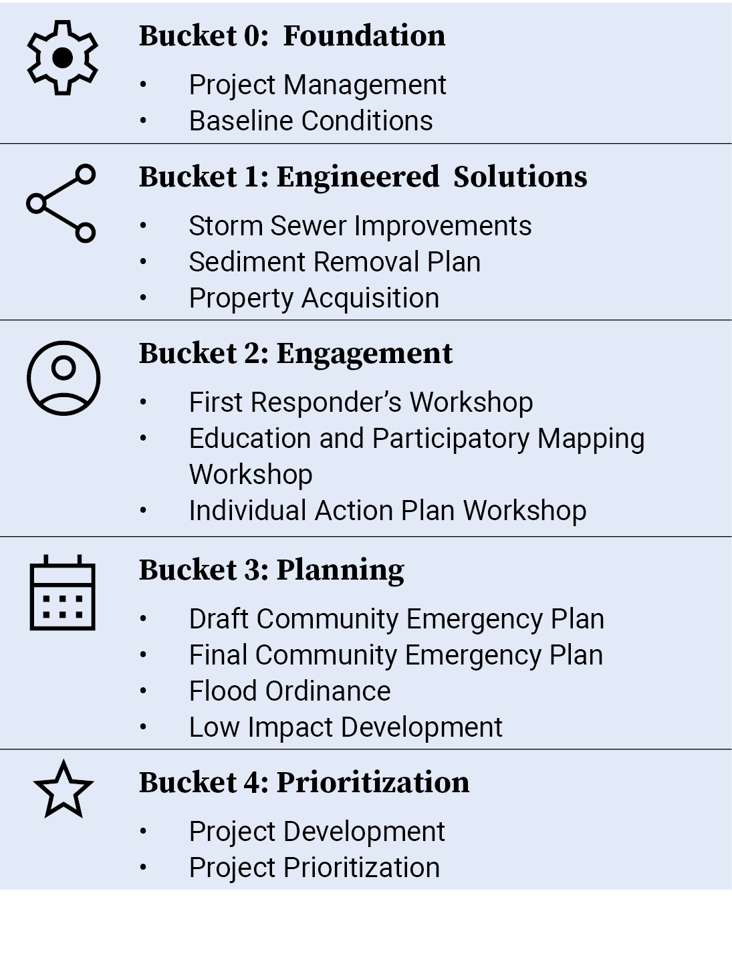
2) Project Scope
Public Workshop
Stakeholder Workshop
Notes:
Including potential solutions

Slide 5
3) Project Schedule
Jul 2025
Aug 2025
Sept 2025
Oct 2025
Nov 2025
Dec 2025
Jan
2026
Feb
2026
Mar
2026
Aprl
2026
May
2026
Jun
2026
Jul
2026
Aug
2026
Task | Jun | Jul | Aug | Sep | Oct | Nov | Dec | Jan | Feb | Mar | Apr | May | Jun | Jul
Project Management
Baseline Conditions
Storm Sewer Standards
Sediment Removal
First Responder’s Workshop
Public Workshop 1: Participatory Mapping and Resources
Draft Community Emergency Plan
Final Community Emergency Plan
Public Workshop 2: Individual Action Plan Development
Flood Ordinance Review
Low Impact Dev Guidelines
Concept Dev
Project Prioritization
Property Acquisition Plan
Completed:
Project Kickoff: July 16
Site Visit: August 6th
Starting
Storm Sewer Standards
Sediment Removal

Slide 6
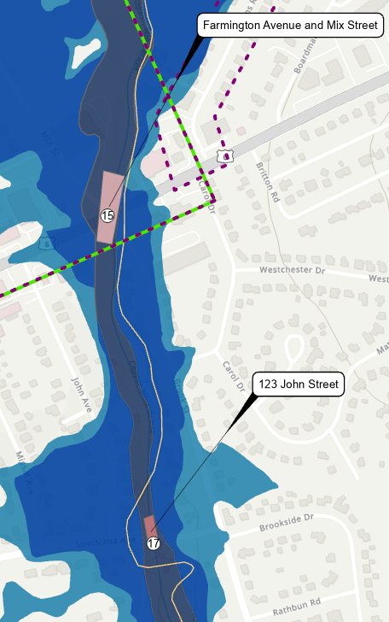
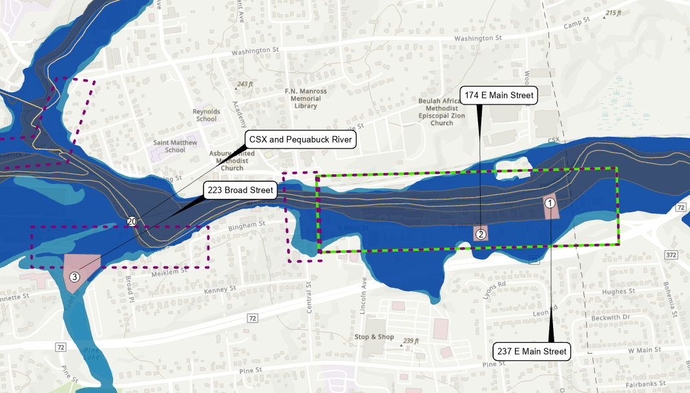
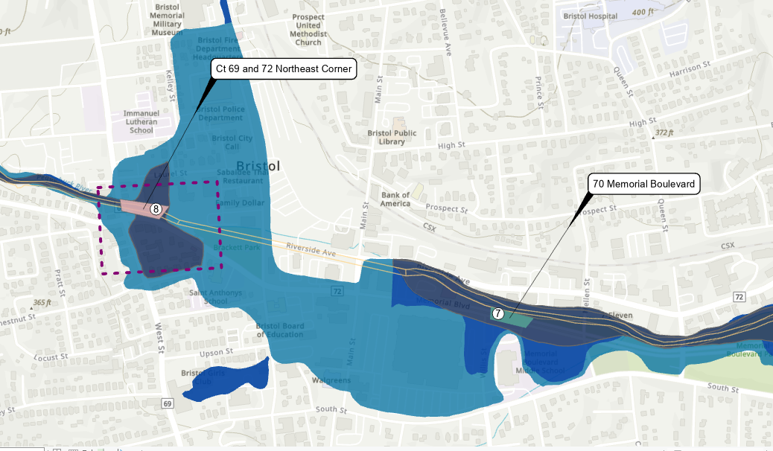
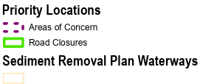
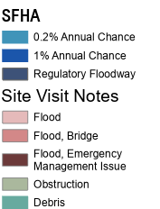
4) Site Visit
Meeting with City to document existing conditions
Incorporating notes into our baseline mapping
Next Steps:
Circulating maps to DPW for review
Additional Data request

Slide 7
Engineering and Data Review
Project Tasks:
Site Visits
GIS Mapping
Review Existing Hydraulic Studies
Historical Data
FEMA Information/Updates
Develop Conceptual Designs

Slide 8
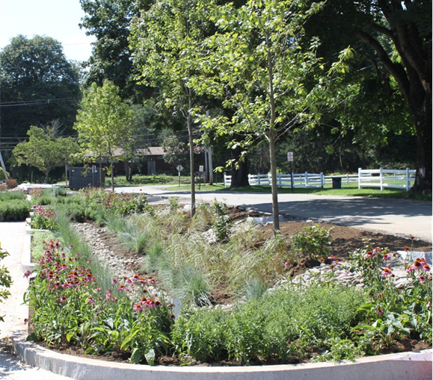
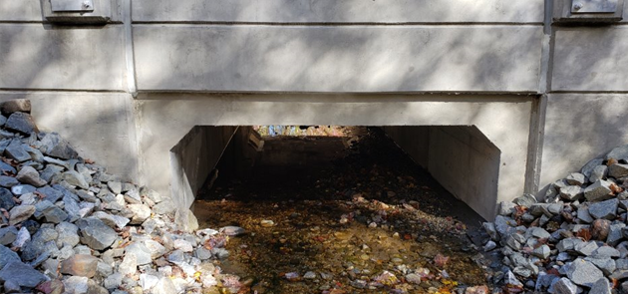
Evaluating Interdisciplinary Solutions
Green Solutions to Consider:
Bioretention areas
Subsurface detention/infiltration systems
Reduce impervious areas
Restoring flood plain
Daylighting streams that are currently in underground culverts
Gray Solutions to Consider:
Increasing capacity of existing infrastructure
Surface ponds/constructed wetlands
Flood-proofing buildings
Property acquisitions
Notes:
DB
So, how can we mitigate the problem? We believe this can be accomplished through green and gray solutions. We can look to nature for inspiration for bioretention, understanding the floodplain, and daylighting portions of the brook that are currently in culverts. We can also look to increase capacity of existing infrastructure and floodproof buildings. Some examples of solutions could include performance of routine maintenance and cleaning of structures and street sweeping. Or, replacement of damaged, failed, and undersized conveyances and inlets.

Slide 9
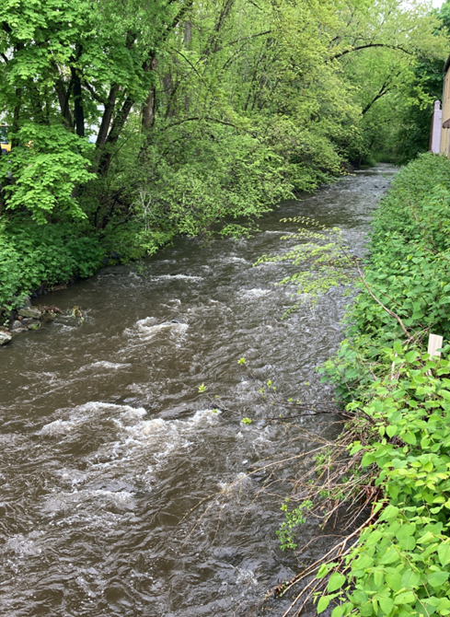
Developing Policy Interventions + Education
Stormwater Regulation updates
Elevation Requirements for new structures
Backwater valve deployment
Upstream retention timing
Emergency Response
Municipal: Strengthening Bristol’s response practices.
Community: Coordination with neighbors
Household: Preparedness, structure-level mitigation
Understanding root causes
Precipitation, riverine, and high water-table impacts
City versus property-owner responsibilities

Slide 10
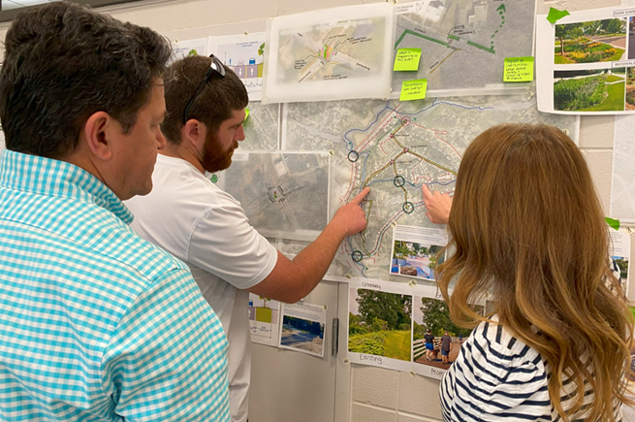
Engaging the Public
Storm Sewer Standards – Workshop with DPW Attendees: DPW, City Staff: Topics: Example standards improvements from other communities. Purpose: Feedback will inform Storm Sewer Improvement Standards | First Responders’ Workshop Attendees: Emergency Management staff, Police Department, Fire Department, and the Water and Sewer Department. Topics: Impact of flooding-induced road closures on community lifeline access. Purpose: Inform Community Emergency Plan
Public Workshop 1: Participatory Mapping and Resources Attendees: Flood-impacted Bristol residents Topics: mapping flood impacts, potential interventions, familiarization with FEMA, state, and local resources. Purpose: Inform Community Emergency Plan, provide opportunity for local first responders to speak with the community. | Public Workshop 2: Individual Action Plan Development Attendees: flood-impacted Bristol Residents Topics: Individual actions plans, evacuation routes, floodproofing techniques, flood sourcing and causation, buyout program participation pathways. Purpose: Emergency preparedness.
Notes:
Public workshop 2: Information about LoMAs, Flood “proofing”, education on what flooding means and what causes it

Slide 11
Thank you

