Slide 1



State Project No. 0017-0196
Route 72 Improvements in the City of Bristol
PUBLIC INFORMATION MEETING
April 29, 2025
Prepared for: City of Bristol
Prepared by: GM2 Associates, Inc.

Slide 2
Riverside Avenue Overview
MEET THE PROJECT TEAM
MEETING FORMAT
TITLE VI – CIVIL RIGHTS
PROJECT PRESENTATION
QUESTION AND ANSWER
Project No. 0017-0196

Slide 3
Organizational Chart
GM2 Staff | Stakeholder Representatives | CTDOT Liaisons
Principal In Charge Matthew Vail | Raymond Rogozinski | Principal Engineer Michael Cherpak
Project Manager Paul Brand | Justin Malley | Supervising Engineer Devin Raciot
Project Engineer Danielle Dixon |  | Right of Way Coordinator Zachary Guarino
Project No. 0017-0196

Slide 4
Meeting Format
Recording:
  https://bristolct.portal.civicclerk.com/
Submit a Question or Comment
  Q&A Session
  Email: RaymondRogozinski@bristolct.gov
  Telephone: Raymond Rogozinski at (860) 584-6125
Comment Period
  Open through May 13, 2025
  Email or Telephone
Project No. 0017-0196

Slide 5
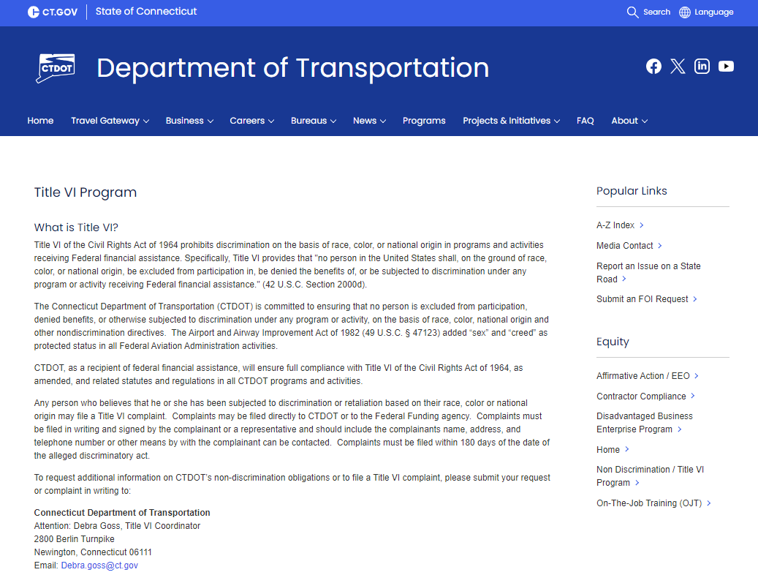
Title VI – Your Civil Rights
No person shall, on the basis of race, color, or national origin, be excluded from participation or subject to discrimination in the development of this project.
Civil Rights information:
  https://portal.ct.gov/dot/equity/title-vi
Project No. 0017-0196

Slide 6

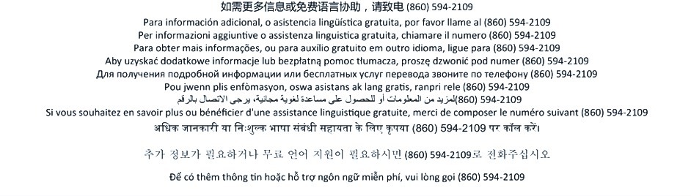
Connecticut Department of Transportation
Title VI Notice to the Public
The Connecticut Department of Transportation (CTDOT) operates its programs and services without regard to race, color, and national origin in accordance with Title VI of the Civil Rights Act. Any person who believes she or he has been aggrieved by any unlawful discriminatory practice under Title VI may file a complaint with the CTDOT.
For more information on the CTDOT’s civil rights program, and the procedures to file a complaint, contact the CTDOT Title VI Coordinator at (860) 594-2169, TRS 711;
Debra.Goss@ct.gov; or visit our administrative office at 2800 Berlin Turnpike, Newington, CT 06131. For more information, visit www.ct.gov/dot.
A complainant may file a complaint directly with the Federal Transit Administration by filing a complaint with the FTA Office of Civil Rights, Attention: Title VI Program Coordinator, East Building, 5th Floor-TCR, 1200 New Jersey Ave., SE, Washington, DC 20590
A complainant may file a complaint directly with the Federal Highway Administration by filing a complaint with the FHWA Office of Civil Rights, Attention: Title VI Program Coordinator, 8th Floor E81-105, 1200 New Jersey Ave., SE, Washington, DC 20590
Individuals and organizations may file a complaint by completing the Title VI complaint form (https://railroads.dot.gov/resource-center/title-vi-civil-rights-act-1964/title-vi-complaint-format). Complaints should be signed and include contact information and should be sent to: Office of Civil Rights Federal Railroad Administration 1200 New Jersey Avenue, SE ROA-10, Mail Stop 5 Washington, DC 20590

Slide 7
El Departamento de Transporte de Connecticut (CTDOT) se compromete a asegurar que ninguna persona sea excluida de participar en, o le sean negados los beneficios de, sus servicios de transporte basándose en la raza, color o país de origen de la persona protegida por el Título VI de la Ley de los Derechos Civiles. Si a usted le parece que ha sido objeto de discriminación en lo que corresponde al Titulo VI, puede presentar una queja al CTDOT.
Para más información sobre el programa de derechos civiles del CTDOT y el proceso de presentar una queja, comuníquese con el Coordinadora del Título VI del CTDOT al teléfono (860) 594-2169, TRS 711; Debra.Goss@ct.gov. Tambien puede visitar nuestra oficina administrativa en 2800 Berlin Turnpike, Newington, CT 06131. Para más información, visite www.ct.gov/dot.
Un denunciante puede presentar una queja directamente ante la Federal Transit Administration si lo hace ante la FTA Office of Civil Rights, Attention: Title VI Program Coordinator, East Building, 5th Floor-TCR, 1200 New Jersey Ave., SE, Washington, DC 20590.
Un denunciante podrá presentar una queja directamente ante la Federal Highway Administration si lo hace ante la FHWA Office of Civil Rights, Attention: Title VI Program Coordinator, 8th Floor E81-105, 1200 New Jersey Ave., SE, Washington, DC 20590.
Para recibir más información o ayuda gratuita en otros idiomas, llame al (860) 594-2109.
Departamento de Transporte de Connecticut
Título VI Aviso al Público
Individuals and organizations may file a complaint by completing the Title VI complaint form (https://railroads.dot.gov/resource-center/title-vi-civil-rights-act-1964/title-vi-complaint-format). Complaints should be signed and include contact information and should be sent to: Office of Civil Rights Federal Railroad Administration 1200 New Jersey Avenue, SE ROA-10, Mail Stop 5 Washington, DC 20590

Slide 8
General Project Information
Project Origin
  Streetscape Study and Design Concepts completed in 2021
    Riverside Avenue
    Divinity Street
    Park Street
Purpose & Need
  Purpose: To improve safety, access management, pedestrian accommodations and aesthetic qualities along Riverside Avenue.
  Need: Current condtion of existing facilities along Riverside Avenue and the poorly developed and disconnected sidewalk system.
Project No. 0017-0196

Slide 9
General Project Information
Funding
City of Bristol Project Design | CT Department of Transportation Fund & Perform Rights of Way Construction Phase Cost
Project Schedule
  Contract Documents: July 2026
  Advertising: September 2026
  Construction: April 2026
Project No. 0017-0196

Slide 10
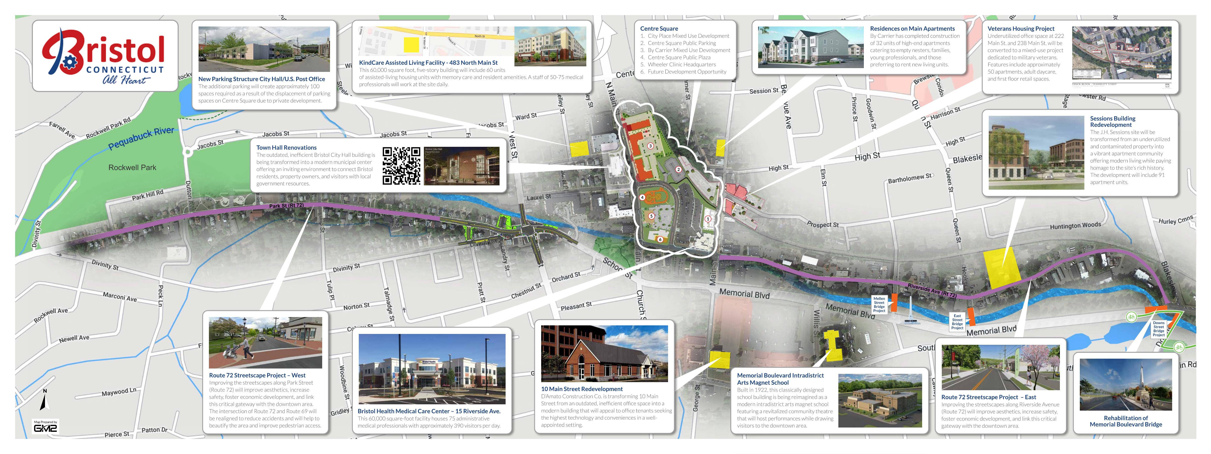
Route 72 Corridor
Project No. 0017-0196

Slide 11
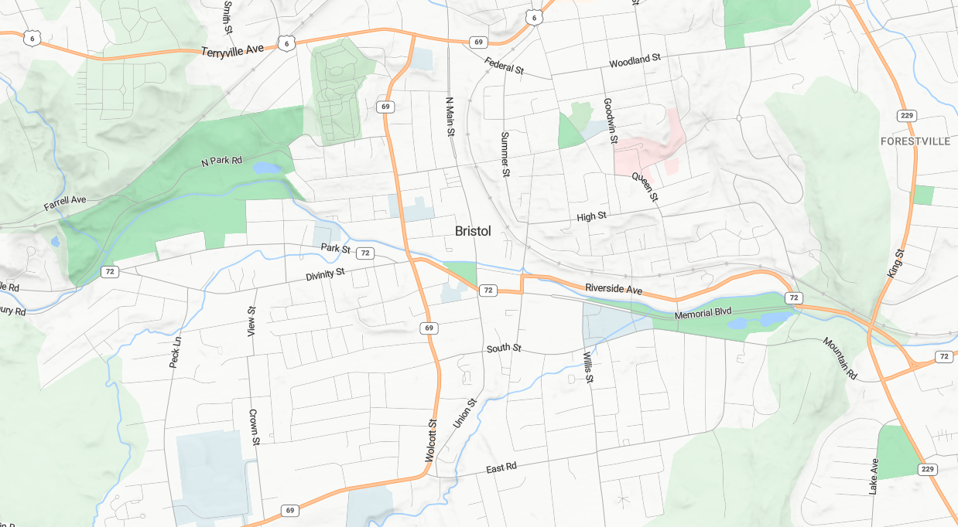




Project Locations
West Cemetery
Bristol
Hospital
Rockwell
Park
Memorial Blvd Park
Project No. 0017-0196

Slide 12
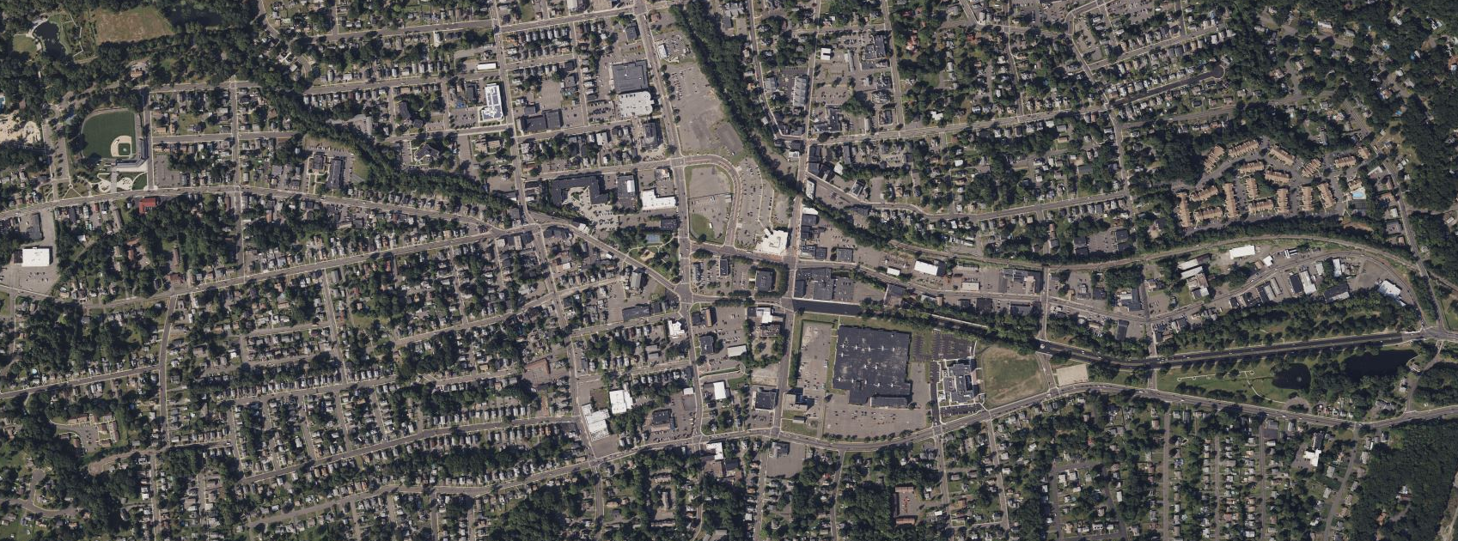

Projects Locations
69
RIVERSIDE AVENUE
Muzzy Field
0017-0195
273 Riverside Ave Site Work
Carousel Museum Site Work
0171-0504
72
PARK STREET
72
0017-0187
Memorial
Blvd Park
0017-0193
0017-0192
L017-0002
Project No. 0017-0196

Slide 13
Presentation Overview
PROJECT LOCATION
EXISTING CONDITIONS
SAFETY ANALYSIS
PROPOSED IMPROVEMENTS
CONSTRUCTION STAGING
OTHER CONSIDERATIONS
Project No. 0017-0196

Slide 14
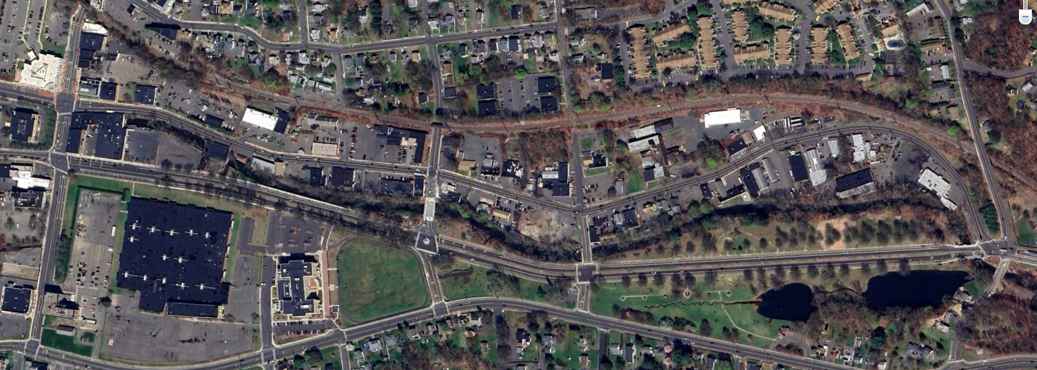
Project Location
Mellen St.
Main Street
Riverside Ave
Hooker Ct.
Blakeslee St.
East St.
Memorial Blvd.
Memorial Blvd Park
Project No. 0017-0196

Slide 15
Presentation Overview
PROJECT LOCATION
EXISTING CONDITIONS
SAFETY ANALYSIS
PROPOSED IMPROVEMENTS
CONSTRUCTION STAGING
OTHER CONSIDERATIONS
Project No. 0017-0196

Slide 16
Existing Conditions
Corridor Information
  Functional Classification
    Riverside Avenue: Urban Principal Arterial (Built-up)
    Local Roads: Urban Local Roads (Built-up)
  Average Daily Traffic Counts (ADT)
  Posted Speed Limits
Roadway | 2021 ADT (vpd)
Riverside Ave | 8,700
Main Street | 5,600
Roadway | Posted Speed Limit
Riverside Ave | 30 m.p.h.
Main Street | 25 m.p.h.
Mellen Street | 25 m.p.h.
East Street | 30 m.p.h.
Project No. 0017-0196

Slide 17
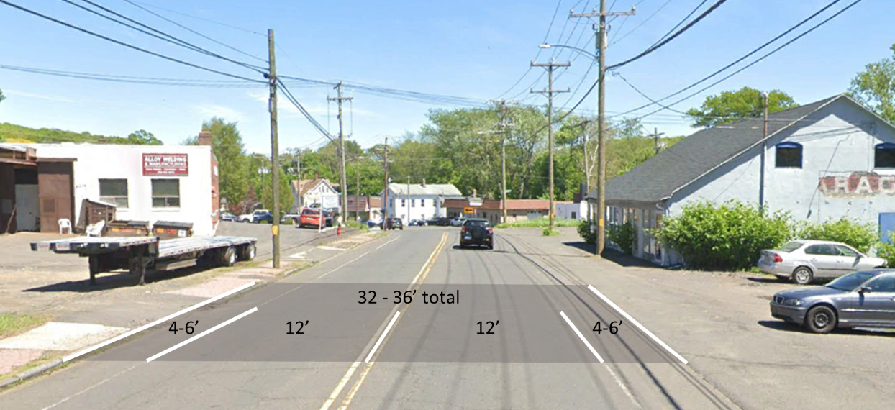
Existing Conditions
Typical Section:
Project No. 0017-0196

Slide 18
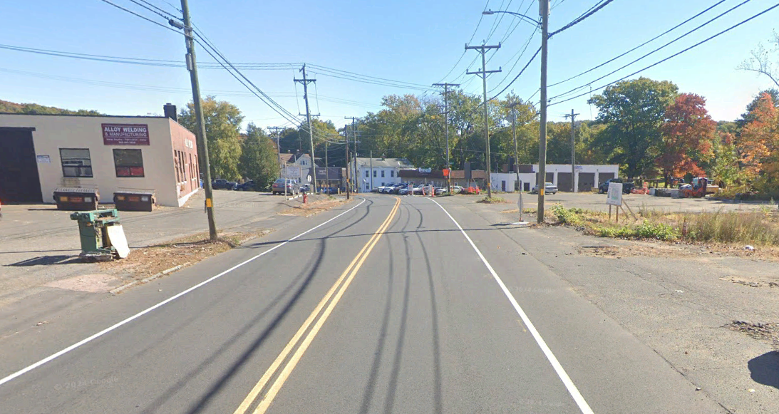
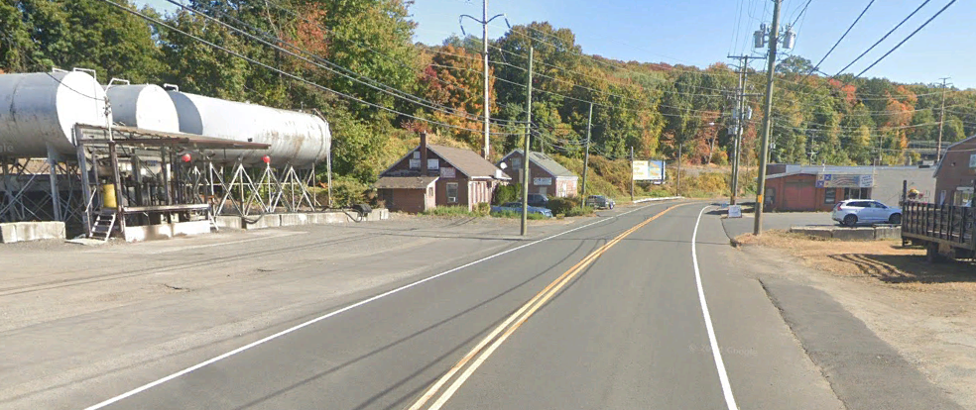
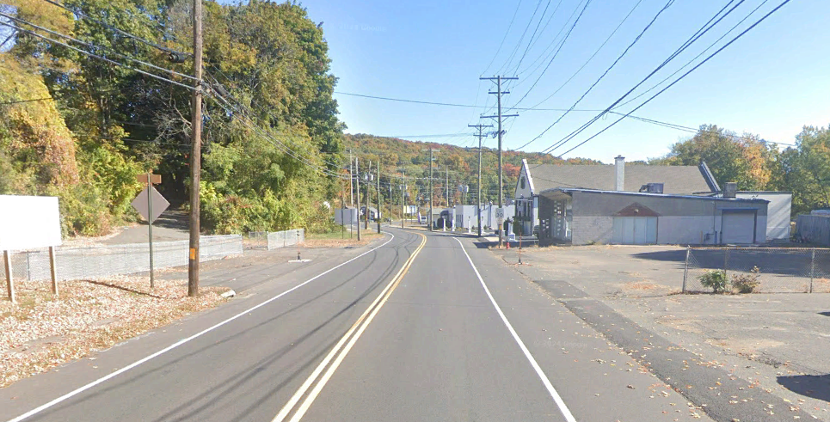
Existing Conditions
Wide Curb Cuts
Random Ingress and Egress
Low Aesthetic quality
No Formal Streetscape
Utility Poles on both sides of the street (some located in driveways)
Project No. 0017-0196

Slide 19
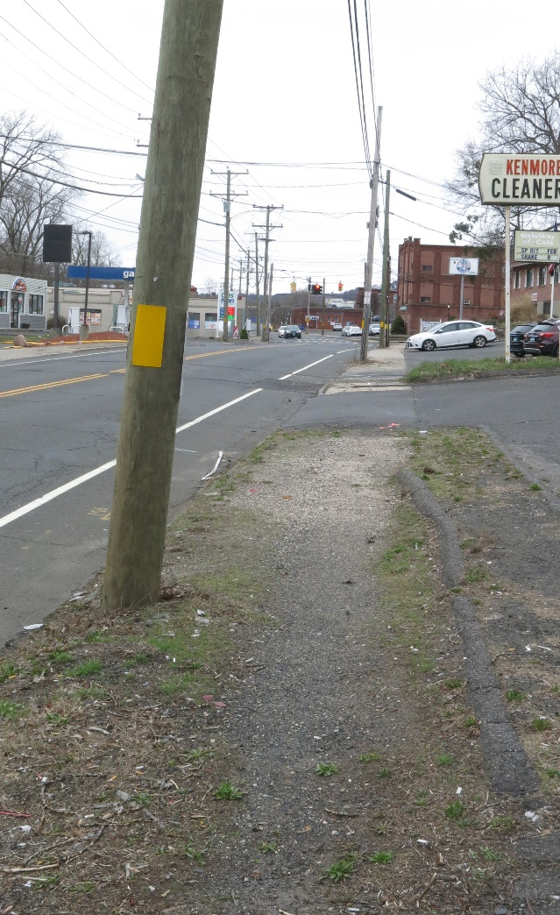
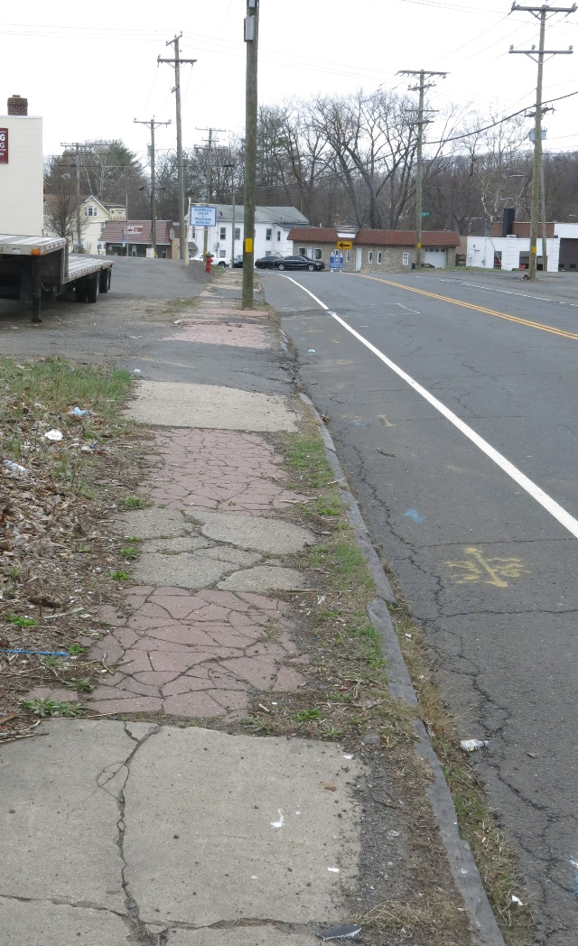
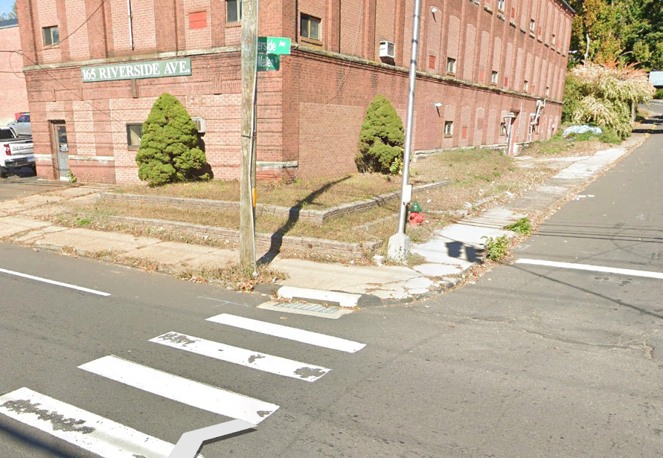
Existing Conditions
Pedestrian Accommodations
  Disconnected and Poorly Developed
  Poor Condition
  Inconsistent and Infrequent Buffer
  Scarcity of ADA-Compliant Curb Ramps
  Non-existent Pedestrian Lighting
Project No. 0017-0196

Slide 20
Presentation Overview
PROJECT LOCATION
EXISTING CONDITIONS
SAFETY ANALYSIS
PROPOSED IMPROVEMENTS
CONSTRUCTION STAGING
OTHER CONSIDERATIONS
Project No. 0017-0196

Slide 21
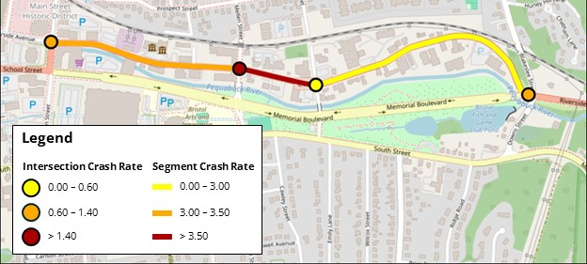

Safety Analysis
Crash Data
Crash Data Collected from Connecticut Crash Data Repository Traffic Safety Dashboard.
    2017 – 2019, 2022, 2023
Calculated Crash Rate and Critical Crash Rate for each roadway segment and intersection.
All observed Crash Rates are below the Critical Crash Rate.
Crash Type | Number of Crashes | Percentage
Front to Rear | 64 | 41.8
Angle | 42 | 27.5
Fixed Object | 26 | 17.0
Time of Day | Number of Crashes | Percentage
Daylight | 108 | 70.6
Dark-Lighted | 38 | 24.7
N
5-Year Period
153 Crashes
0 Fatalities
2 Severe Injuries
Project No. 0017-0196

Slide 22
Presentation Overview
PROJECT LOCATION
EXISTING CONDITIONS
SAFETY ANALYSIS
PROPOSED IMPROVEMENTS
CONSTRUCTION STAGING
OTHER CONSIDERATIONS
Project No. 0017-0196

Slide 23
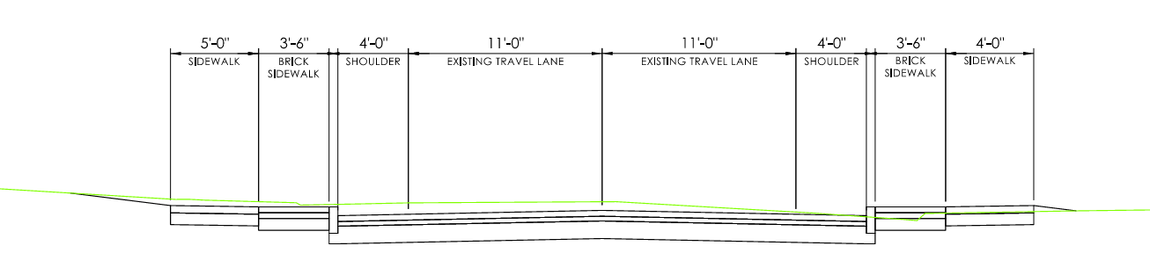
Proposed Improvements
Full Depth Reconstruction
Granite Stone Curbing
Standardization of Driveways
3.5’ Brick Sidewalk
5’ Sidewalks
Decorative Lighting
Pavement Structure
4” HMA S0.5
3” HMA S1.0
12” Subbase
Project No. 0017-0196

Slide 24
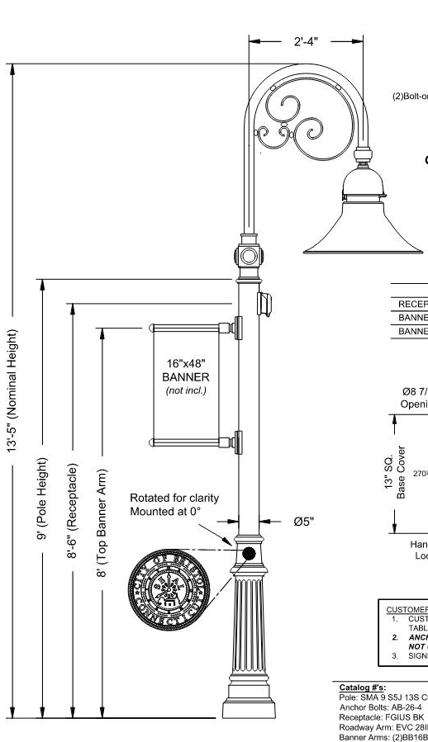
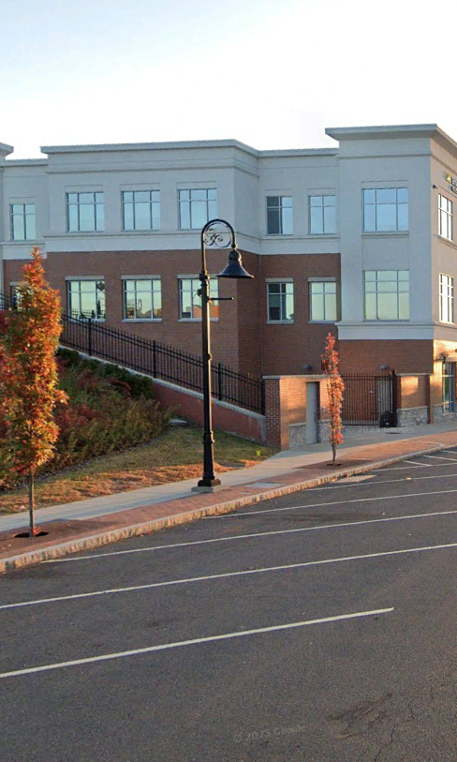
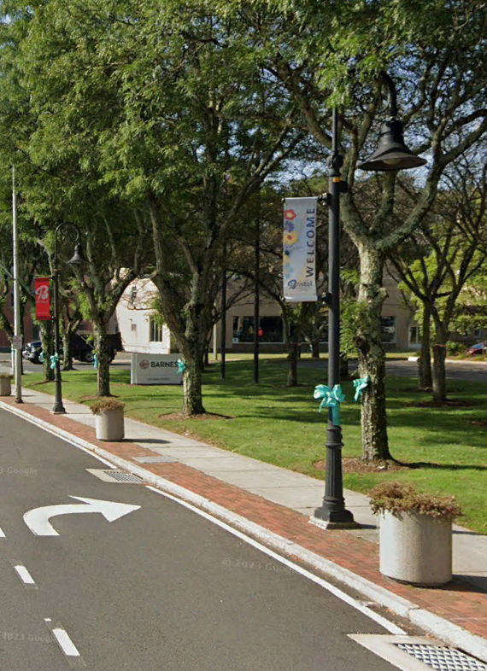
Proposed Improvements
Project No. 0017-0196

Slide 25
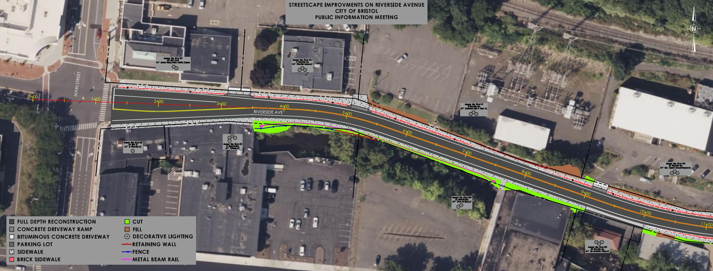
Project No. 0017-0196

Slide 26
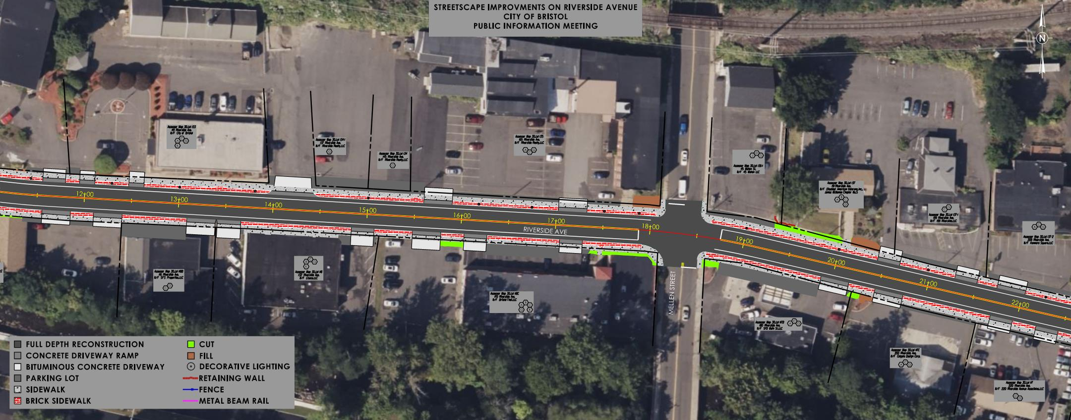
Project No. 0017-0196

Slide 27
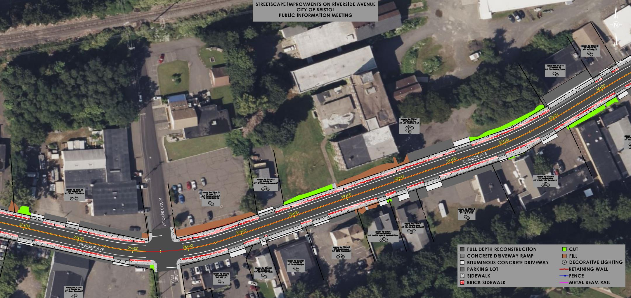
Project No. 0017-0196

Slide 28
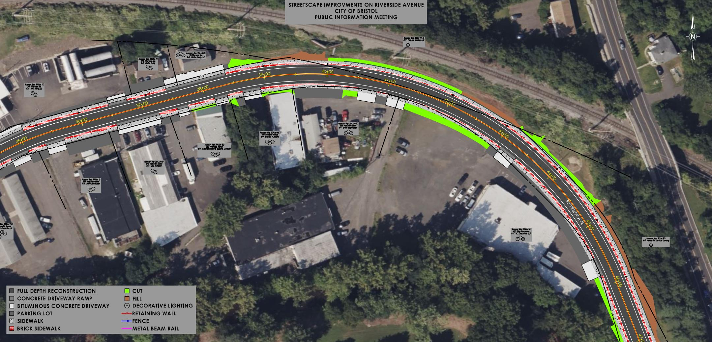
Project No. 0017-0196

Slide 29
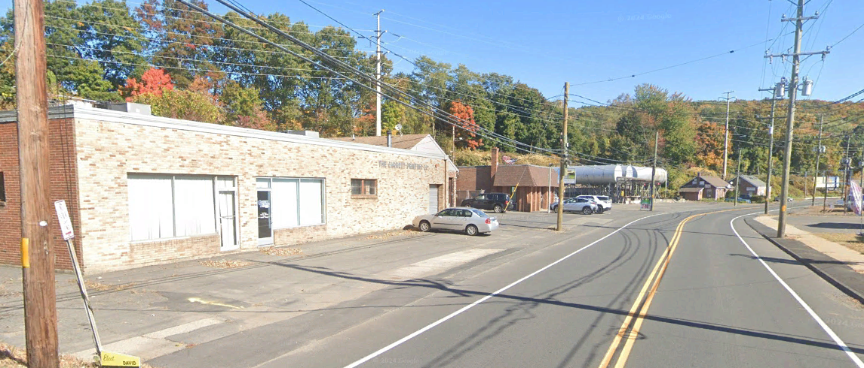
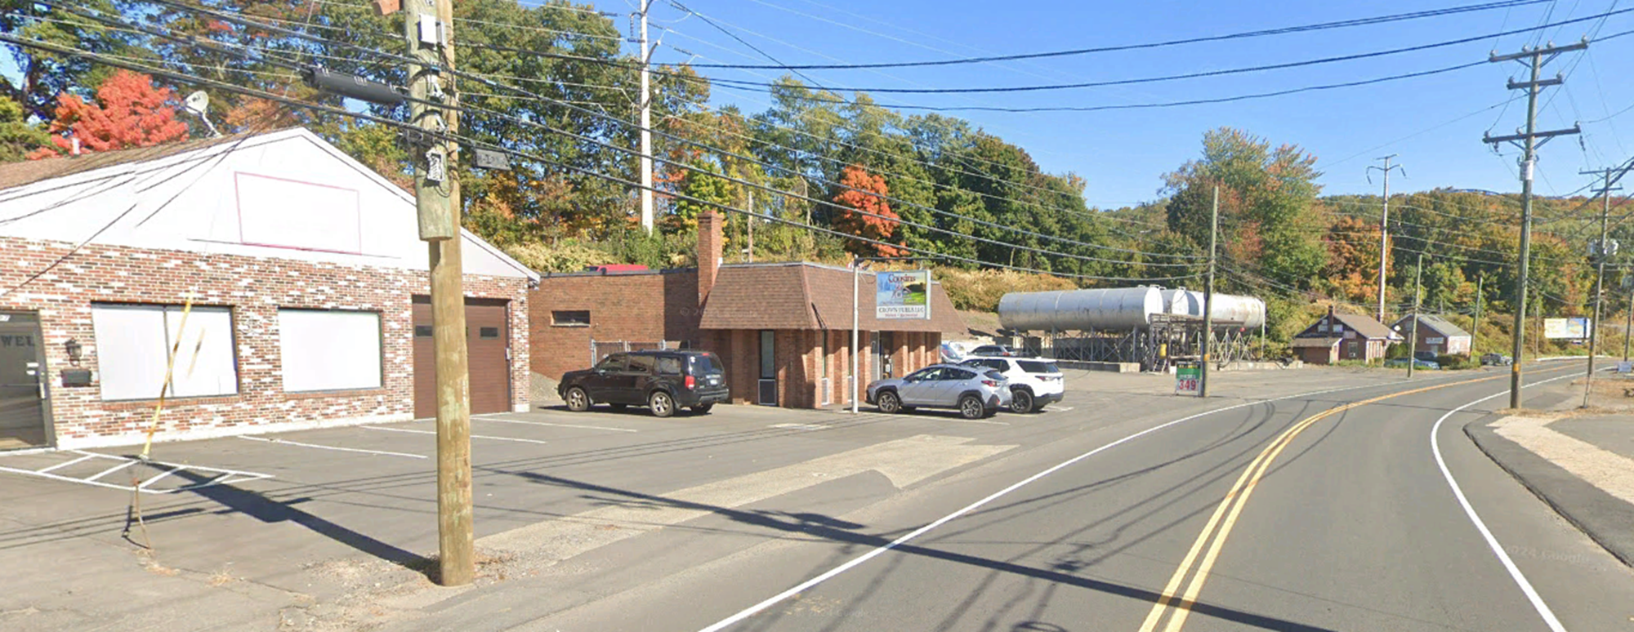
Proposed Improvements
N
N
337 Riverside Ave
347 Riverside Ave
331 Riverside Ave
Riverside Ave
Riverside Ave
Project No. 0017-0196

Slide 30
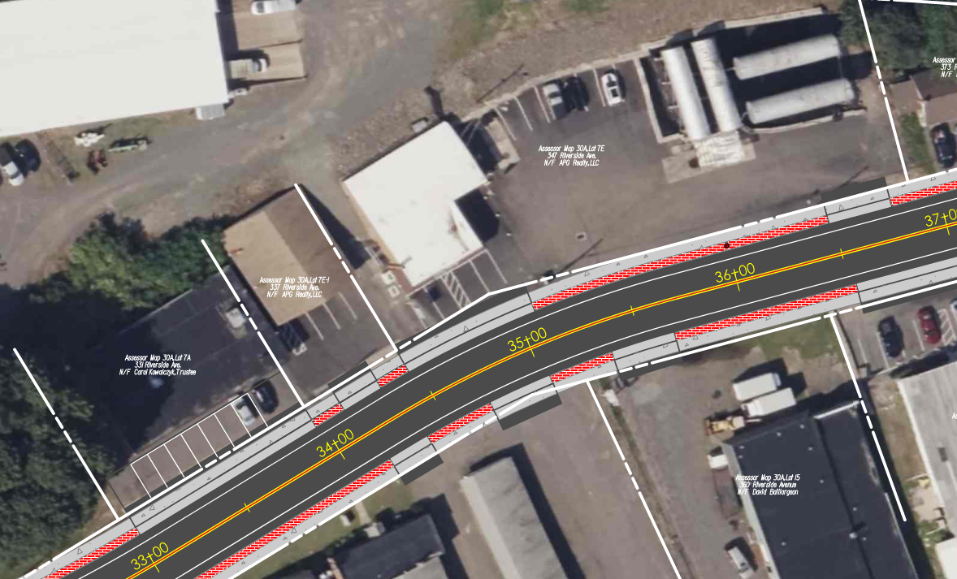
Proposed Improvements
347 Riverside Ave
337 Riverside Ave
331 Riverside Ave
Project No. 0017-0196

Slide 31
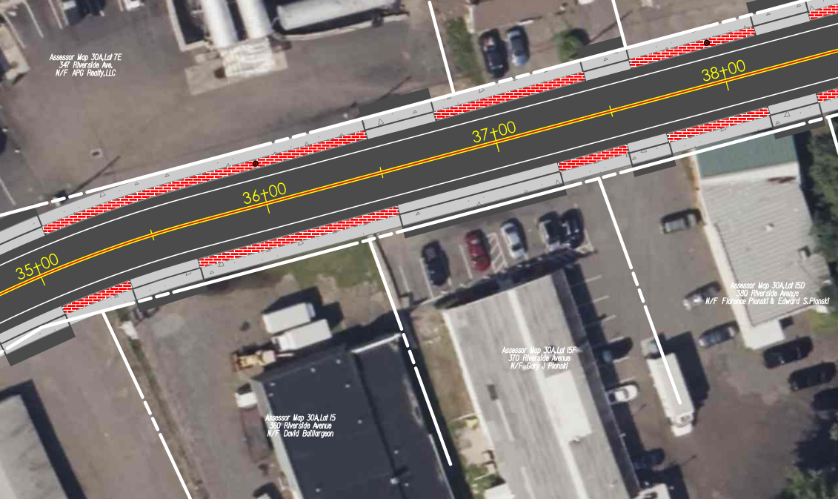
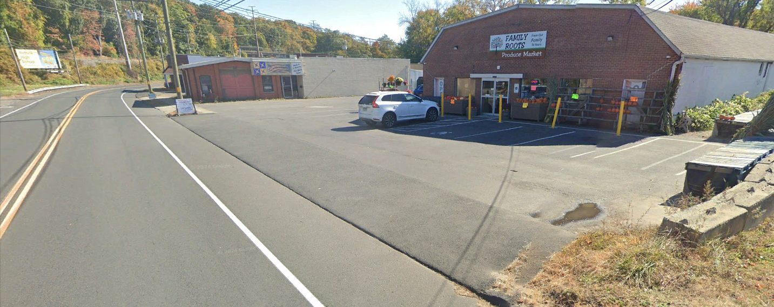
Proposed Improvements
370 Riverside Ave
N
370 Riverside Ave
Project No. 0017-0196

Slide 32
Presentation Overview
PROJECT LOCATION
EXISTING CONDITIONS
SAFETY ANALYSIS
PROPOSED IMPROVEMENTS
CONSTRUCTION STAGING
OTHER CONSIDERATIONS
Project No. 0017-0196

Slide 33
Construction Staging
Option 1: Daytime Work
  Maintain two-lanes of traffic
  Driveway access maintained
  Sidewalk access maintained
    Pedestrian Detours
Option 2: Nighttime Work
  Alternating one-way traffic
  Sidewalk access maintained
    Pedestrian Detours
  Final Paving
Project No. 0017-0196

Slide 34
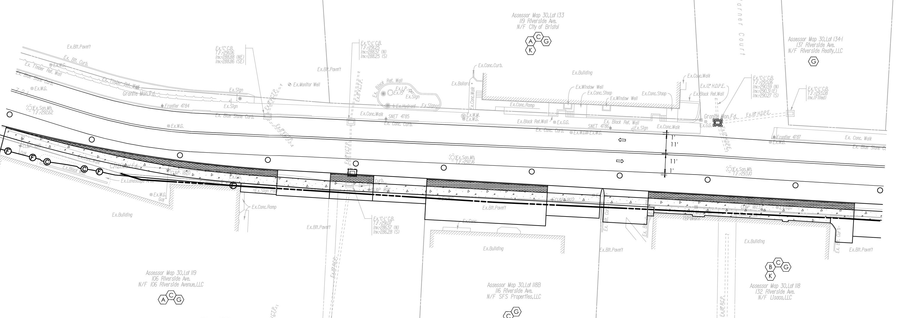
Construction Staging
Project No. 0017-0196

Slide 35
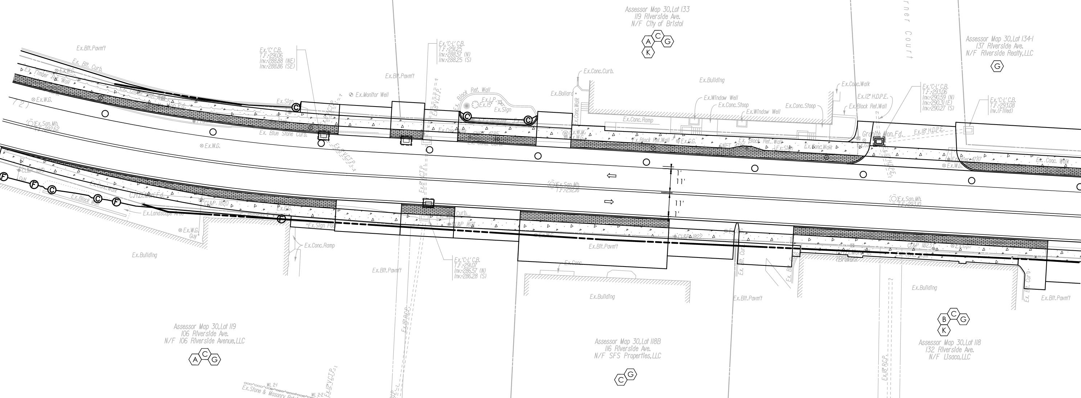
Construction Staging
Project No. 0017-0196

Slide 36
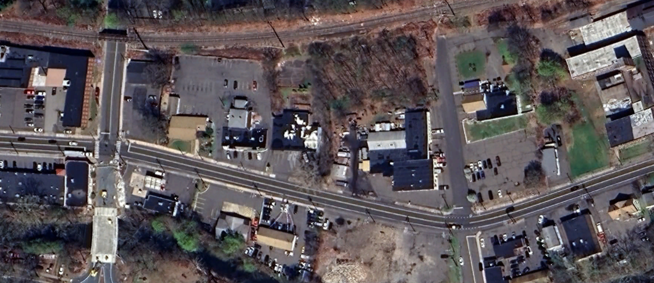
Construction Staging
Sidewalk Closed
Mellen St.
Sidewalk Closed
Hooker Ct.
Riverside Ave
Temporary Crosswalk
East St.
Project No. 0017-0196

Slide 37
Presentation Overview
PROJECT LOCATION
EXISTING CONDITIONS
SAFETY ANALYSIS
PROPOSED IMPROVEMENTS
CONSTRUCTION STAGING
OTHER CONSIDERATIONS
  Right Of Way
  Bicycle Facilities
  Design Exceptions
  Utilities & Drainage
Project No. 0017-0196

Slide 38
Right Of Way
  Function
    Acquire all property/property rights necessary for the project.
  Statutory References
    State of Connecticut: C.G.S. Section 13a-73 & 13a-98e
    Federal: Uniform Relocation Assistance and Real Property Acquisition Policies Act of 1970, as Amended.
  Impacts to Private Property*
    Partial Acquisitions
    Easements
    Rights
    *Impacts Subject to Change as Design Progresses
Project No. 0017-0196
Notes:
15 – Defined Easement for Highway Purposes
1 – Easement to install and Maintain end anchorage
1 – Partial Take

Slide 39
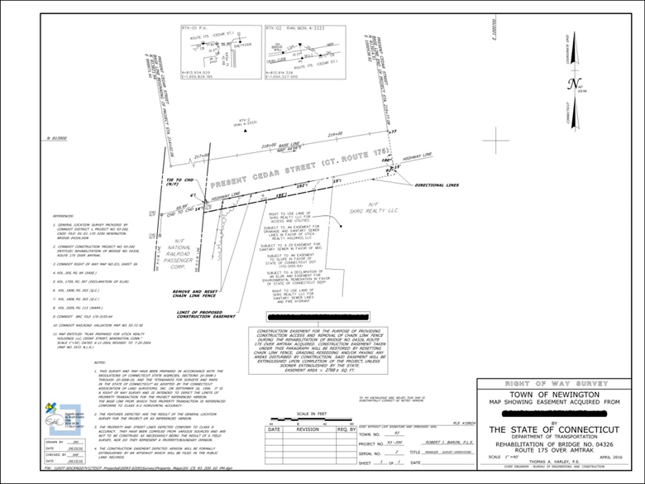
Right Of Way
  ROW Process
    Letter of Intent to Acquire
    Valuation
    Offer of Compensation
    Negotiation
    Acquisition
      Agreement
      Condemnation
Project No. 0017-0196
Notes:
15 – Defined Easement for Highway Purposes
1 – Easement to install and Maintain end anchorage
1 – Partial Take

Slide 40
Right Of Way
Rights | Number of Properties Impacted
Grade | 30
Construct Driveway | 41
Construct Parking Area | 38
Install Bituminous Concrete Curb | 3
Construct Retaining Wall | 4
Construct Sidewalk / Concrete Walk | 10
Remove and Reset Chain Link Fence | 1
Various Rights to install Drainage Items | 3
Easements
Install and Maintain End Anchorage | 1
Construction Easement | 1
Partial Acquisition (Sidewalk) | 19
Partial Acquisition (Roadway) | 1
Project No. 0017-0196
Notes:
15 – Defined Easement for Highway Purposes
1 – Easement to install and Maintain end anchorage
1 – Partial Take

Slide 41
Bicycle Facilities
Bicycle Facilities are not Proposed under Project 0017-0196
Bristol partnered with Naugatuck Valley Council of Governments to conduct a study of potential downtown routing options to provide a safe, continuous connection between Rockwell Park in the west to Downtown, continuing east to Route 229.
Pequabuck River Trail Project will provide bike and pedestrian access from Rockwell Park to Memorial Boulevard and from Memorial Boulevard to Middle Street Trail.
Project No. 0017-0196

Slide 42
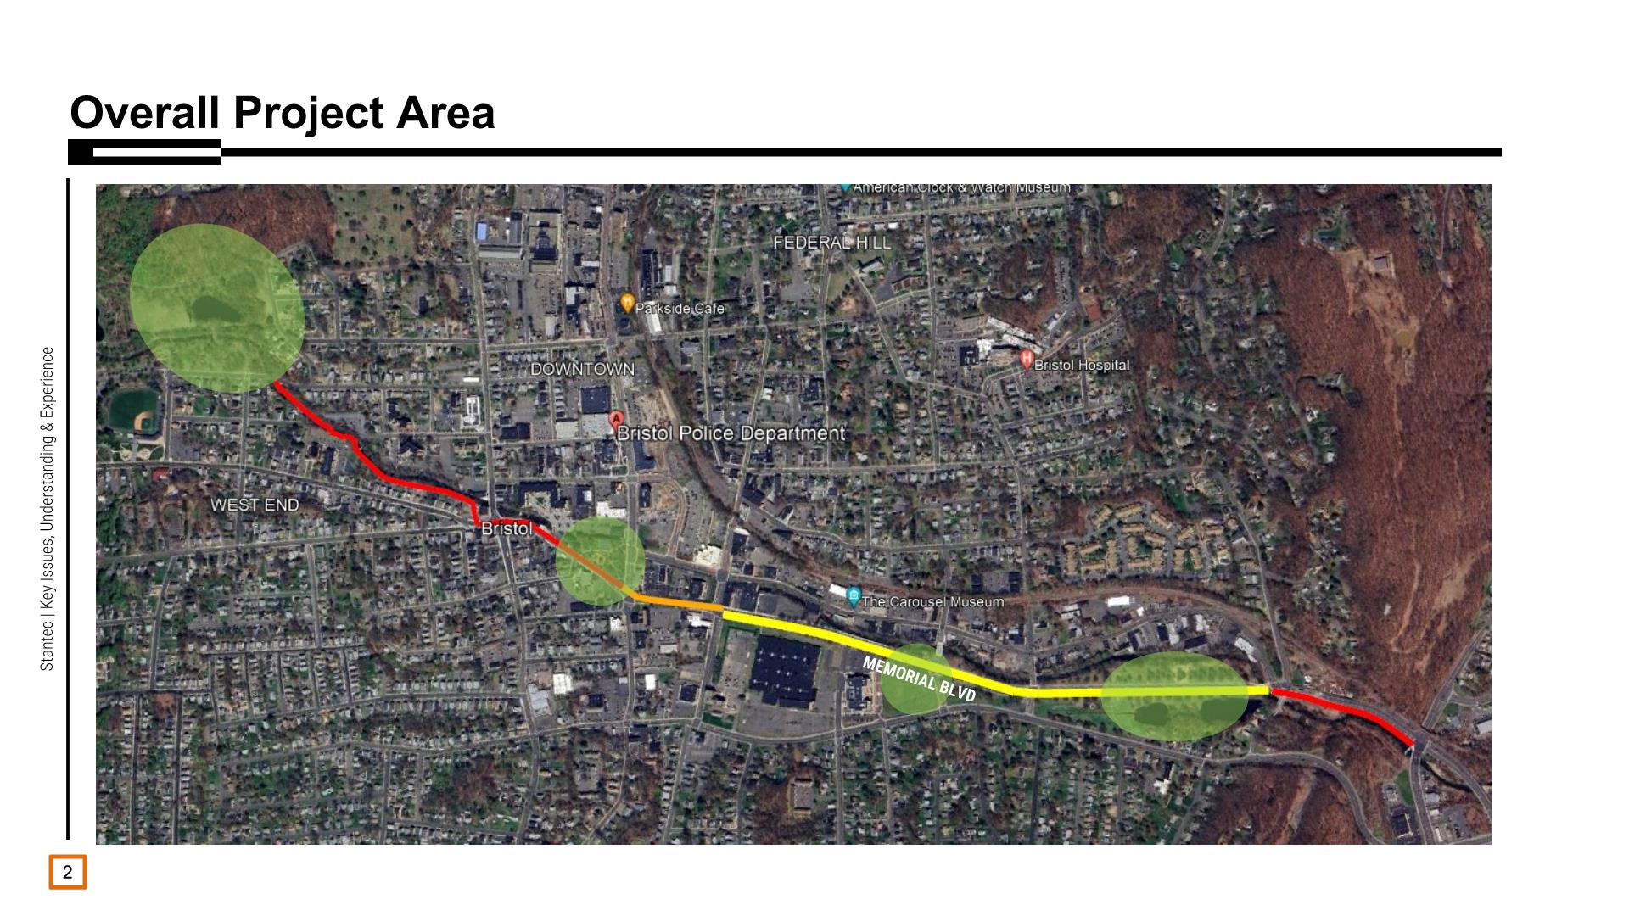
Project No. 0017-0196
Project No. 0017-0196

Slide 43
Design Standards
Design Element | Design Standard | Proposed Design
Travel Lane Width | 10’ – 12’ | 11’
Shoulder Width | 4’ – 8’ | 4’
Typical Cross Slope Travel Lane Shoulder | 1.5% - 2.0% 4.0% - 6.0% | 1.5% 4.0%
Turn Lane | 1’ Less than TL Width – TL Width | 10’
Sidewalk Width | 5’ Minimum | 5’
Stopping Sight Distance | 250’ | 432’
Minimum Radius | 375’ | 400’
Superelevation Rate | 4.0% | 2.4%
Maximum Grade | 11.0% | 3.96%
Project No. 0017-0196

Slide 44
Design Exceptions
Anticipated Design Exceptions
  Intersection Sight Distance (ISD)
What is Sight Distance?
  Sight Distance is the length of the roadway ahead that is visible to the driver
Project No. 0017-0196

Slide 45
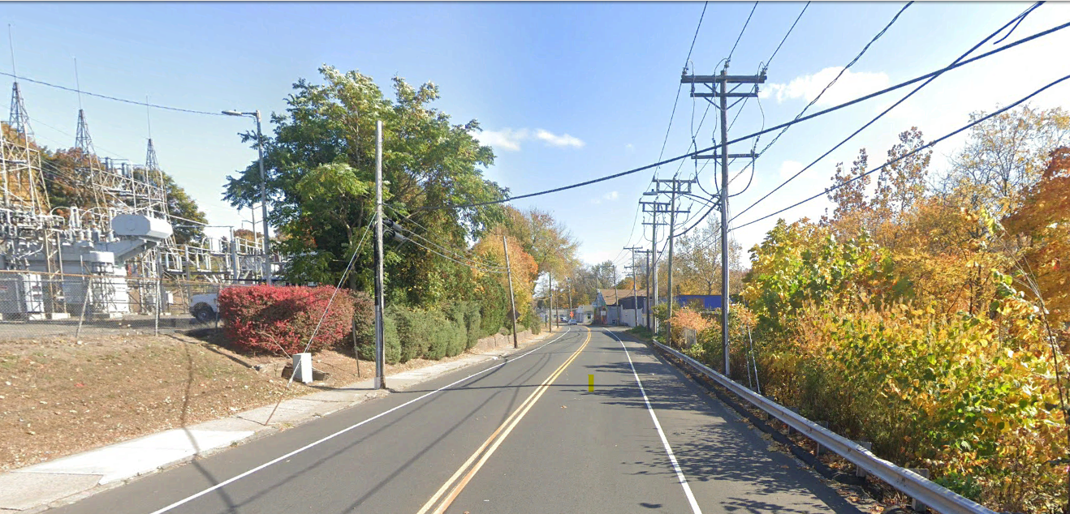

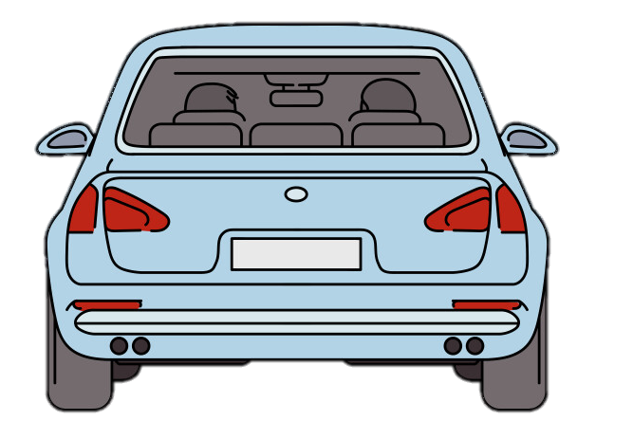
Intersection Sight Distance
Project No. 0017-0196

Slide 46
Intersection Sight Distance
Anticipated Design Exceptions
  Intersection Sight Distance (ISD)
What is Sight Distance?
  Sight Distance is the length of the roadway ahead that is visible to the driver
What is Intersection Sight Distance?
  Intersection Sight Distance is the sight distance observed within the corners of an intersection
  The ISD is determined for both left and right turns at each intersection to ensure there is sufficient sight distance for a driver to perceive potential conflicts and maneuver through the intersection safely
Project No. 0017-0196

Slide 47
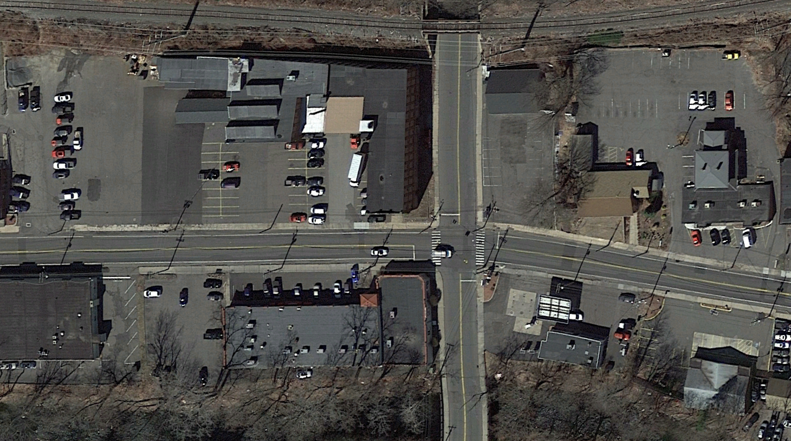

Intersection Sight Distance
Project No. 0017-0196

Slide 48
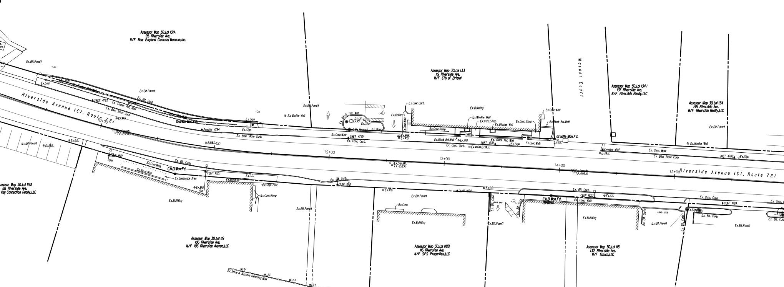
Project No. 0017-0196

Slide 49
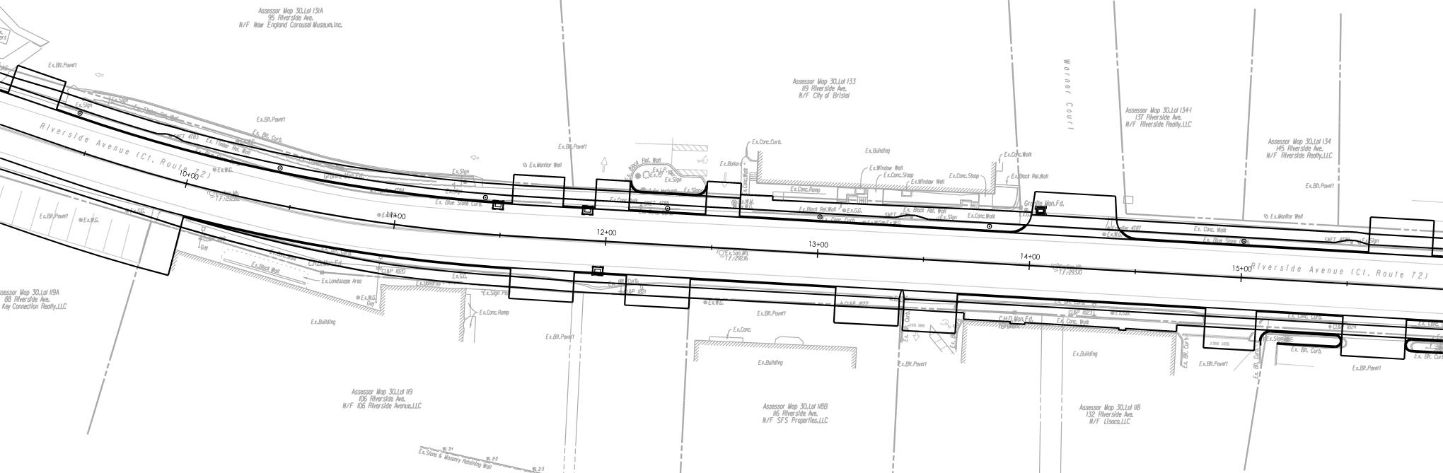
Proposed Edge of Road
Ex. Edge of Road
Project No. 0017-0196

Slide 50
Project No. 0017-0196

Slide 51
Utilities
Utility companies with facilities in the project area:
  Eversource Energy – Electric Distribution
  Eversource Energy – Gas
  City of Bristol Water and Sewer Department
  Frontier Communications
  Comcast Cable
  Crown Castle
Project No. 0017-0196

Slide 52
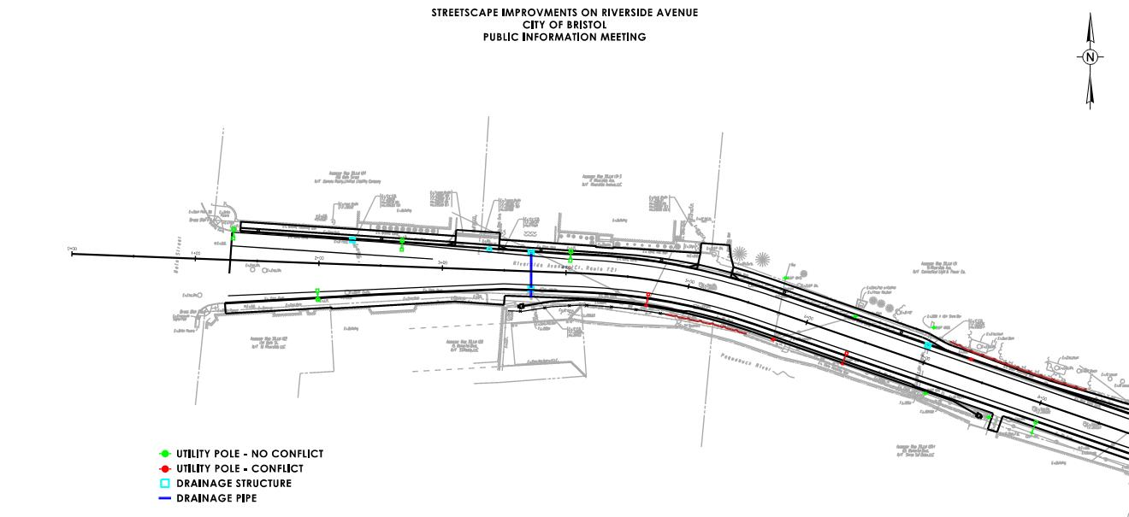
Overhead Utilities and Drainage
Project No. 0017-0196

Slide 53
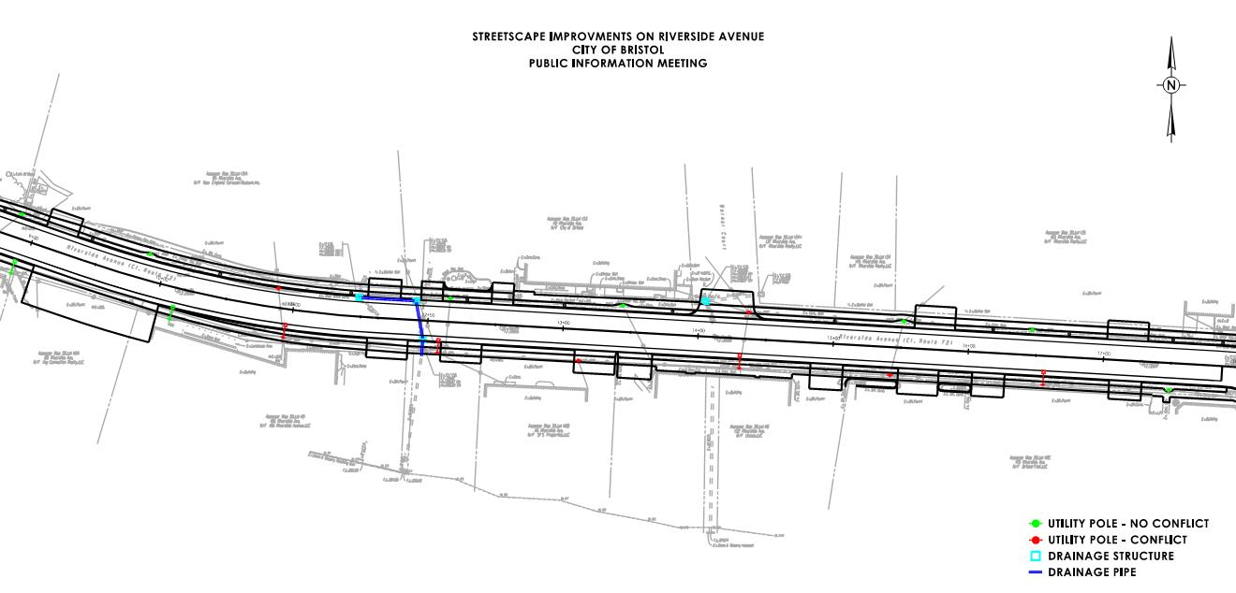
Project No. 0017-0196

Slide 54
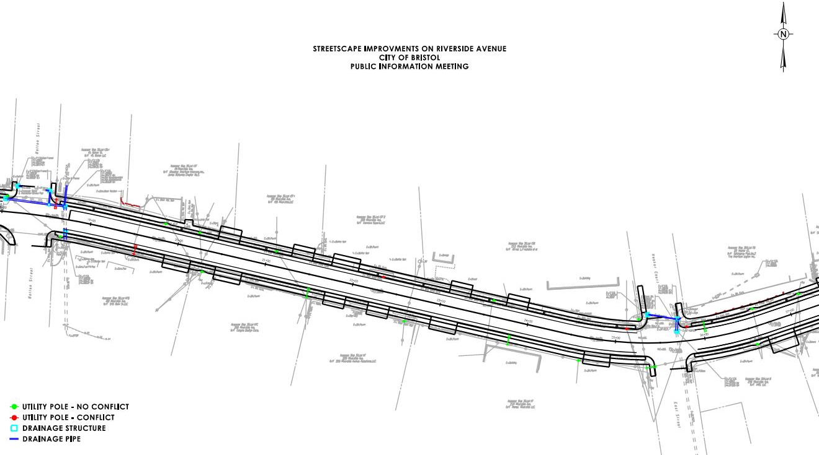

Slide 55
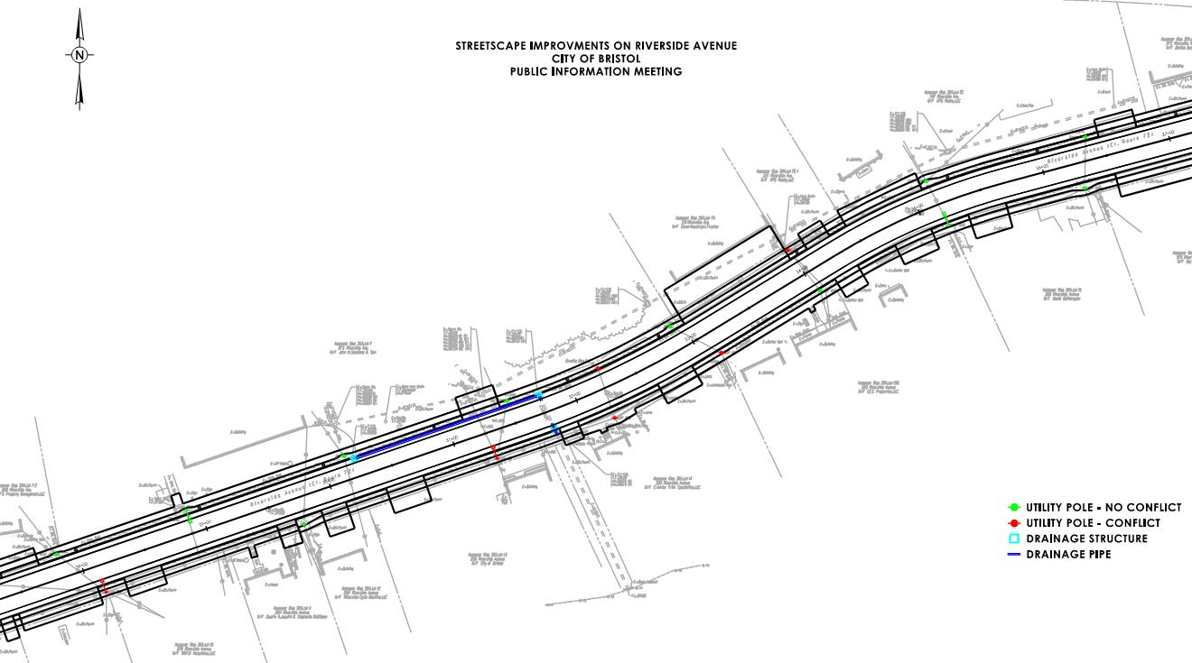

Slide 56
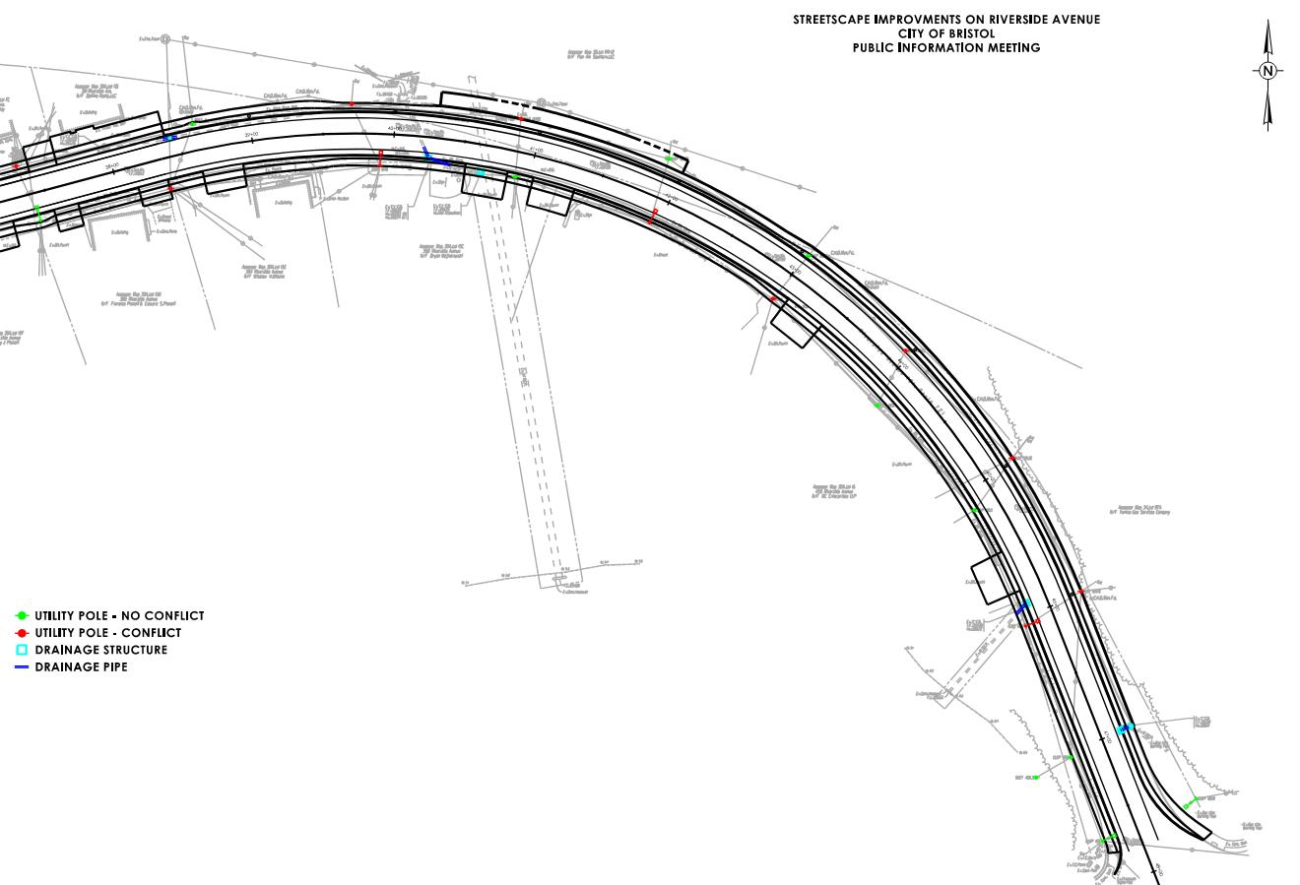
Project No. 0017-0196

Slide 57
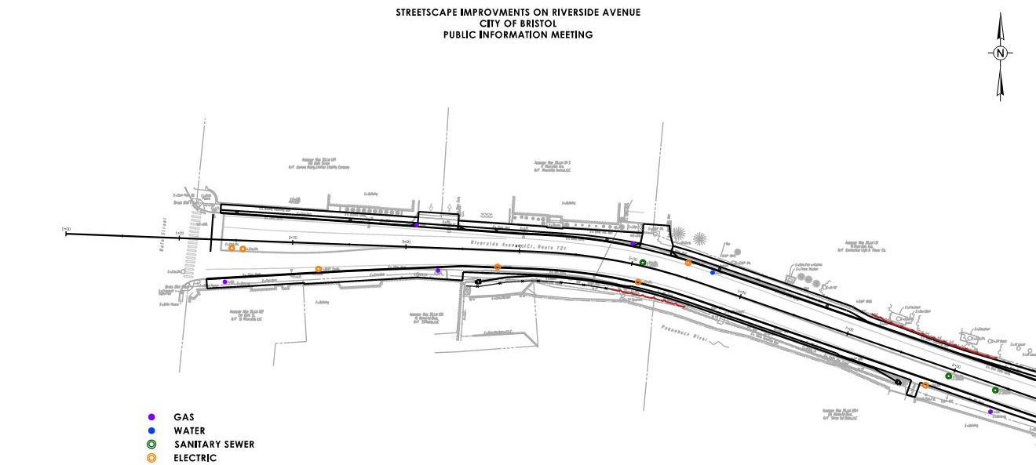
Underground Utilities
Project No. 0017-0196

Slide 58
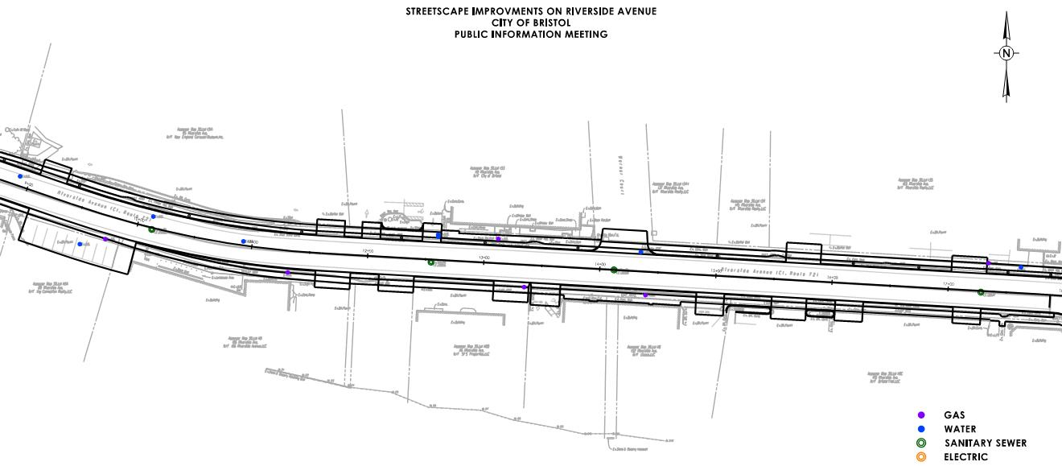
Project No. 0017-0196

Slide 59
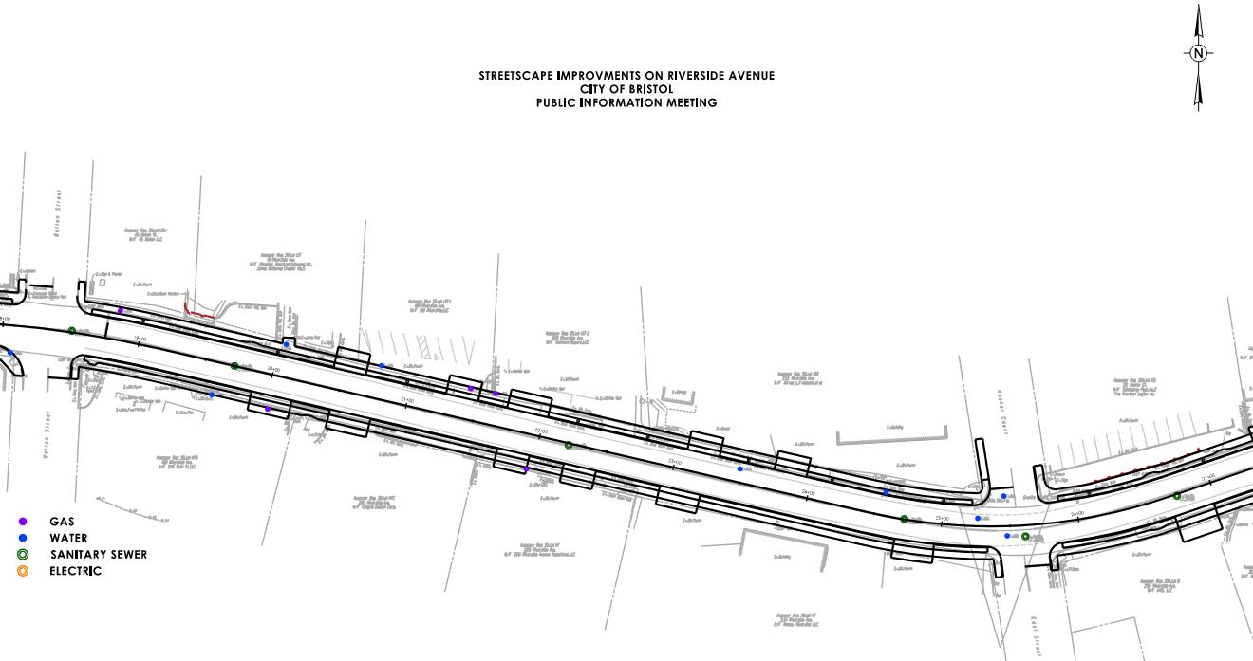
Project No. 0017-0196

Slide 60
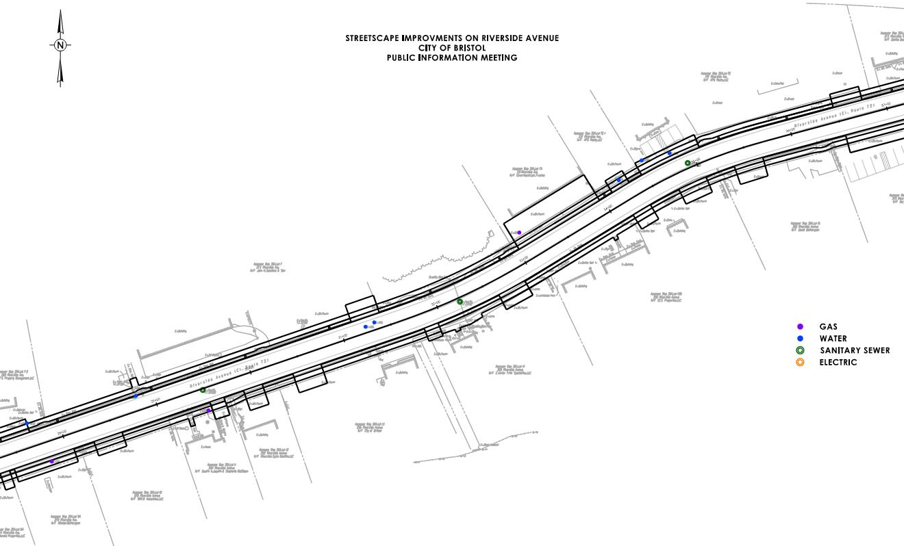
Project No. 0017-0196

Slide 61
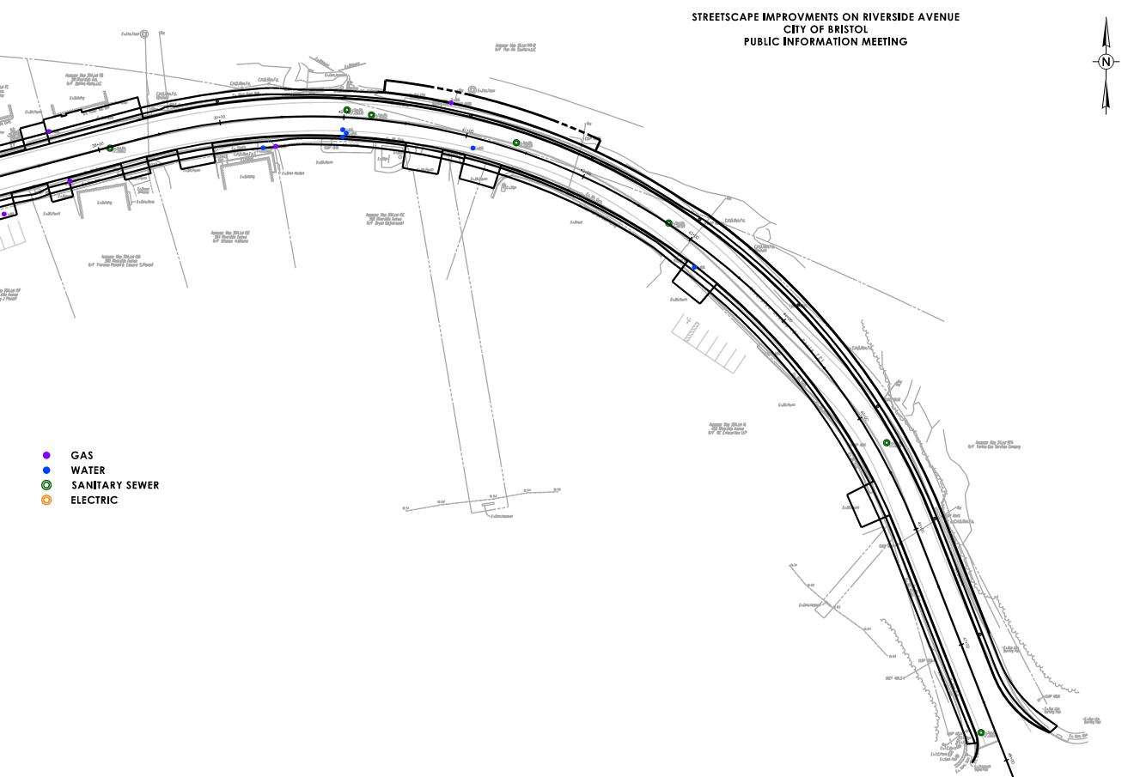
Project No. 0017-0196

Slide 62
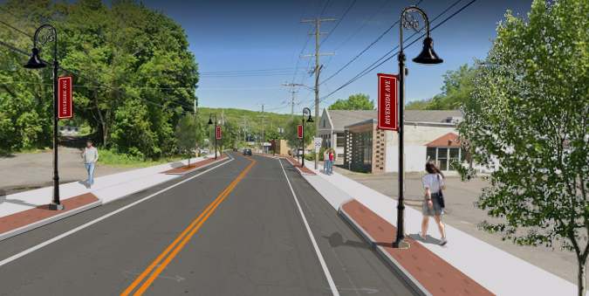
Summary
Purpose
  Purpose: To improve safety, access management, pedestrian accommodations and aesthetic qualities along Riverside Avenue.
Proposed Improvements
  Full Depth Reconstruction
  Granite Stone Curbing
  Standardization of Driveways
  3.5’ Brick Sidewalk
  5’ Sidewalks
  Decorative Lighting
Project Schedule
  Contract Documents: July 2026
  Advertising: September 2026
  Construction: April 2026
Project No. 0017-0196

Slide 63

Questions and Answer
Recording:
  https://bristolct.portal.civicclerk.com/
Submit a Question or Comment
  Q&A Session
  Email: RaymondRogozinski@bristolct.gov
  Telephone: Raymond Rogozinski at (860) 584-6125
Comment Period is open through May 13, 2025, via Email or Telephone
Project No. 0017-0196

