Slide 1



State Project No. 0017-0196 Route 72 Improvements in the City of Bristol
PUBLIC INFORMATION MEETING
April 29, 2025
Prepared for: City of Bristol
Prepared by: GM2 Associates, Inc.

Slide 2
Riverside Avenue Overview
MEET THE PROJECT TEAM
MEETING FORMAT
TITLE VI – CIVIL RIGHTS
PROJECT PRESENTATION
QUESTION AND ANSWER
Project No. 0017-0196

Slide 3
Organizational Chart
GM2 Staff | Stakeholder Representatives | CTDOT Liaisons
Principal In Charge Matthew Vail | Raymond Rogozinski | Principal Engineer Michael Cherpak
Project Manager Paul Brand | Justin Malley | Supervising Engineer Devin Raciot
Project Engineer Danielle Dixon |  | Right of Way Coordinator Zachary Guarino

Slide 4
Meeting Format
Recording:
https://bristolct.portal.civicclerk.com/
Submit a Question or Comment
Q&A Session
Email: RaymondRogozinski@bristolct.gov
Telephone: Raymond Rogozinski at (860) 584-6125
Comment Period
Open through May 13, 2025
Email or Telephone

Slide 5
Title VI – Civil Rights

Slide 6
General Project Information
Project Origin
Streetscape Study and Design Concepts completed in 2021
Riverside Avenue
Divinity Street
Park Street
Purpose & Need
Purpose: To improve safety, access management, pedestrian accommodations and aesthetic qualities along Riverside Avenue.
Need: Current condtion of existing facilities along Riverside Avenue and the poorly developed and disconnected sidewalk system.

Slide 7
General Project Information
Funding
City of Bristol Project Design | CT Department of Transportation Fund & Perform Rights of Way Construction Phase Cost
Project Schedule
Contract Documents: July 2026
Advertising: September 2026
Construction: April 2026

Slide 8
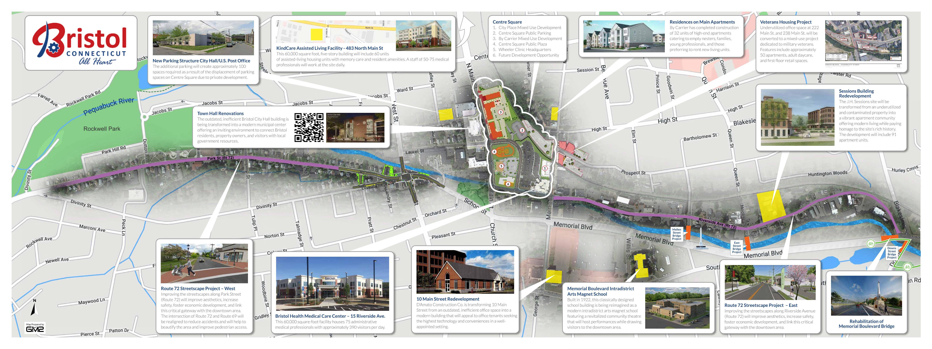
Route 72 Corridor
Project No. 0017-0196

Slide 9
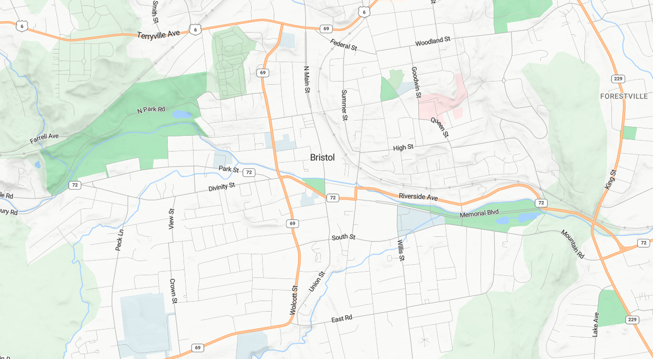




Project Locations
West Cemetery
Bristol
Hospital
Rockwell
Park
Memorial Blvd Park
Project No. 0017-0196

Slide 10
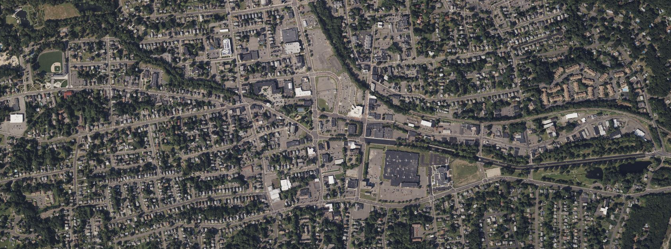

Projects Locations
69
RIVERSIDE AVENUE
Muzzy Field
0017-0195
273 Riverside Ave Site Work
Carousel Museum Site Work
0171-0504
72
PARK STREET
72
0017-0187
Memorial
Blvd Park
0017-0193
0017-0192
L017-0002
Project No. 0017-0196

Slide 11
Presentation Overview
PROJECT LOCATION
EXISTING CONDITIONS
SAFETY ANALYSIS
PROPOSED IMPROVEMENTS
CONSTRUCTION STAGING
OTHER CONSIDERATIONS
Project No. 0017-0196

Slide 12
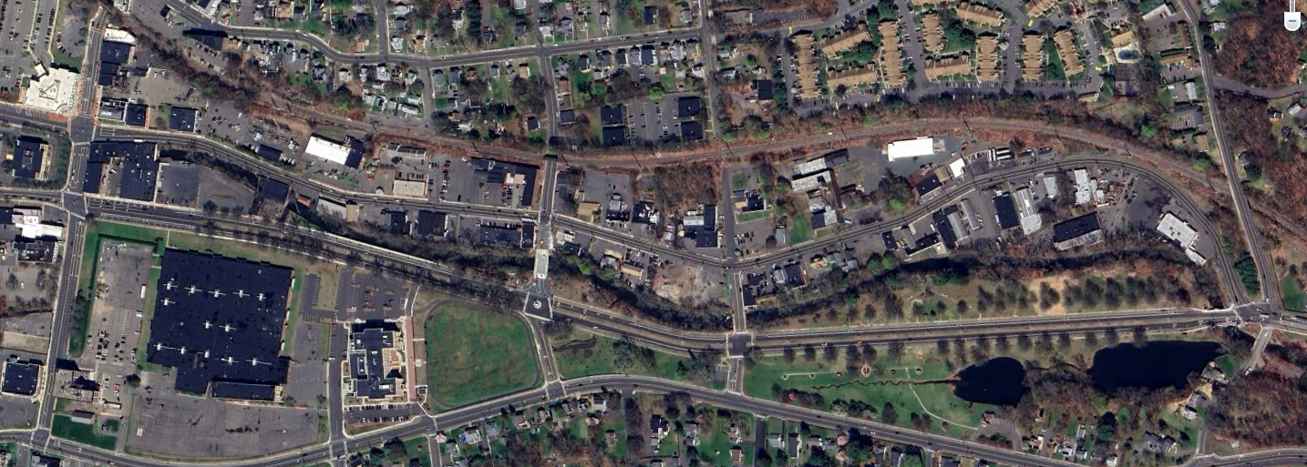
Project Location
Mellen St.
Main Street
Riverside Ave
Hooker Ct.
Blakeslee St.
East St.
Memorial Blvd.
Memorial Blvd Park
Project No. 0017-0196

Slide 13
Presentation Overview
PROJECT LOCATION
EXISTING CONDITIONS
SAFETY ANALYSIS
PROPOSED IMPROVEMENTS
CONSTRUCTION STAGING
OTHER CONSIDERATIONS
Project No. 0017-0196

Slide 14
Existing Conditions
Corridor Information
Functional Classification
Riverside Avenue: Urban Principal Arterial (Built-up)
Local Roads: Urban Local Roads (Built-up)
Average Daily Traffic Counts (ADT)
Posted Speed Limits
Roadway | 2021 ADT (vpd)
Riverside Ave | 8,700
Main Street | 5,600
Roadway | Posted Speed Limit
Riverside Ave | 30 m.p.h.
Main Street | 25 m.p.h.
Mellen Street | 25 m.p.h.
East Street | 30 m.p.h.
Project No. 0017-0196

Slide 15
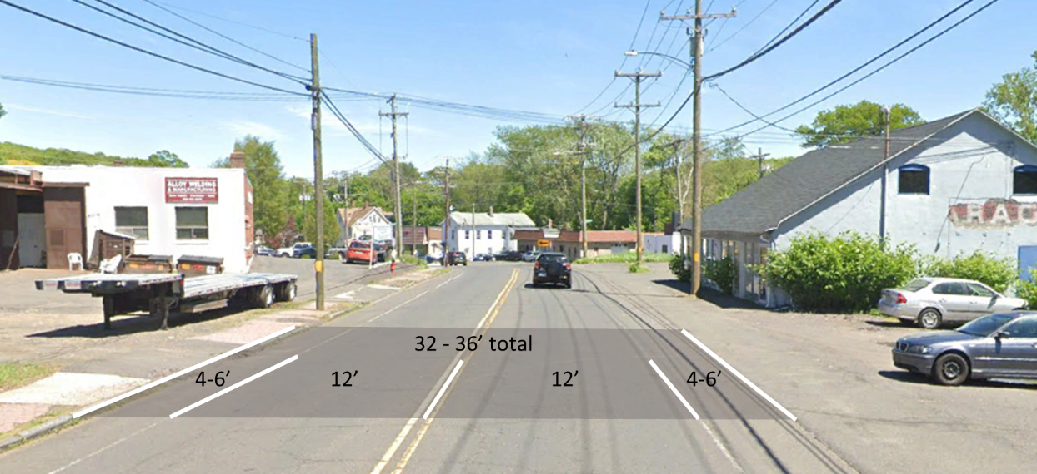
Existing Conditions
Typical Section:
Project No. 0017-0196

Slide 16
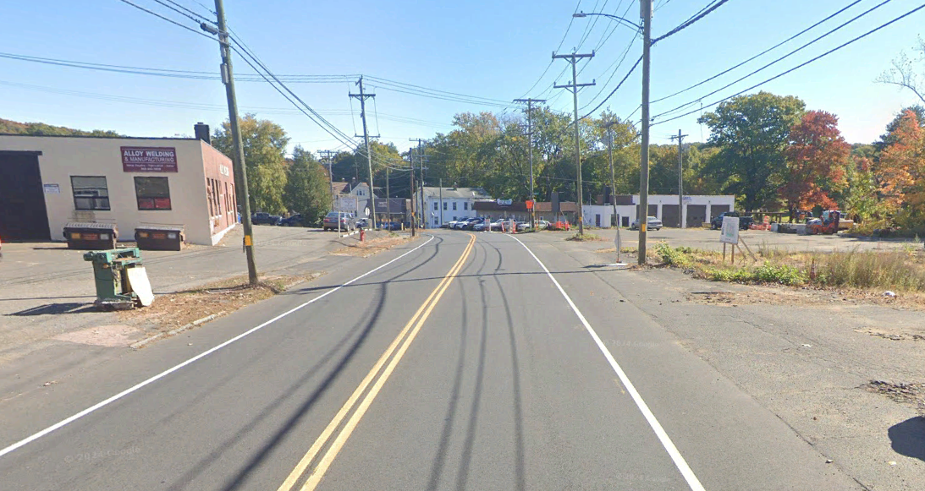
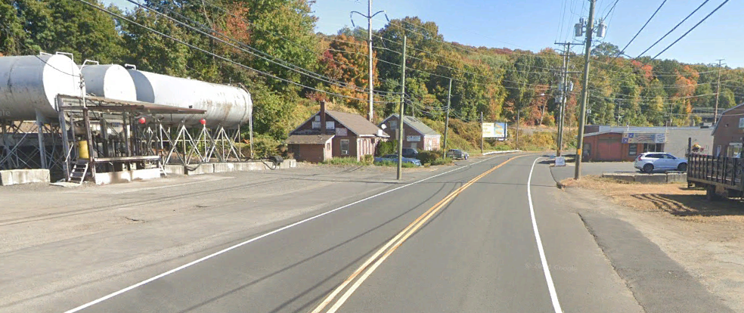
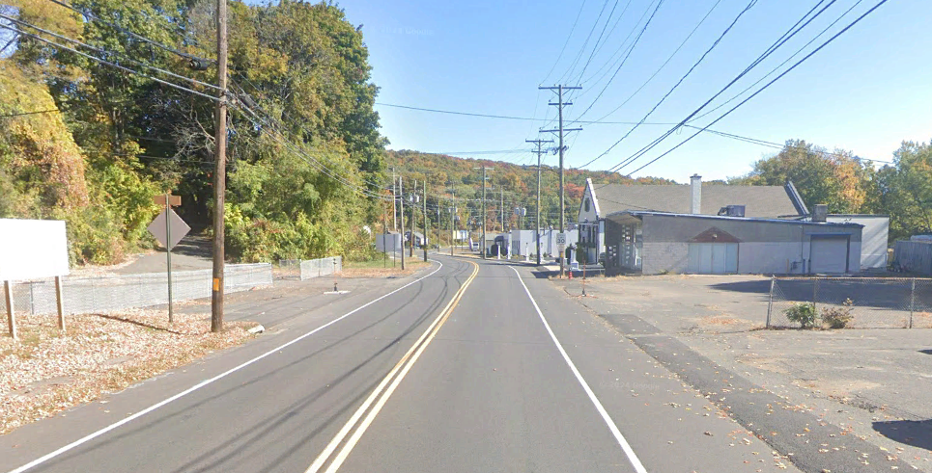
Existing Conditions
Wide Curb Cuts
Random Ingress and Egress
Low Aesthetic quality
No Formal Streetscape
Utility Poles on both sides of the street (some located in driveways)
Project No. 0017-0196

Slide 17
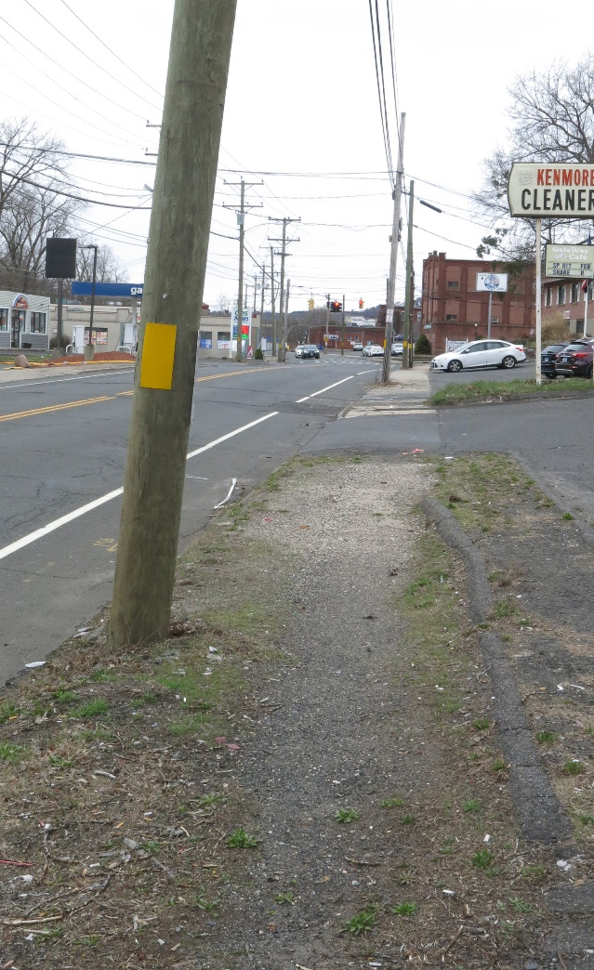
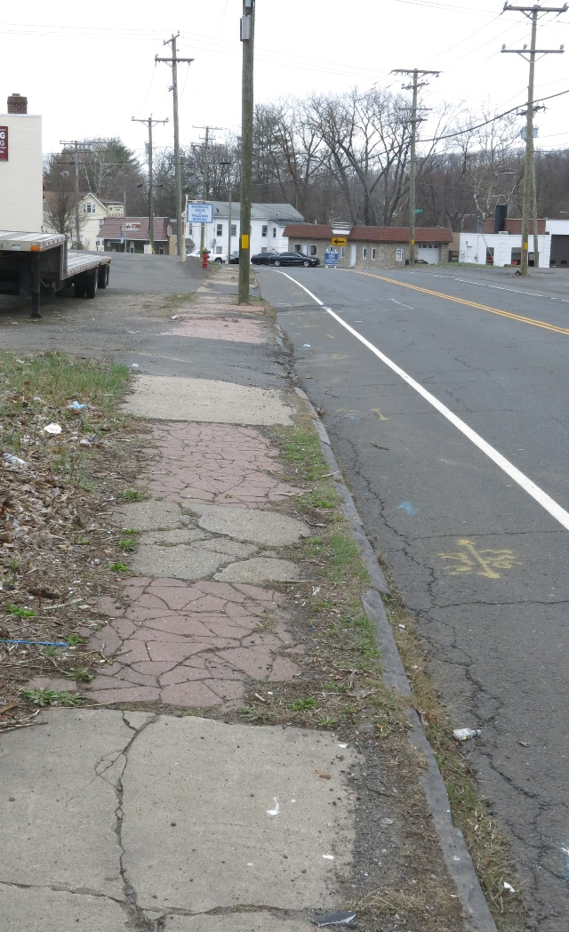
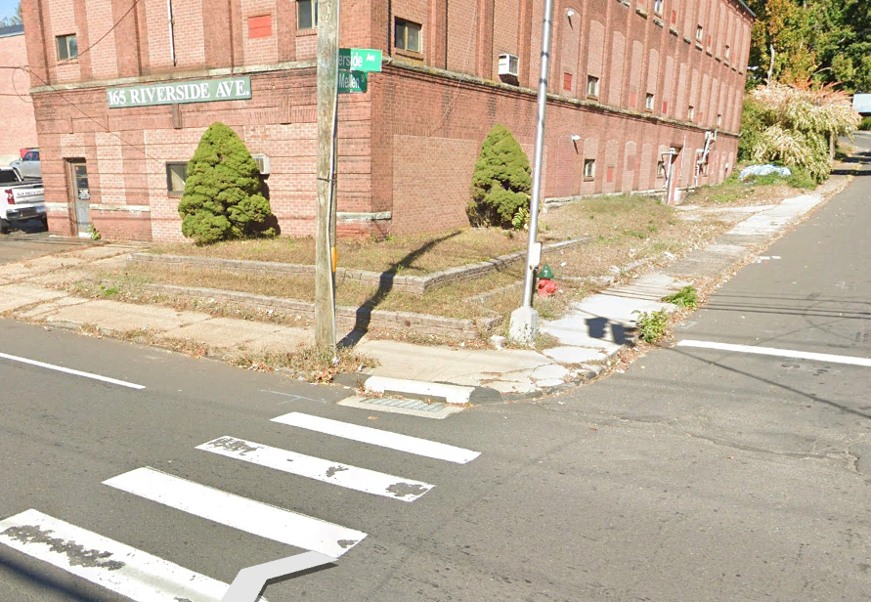
Existing Conditions
Pedestrian Accommodations
Disconnected and Poorly Developed
Poor Condition
Inconsistent and Infrequent Buffer
Scarcity of ADA-Compliant Curb Ramps
Non-existent Pedestrian Lighting
Project No. 0017-0196

Slide 18
Presentation Overview
PROJECT LOCATION
EXISTING CONDITIONS
SAFETY ANALYSIS
PROPOSED IMPROVEMENTS
CONSTRUCTION STAGING
OTHER CONSIDERATIONS
Project No. 0017-0196

Slide 19
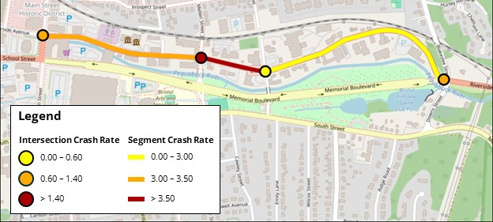

Safety Analysis
Crash Data
Crash Data Collected from Connecticut Crash Data Repository Traffic Safety Dashboard.
2017 – 2019, 2022, 2023
Calculated Crash Rate and Critical Crash Rate for each roadway segment and intersection.
All observed Crash Rates are below the Critical Crash Rate.
Crash Type | Number of Crashes | Percentage
Front to Rear | 64 | 41.8
Angle | 42 | 27.5
Fixed Object | 26 | 17.0
Time of Day | Number of Crashes | Percentage
Daylight | 108 | 70.6
Dark-Lighted | 38 | 24.7
N
5-Year Period
153 Crashes
0 Fatalities
2 Severe Injuries
Project No. 0017-0196

Slide 20
Presentation Overview
PROJECT LOCATION
EXISTING CONDITIONS
SAFETY ANALYSIS
PROPOSED IMPROVEMENTS
CONSTRUCTION STAGING
OTHER CONSIDERATIONS
Project No. 0017-0196

Slide 21
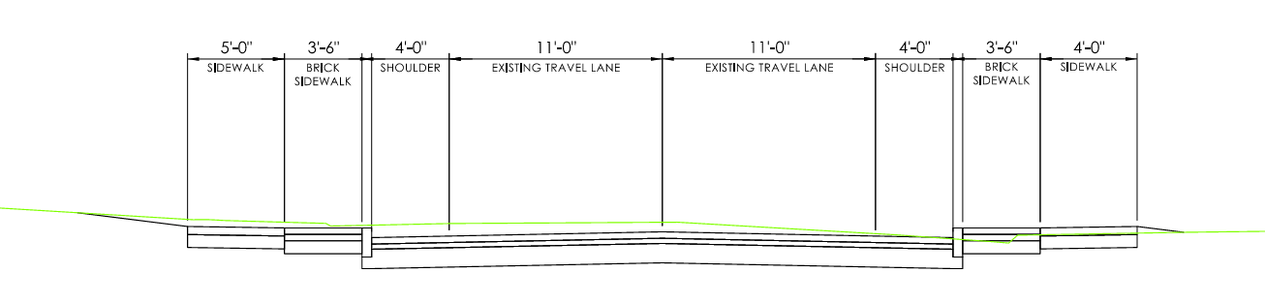
Proposed Improvements
Full Depth Reconstruction
Granite Stone Curbing
Standardization of Driveways
3.5’ Brick Sidewalk
5’ Sidewalks
Decorative Lighting
Pavement Structure
4” HMA S0.5
3” HMA S1.0
12” Subbase
Project No. 0017-0196

Slide 22
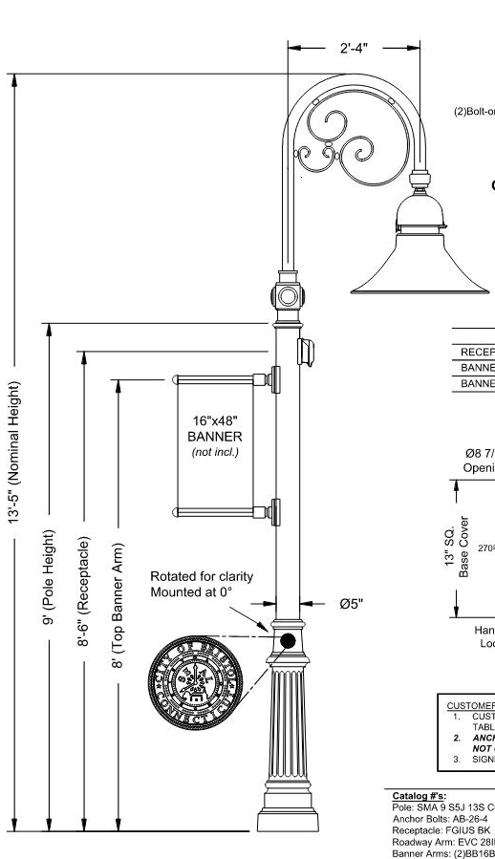
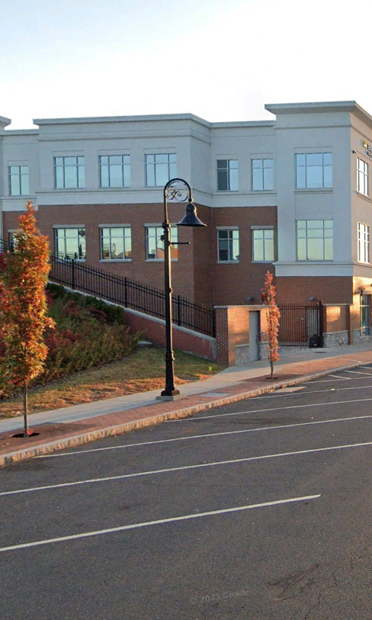
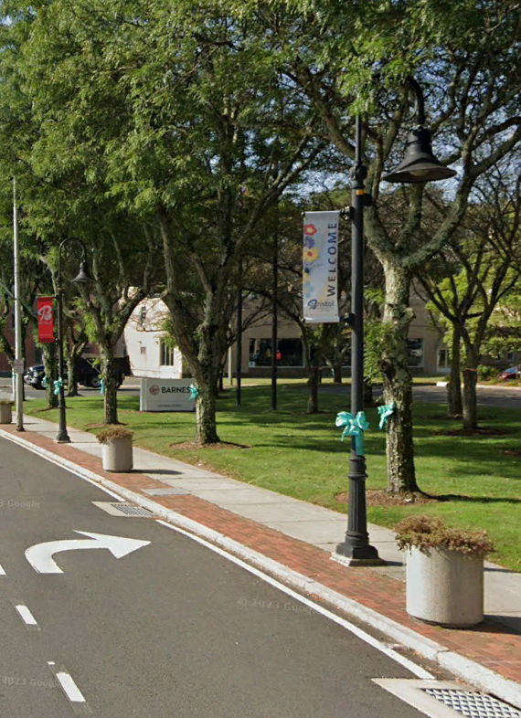
Proposed Improvements
Project No. 0017-0196

Slide 23
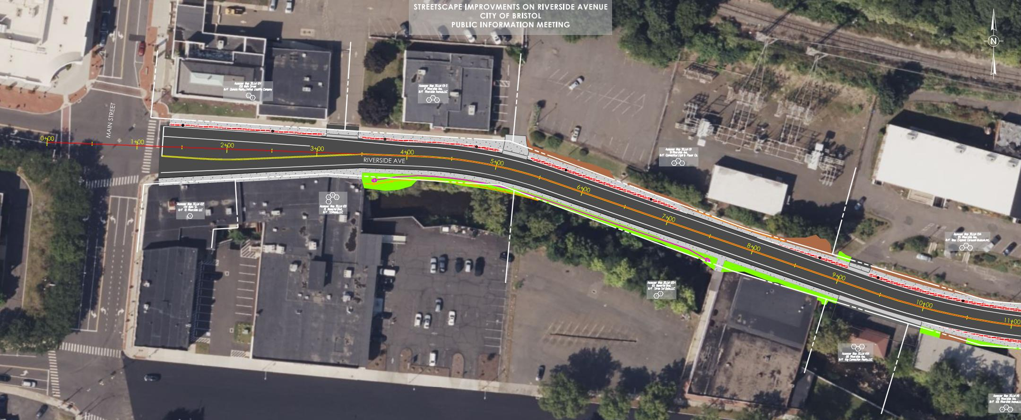
Project No. 0017-0196

Slide 24
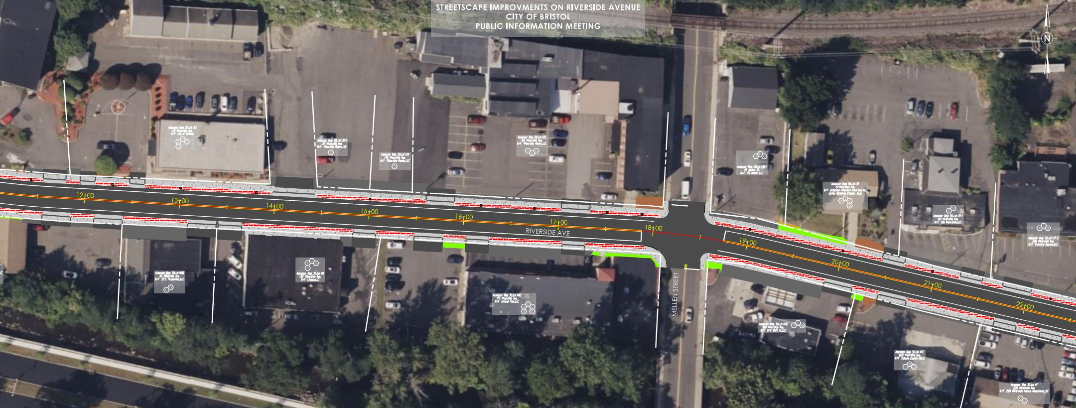
Project No. 0017-0196

Slide 25
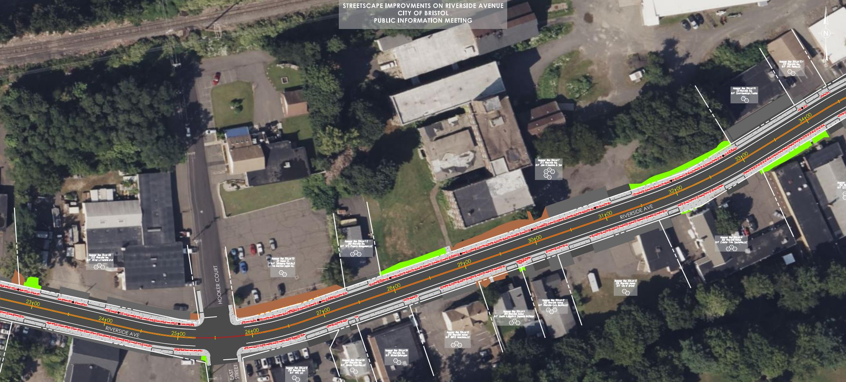
Project No. 0017-0196

Slide 26
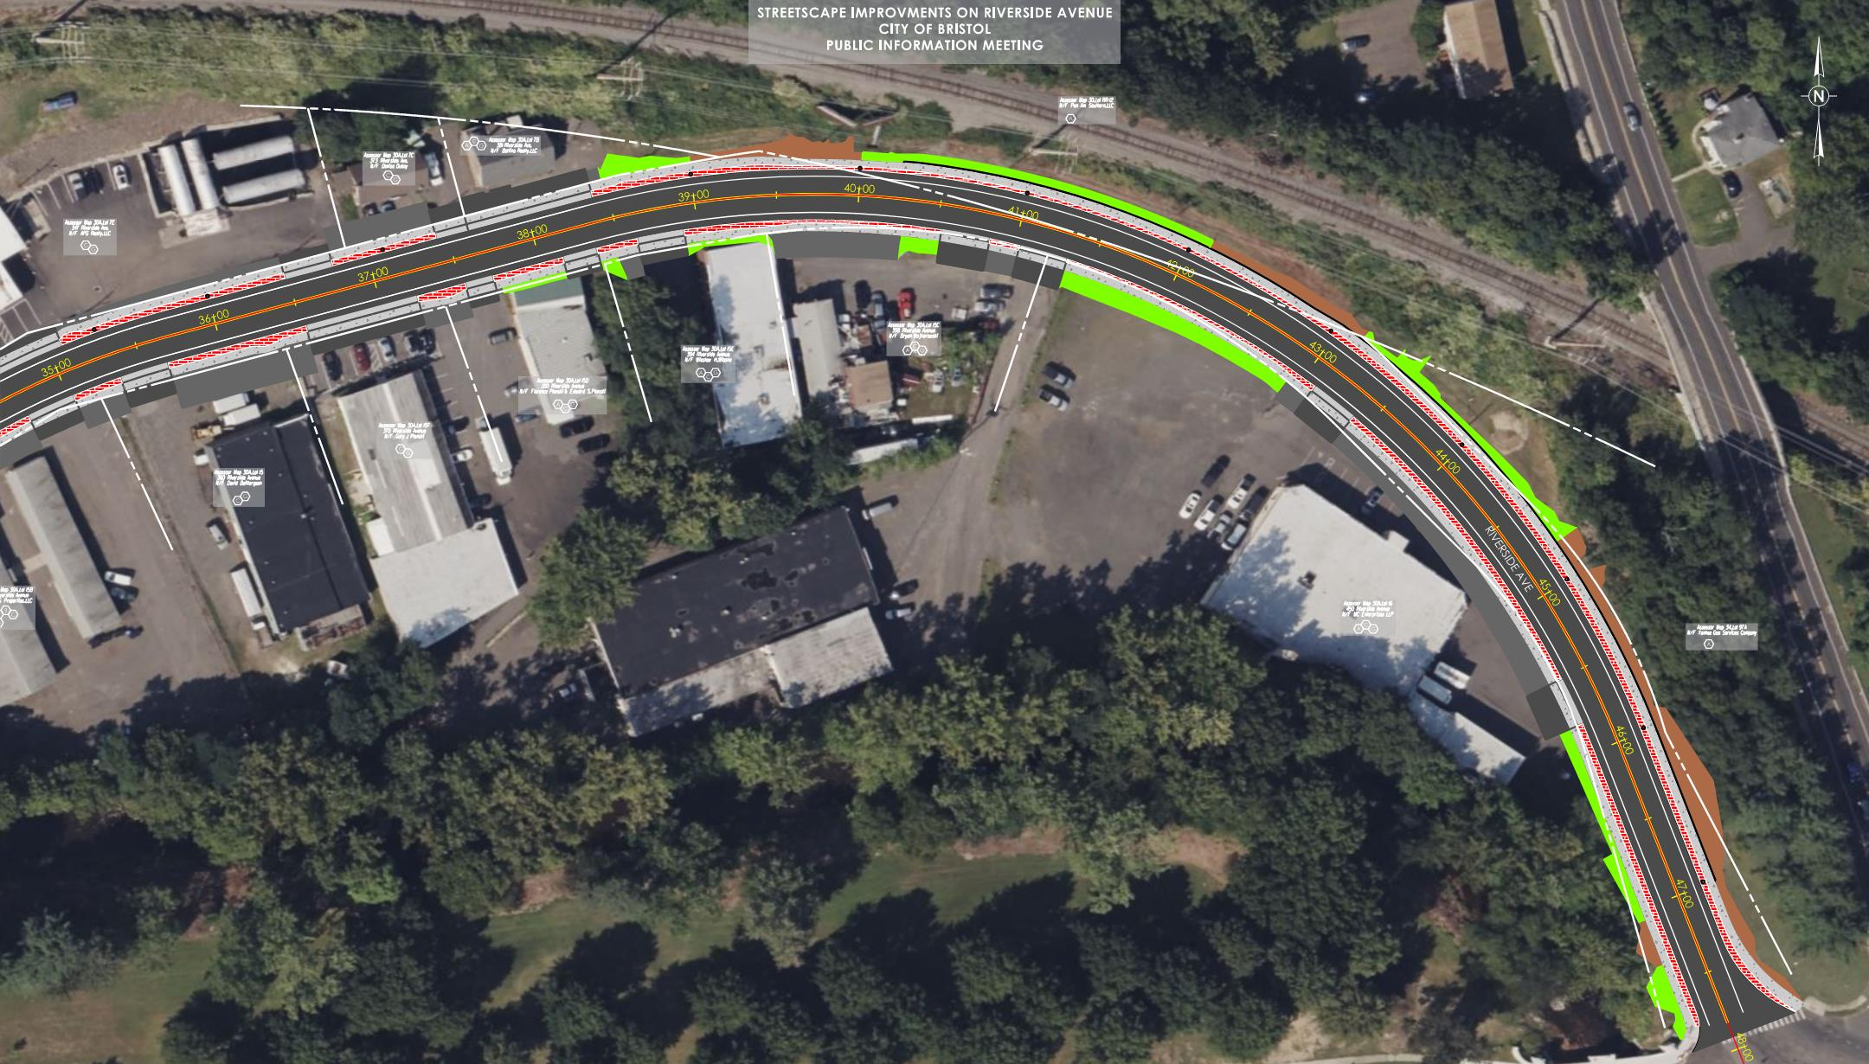

Slide 27
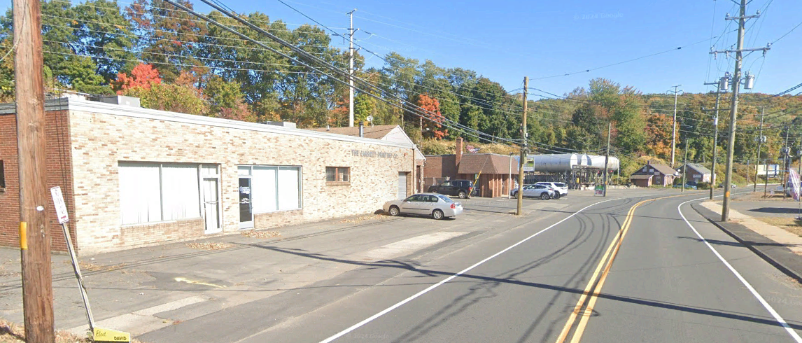
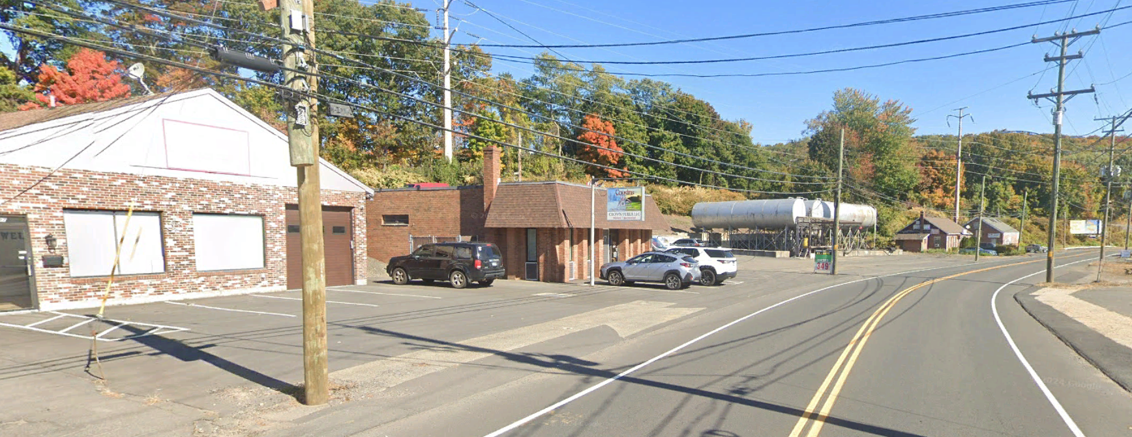
Proposed Improvements
N
N
337 Riverside Ave
347 Riverside Ave
331 Riverside Ave
Riverside Ave
Riverside Ave
Project No. 0017-0196

Slide 28
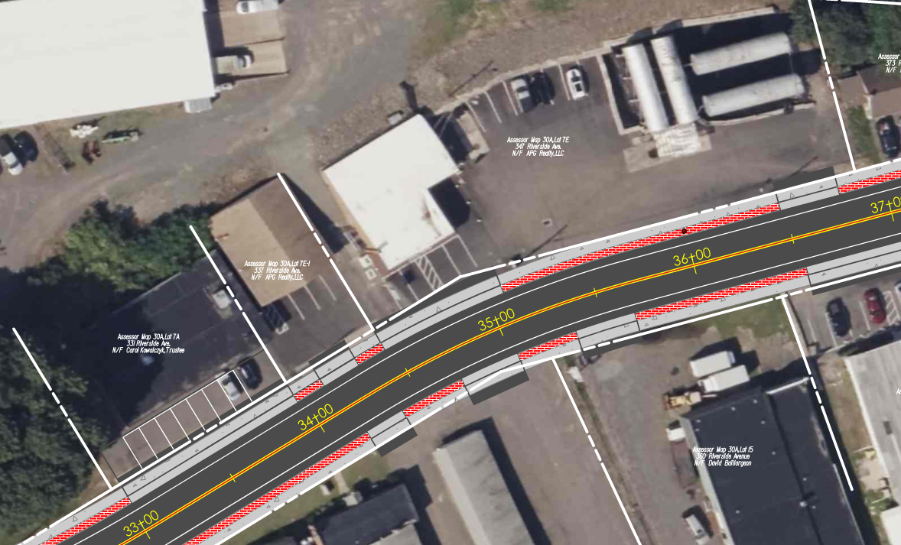
Proposed Improvements
347 Riverside Ave
337 Riverside Ave
331 Riverside Ave
Project No. 0017-0196

Slide 29
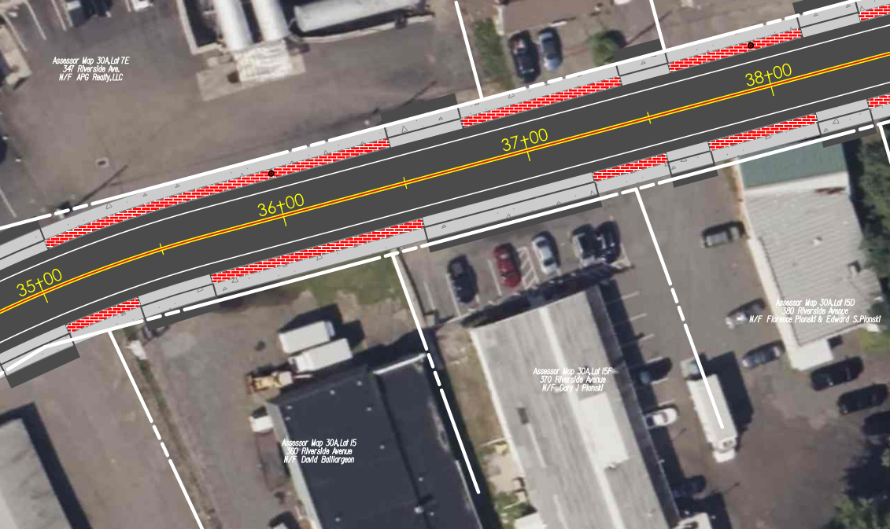
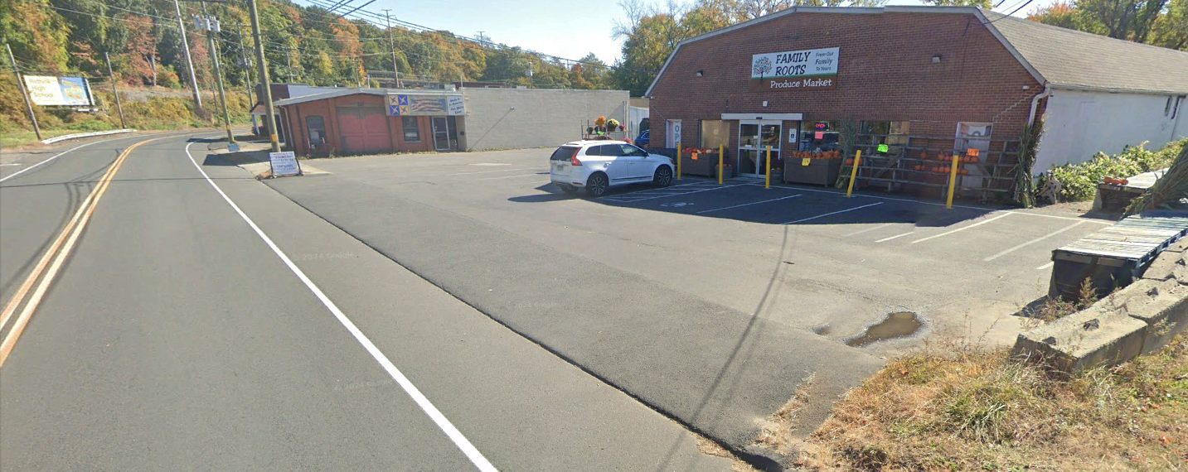
Proposed Improvements
370 Riverside Ave
N
370 Riverside Ave
Project No. 0017-0196

Slide 30
Presentation Overview
PROJECT LOCATION
EXISTING CONDITIONS
SAFETY ANALYSIS
PROPOSED IMPROVEMENTS
CONSTRUCTION STAGING
OTHER CONSIDERATIONS
Project No. 0017-0196

Slide 31
Construction Staging
Option 1: Daytime Work
Maintain two-lanes of traffic
Driveway access maintained
Sidewalk access maintained
Pedestrian Detours
Option 2: Nighttime Work
Alternating one-way traffic
Sidewalk access maintained
Pedestrian Detours
Final Paving
Project No. 0017-0196

Slide 32
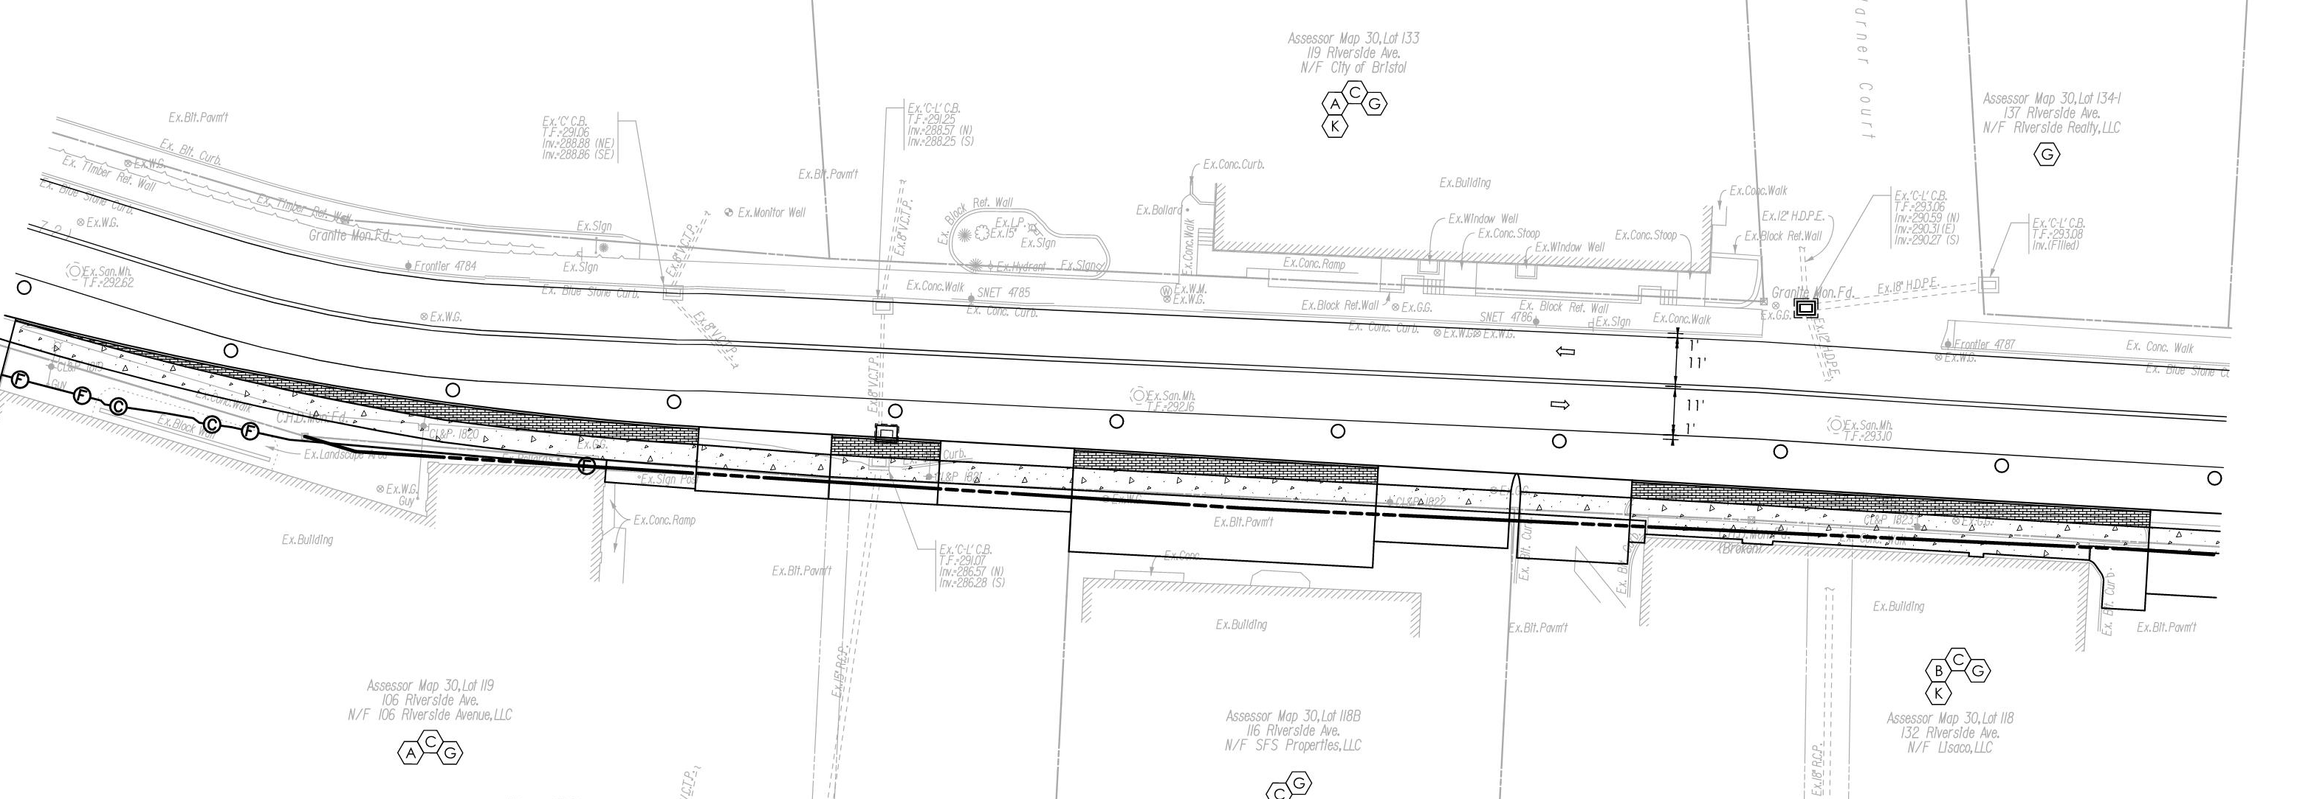
Construction Staging
Project No. 0017-0196

Slide 33
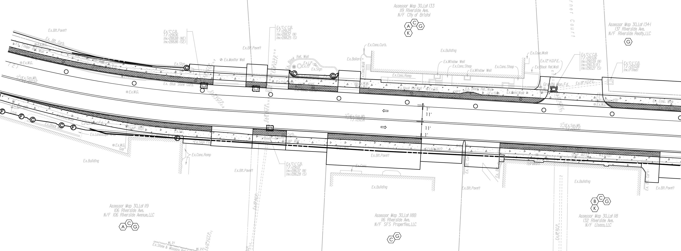
Construction Staging
Project No. 0017-0196

Slide 34
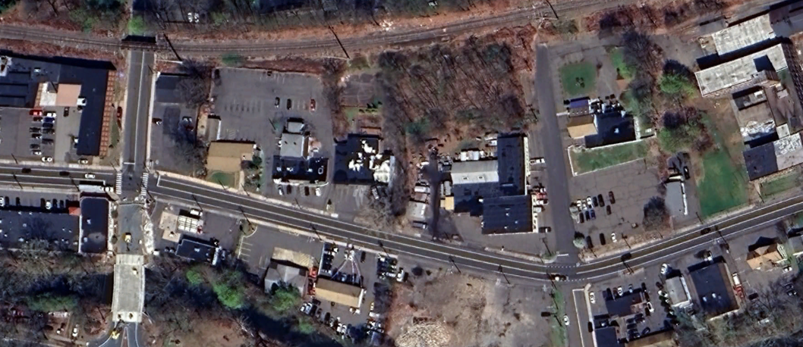
Construction Staging
Sidewalk Closed
Mellen St.
Sidewalk Closed
Hooker Ct.
Riverside Ave
Temporary Crosswalk
East St.
Project No. 0017-0196

Slide 35
Presentation Overview
PROJECT LOCATION
EXISTING CONDITIONS
SAFETY ANALYSIS
PROPOSED IMPROVEMENTS
CONSTRUCTION STAGING
OTHER CONSIDERATIONS
Right Of Way
Bicycle Facilities
Design Exceptions
Utilities
Project No. 0017-0196

Slide 36
Right Of Way
Function
Acquire all property/property rights necessary for the project.
Statutory References
State of Connecticut: C.G.S. Section 13a-73 & 13a-98e
Federal: Uniform Relocation Assistance and Real Property Acquisition Policies Act of 1970, as Amended.
Impacts to Private Property*
Partial Acquisitions
Easements
Rights
*Impacts Subject to Change as Design Progresses
Project No. 0017-0196
Notes:
15 – Defined Easement for Highway Purposes
1 – Easement to install and Maintain end anchorage
1 – Partial Take

Slide 37
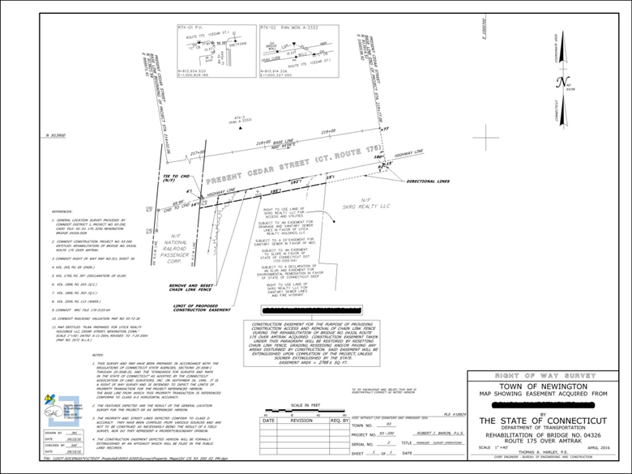
Right Of Way
ROW Process
Letter of Intent to Acquire
Valuation
Offer of Compensation
Negotiation
Acquisition
Agreement
Condemnation
Project No. 0017-0196
Notes:
15 – Defined Easement for Highway Purposes
1 – Easement to install and Maintain end anchorage
1 – Partial Take

Slide 38
Right Of Way
Rights | Number of Properties Impacted
Grade | 1
Construct Driveway | 38
Construct Parking Area | 2
Install Bituminous Concrete Curb | 1
Construct Retaining Wall | 2
Construct Sidewalk / Concrete Walk | 5
Remove and Reset Chain Link Fence | 1
Various Rights to install Drainage Items | 3
Easements
Install and Maintain End Anchorage | 1
Defined Easement for Highway Purposes (Sidewalk) | 15
Acquisition | 1
Project No. 0017-0196
Notes:
15 – Defined Easement for Highway Purposes
1 – Easement to install and Maintain end anchorage
1 – Partial Take

Slide 39
Bicycle Facilities
Bicycle Facilities are not Proposed under Project 0017-0196
Bristol partnered with Naugatuck Valley Council of Governments to conduct a study of potential downtown routing options to provide a safe, continuous connection between Rockwell Park in the west to Downtown, continuing east to Route 229.
Pequabuck River Trail Project will provide bike and pedestrian access from Rockwell Park to Memorial Boulevard and from Memorial Boulevard to Middle Street Trail.
Project No. 0017-0196

Slide 40
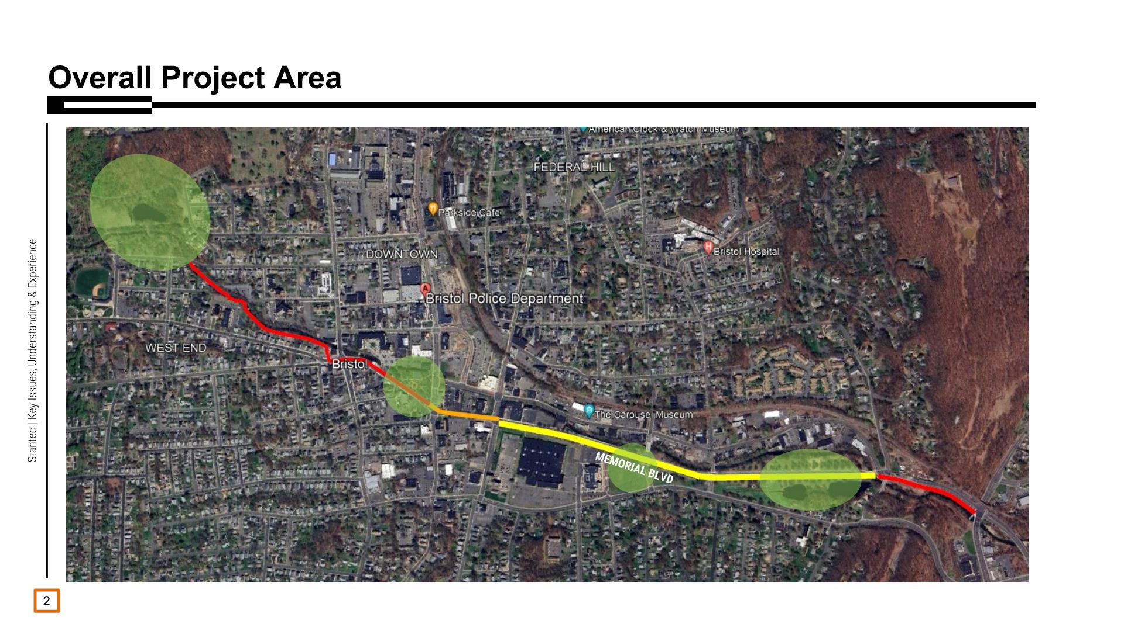
Project No. 0017-0196
Project No. 0017-0196

Slide 41
Design Exceptions
Design Element | Design Standard | Proposed Design
Travel Lane Width | 10’ – 12’ | 11’
Shoulder Width | 4’ – 8’ | 4’
Typical Cross Slope Travel Lane Shoulder | 1.5% - 2.0% 4.0% - 6.0% | 1.5% 4.0%
Turn Lane | 1’ Less than TL Width – TL Width | 10’
Sidewalk Width | 5’ Minimum | 5’
Stopping Sight Distance | 250’ | 432’
Minimum Radius | 375’ | 400’
Superelevation Rate | 4.0% | 2.4%
Maximum Grade | 11.0% | 3.96%
Project No. 0017-0196

Slide 42
Design Exceptions
Anticipated Design Exceptions
Intersection Sight Distance
Project No. 0017-0196

Slide 43
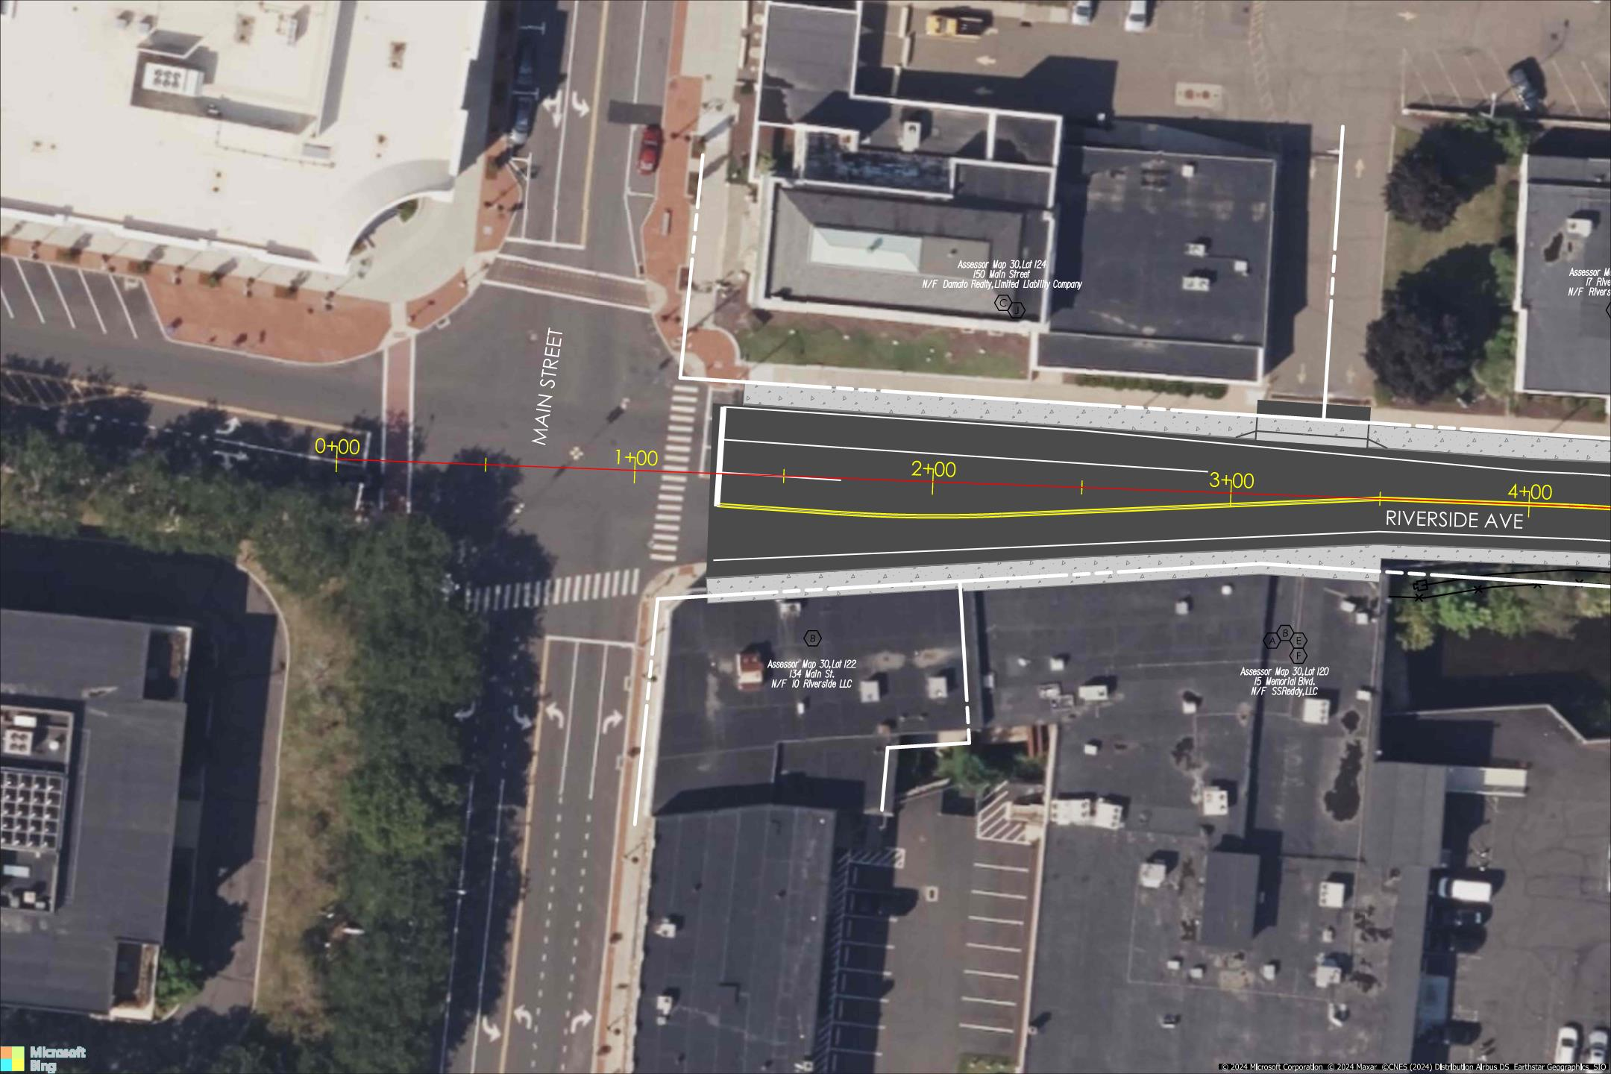
Intersection Sight Distance
Project No. 0017-0196

Slide 44
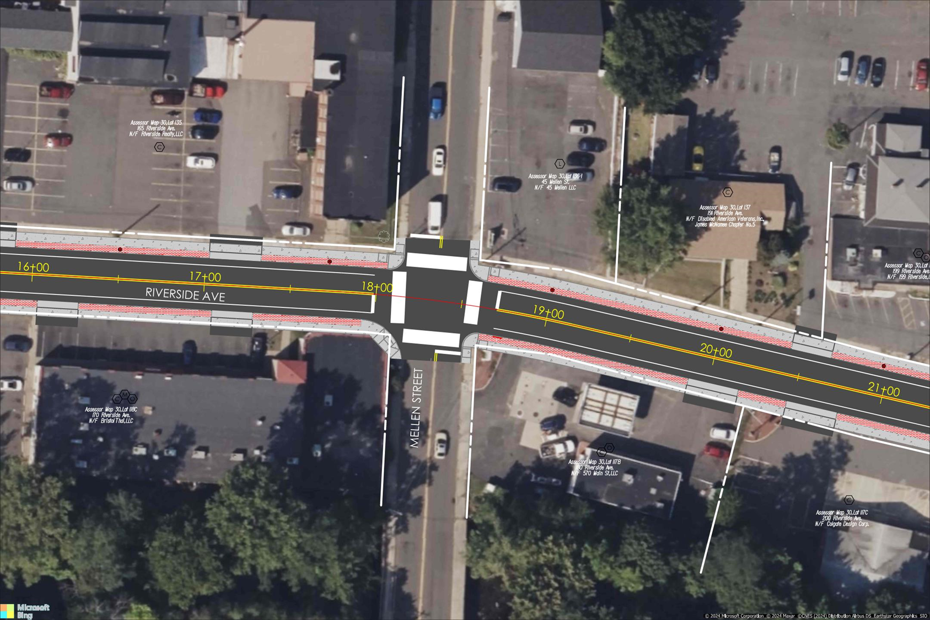
Project No. 0017-0196

Slide 45
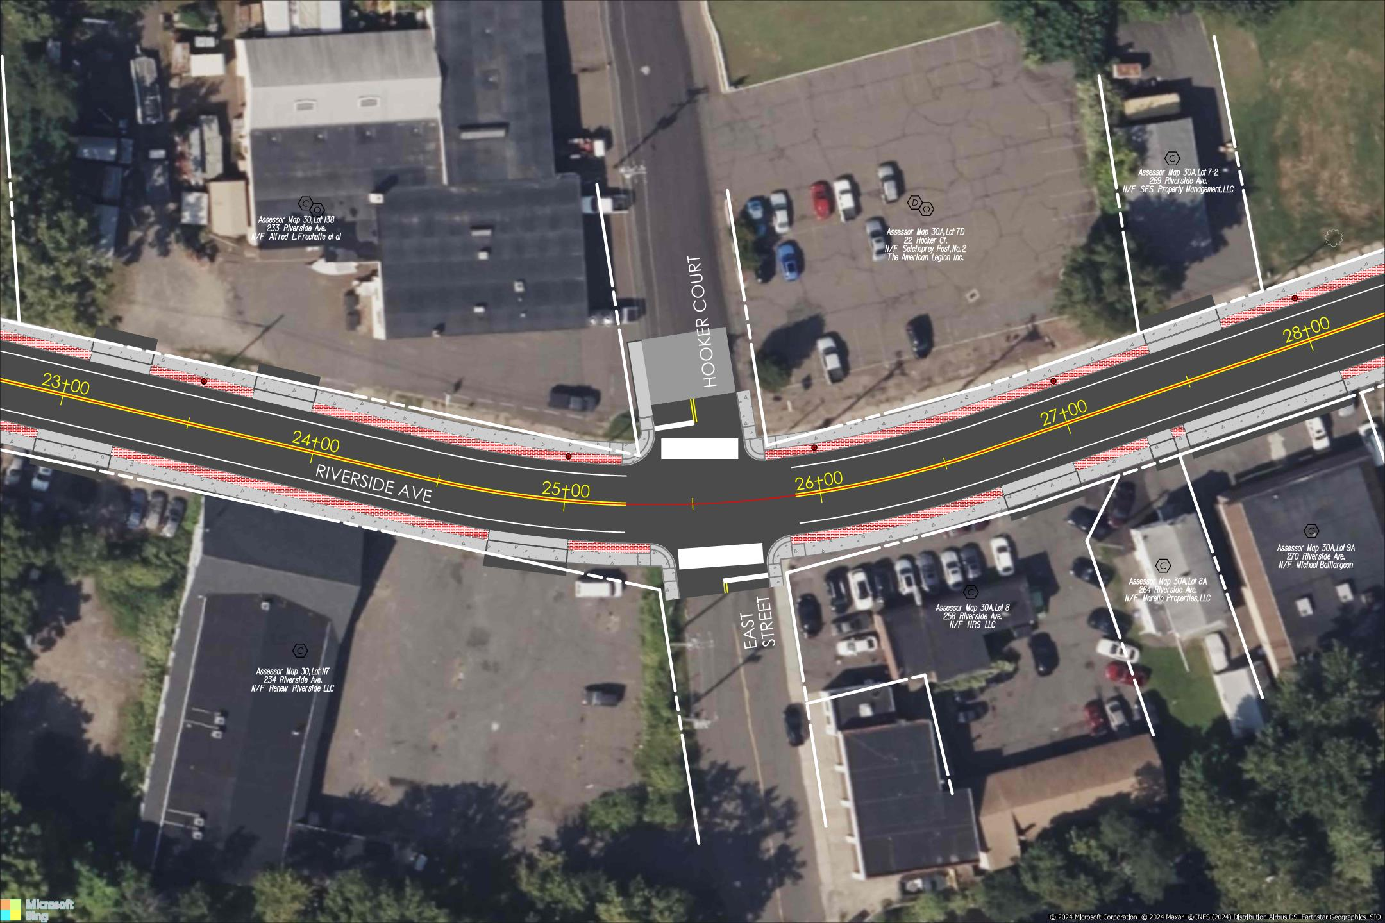
Intersection Sight Distance
Project No. 0017-0196

Slide 46
Utilities
Utility companies with facilities in the project area:
Eversource Energy – Electric Distribution
Eversource Energy – Gas
City of Bristol Water and Sewer Department
Frontier Communications
Comcast Cable
Crown Castle
Project No. 0017-0196

Slide 47
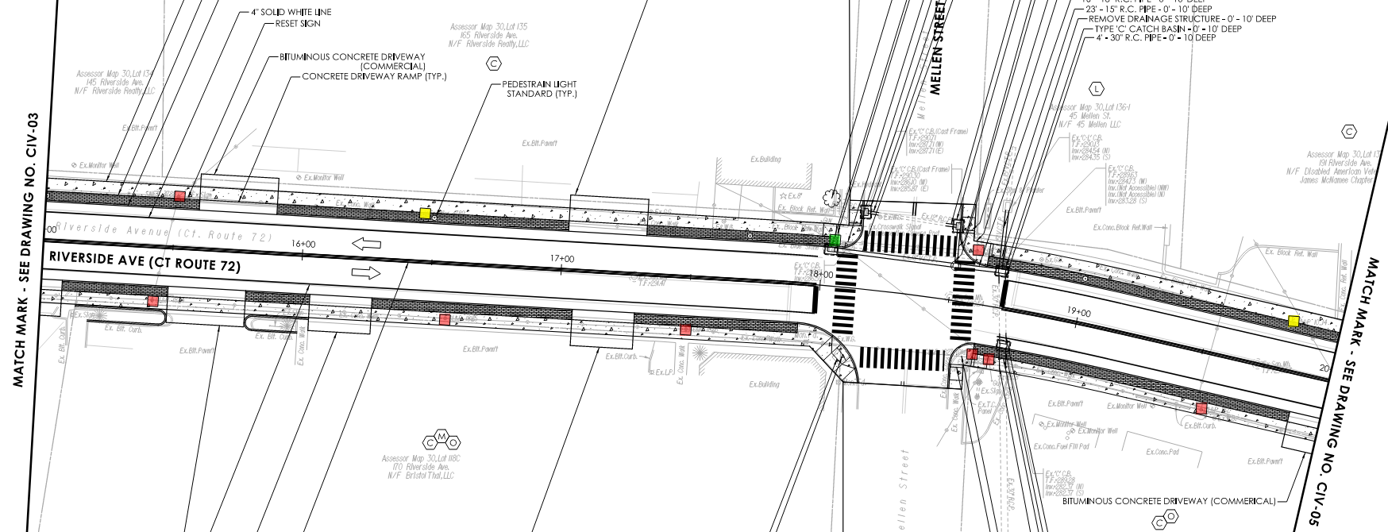
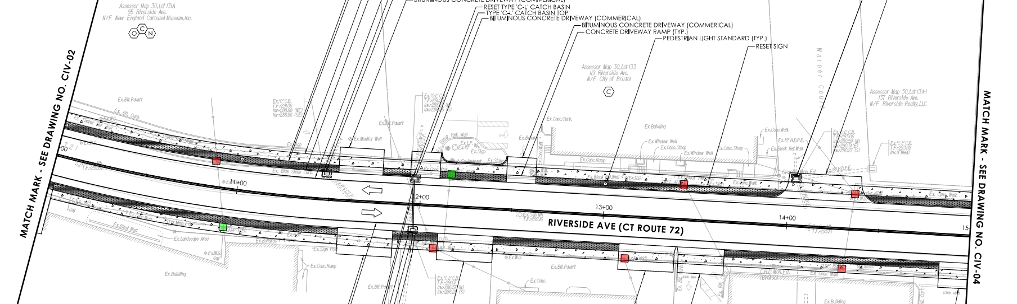
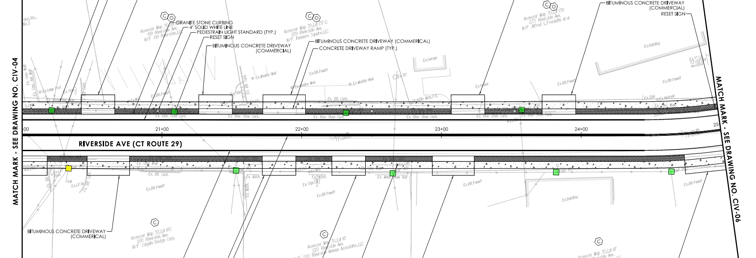
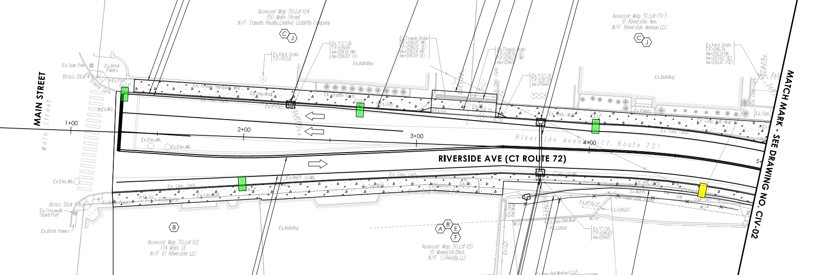
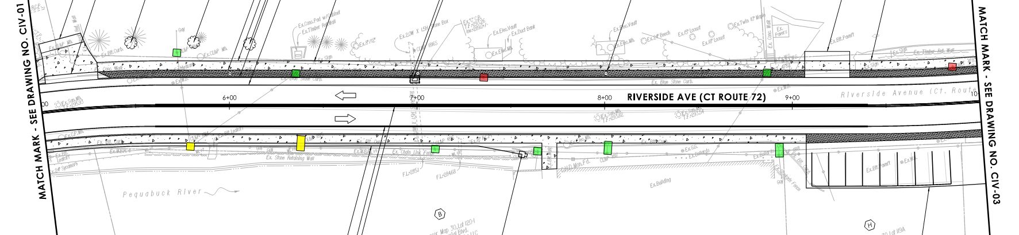
Utility Relocations
Project No. 0017-0196

Slide 48
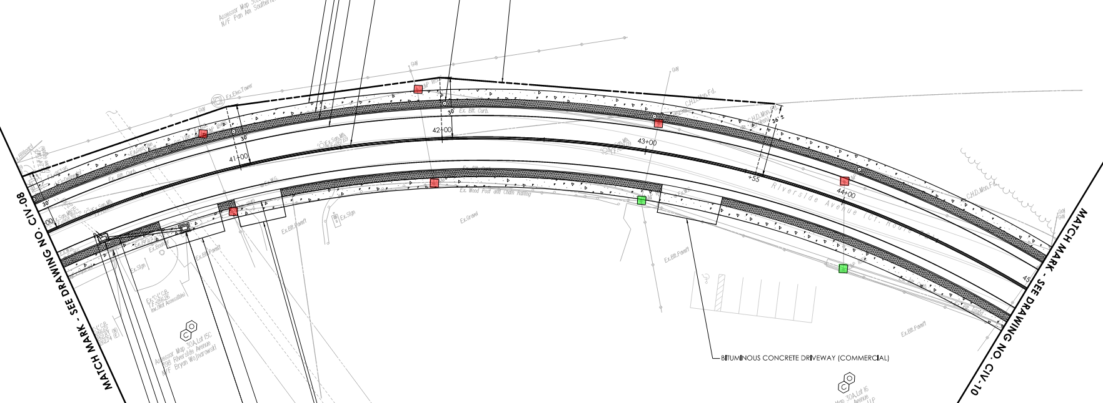
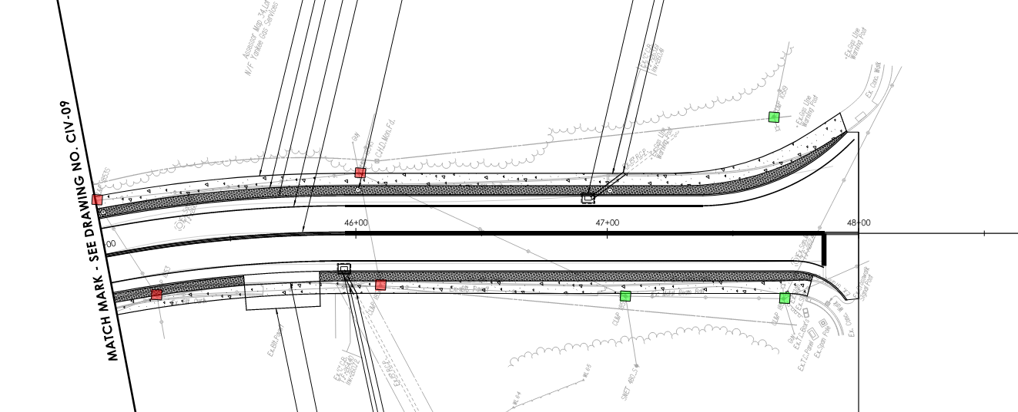
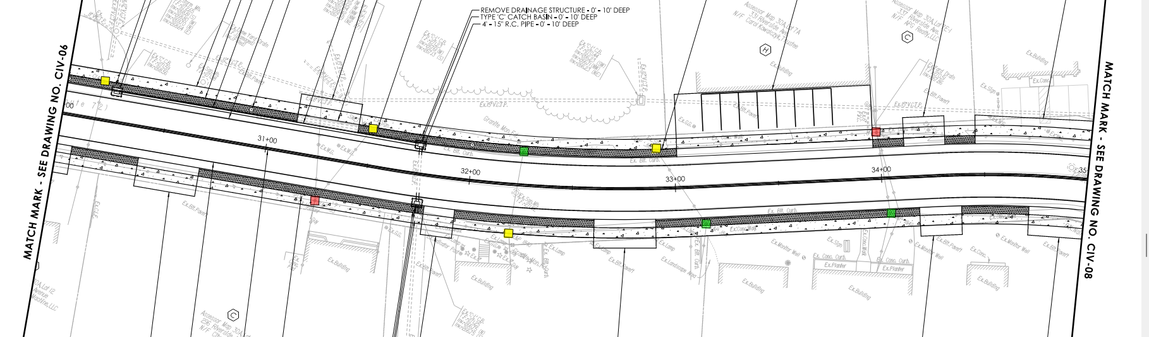
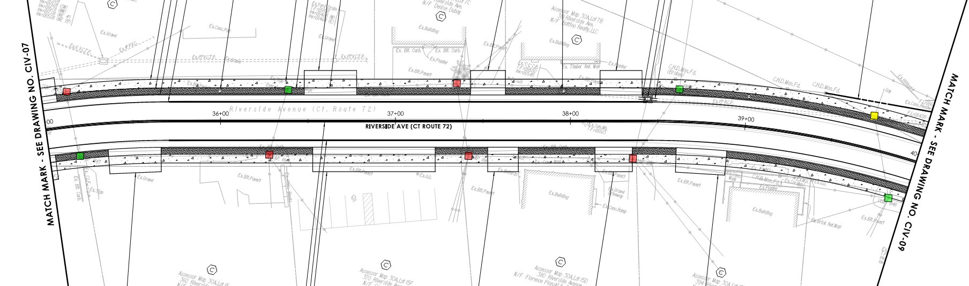
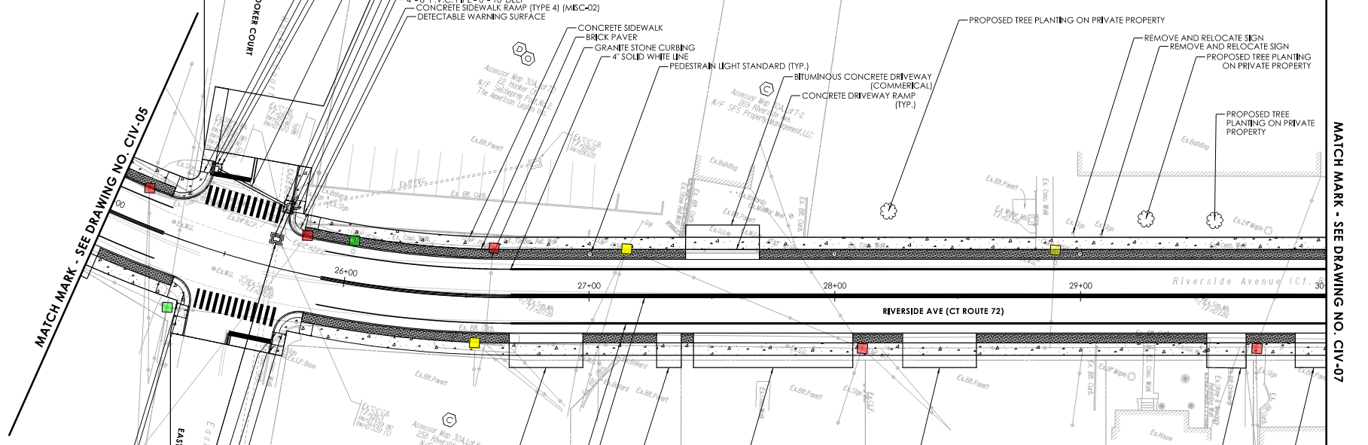
Utility Relocations
Project No. 0017-0196

Slide 49
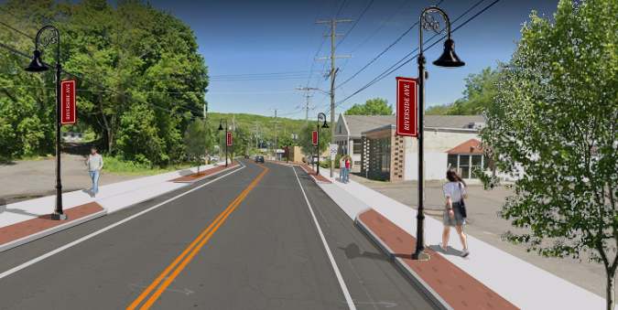
Summary
Purpose
Purpose: To improve safety, access management, pedestrian accommodations and aesthetic qualities along Riverside Avenue.
Proposed Improvements
Full Depth Reconstruction
Granite Stone Curbing
Standardization of Driveways
3.5’ Brick Sidewalk
5’ Sidewalks
Decorative Lighting
Project Schedule
Contract Documents: July 2026
Advertising: September 2026
Construction: April 2026
Project No. 0017-0196

Slide 50

Questions and Answer
Recording:
https://bristolct.portal.civicclerk.com/
Submit a Question or Comment
Q&A Session
Email: RaymondRogozinski@bristolct.gov
Telephone: Raymond Rogozinski at (860) 584-6125
Comment Period is open through May 13, 2025, via Email or Telephone
Project No. 0017-0196

