Slide 1



State Project No. 0017-0196 Route 72 Improvements in the City of Bristol
DESGIN EXCEPTIONS MEETING
August 28, 2025
Prepared for: City of Bristol
Prepared by: GM2 Associates, Inc.

Slide 2
Organizational Chart
GM2 Staff | Stakeholder Representatives | CTDOT Liaisons
Principal In Charge Matthew Vail | Raymond Rogozinski | Principal Engineer Michael Cherpak
Project Manager Paul Brand | Justin Malley | Supervising Engineer Devin Racicot
Project Engineer Danielle Dixon |  | Right of Way Coordinator Zachary Guarino
Project No. 0017-0196

Slide 3
General Project Information
Project Origin
Streetscape Study and Design Concepts completed in 2021
Riverside Avenue
Divinity Street
Park Street
Purpose & Need
Purpose: To improve safety, access management, pedestrian accommodations and aesthetic qualities along Riverside Avenue.
Need: Current condition of existing facilities along Riverside Avenue and the poorly developed and disconnected sidewalk system.
Project No. 0017-0196

Slide 4
General Project Information
Funding
Project Design
City of Bristol
Rights of Way, Construction Phase Cost
CT Department of Transportation
Department of Economic and Community Development – Community Investment Fund Grant
Project Schedule
Contract Documents: September 2026
Advertising: December 2026
Construction: April 2027
Project Cost
Total Construction Cost: $12,600,000
Right of Way: $465,000
Project No. 0017-0196

Slide 5
Presentation Overview
PROJECT LOCATION
EXISTING CONDITIONS
SAFETY ANALYSIS
PROPOSED IMPROVEMENTS
DESIGN EXCPETIONS
Project No. 0017-0196

Slide 6
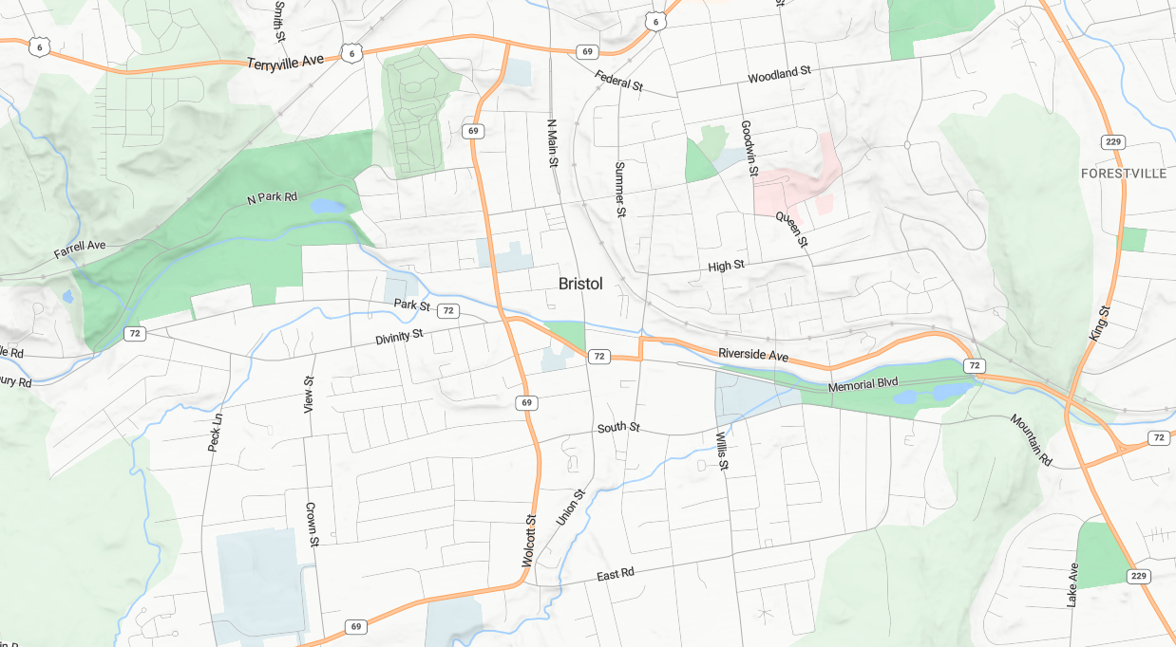




Project Locations
West Cemetery
Bristol
Hospital
Rockwell
Park
Memorial Blvd Park
Project No. 0017-0196

Slide 7
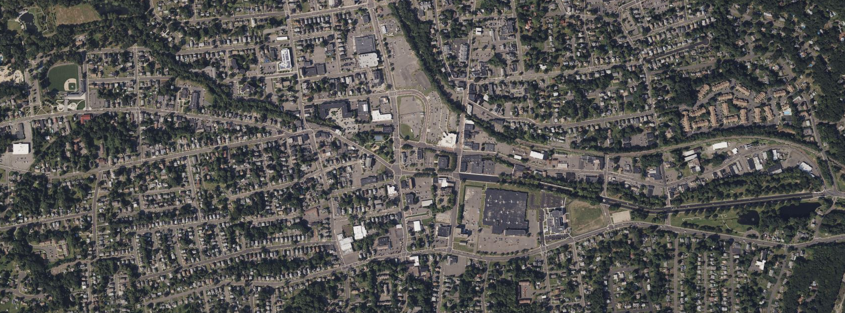

Projects Locations
69
RIVERSIDE AVENUE
Muzzy Field
0017-0195
273 Riverside Ave Site Work
Carousel Museum Site Work
0171-0504
72
PARK STREET
72
0017-0187
Memorial
Blvd Park
0017-0193
0017-0192
L017-0002
Project No. 0017-0196

Slide 8
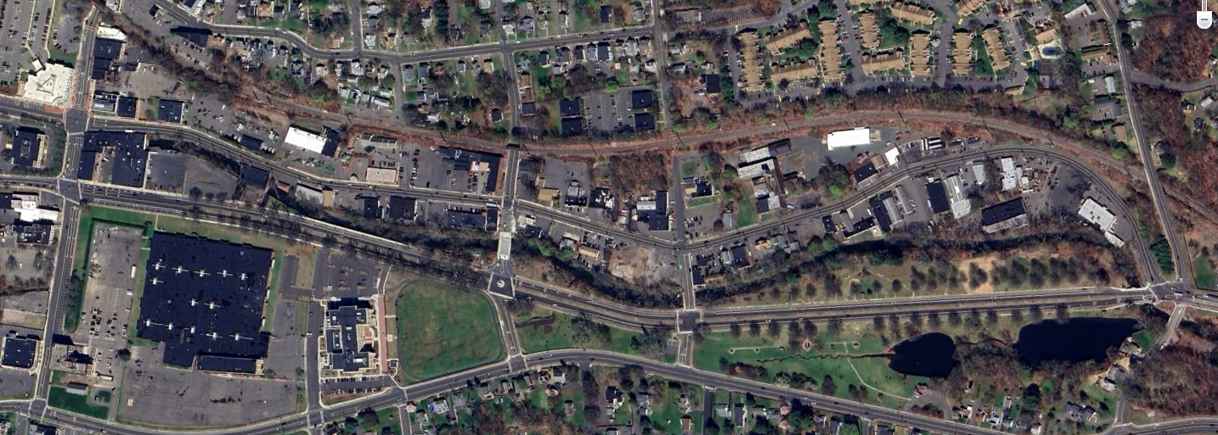
Project Location
Mellen St.
Main Street
Riverside Ave
Hooker Ct.
Blakeslee St.
East St.
Memorial Blvd.
Memorial Blvd Park
Project No. 0017-0196

Slide 9
Presentation Overview
PROJECT LOCATION
EXISTING CONDITIONS
SAFETY ANALYSIS
PROPOSED IMPROVEMENTS
DESIGN EXCEPTIONS
Project No. 0017-0196

Slide 10
Existing Conditions
Corridor Information
Functional Classification
Riverside Avenue: Urban Principal Arterial (Built-up)
Local Roads: Urban Local Roads (Built-up)
Average Daily Traffic Counts (ADT)
Posted Speed Limits
Roadway | 2021 ADT (vpd)
Riverside Ave | 8,700
Main Street | 5,600
Roadway | Posted Speed Limit
Riverside Ave | 30 m.p.h.
Main Street | 25 m.p.h.
Mellen Street | 25 m.p.h.
East Street | 30 m.p.h.
Project No. 0017-0196

Slide 11
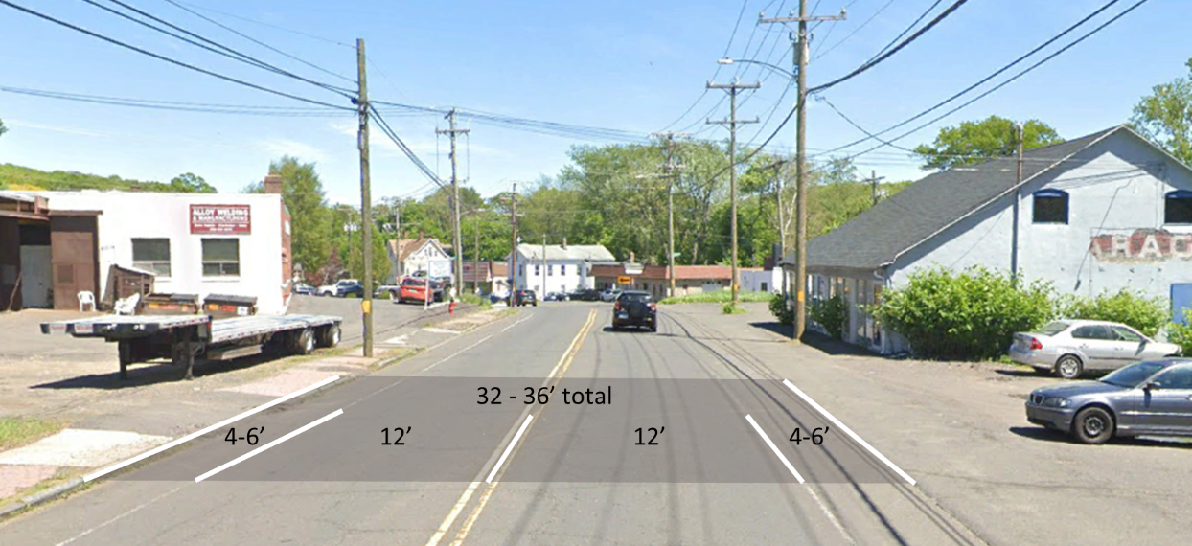
Existing Conditions
Typical Section:
Project No. 0017-0196

Slide 12
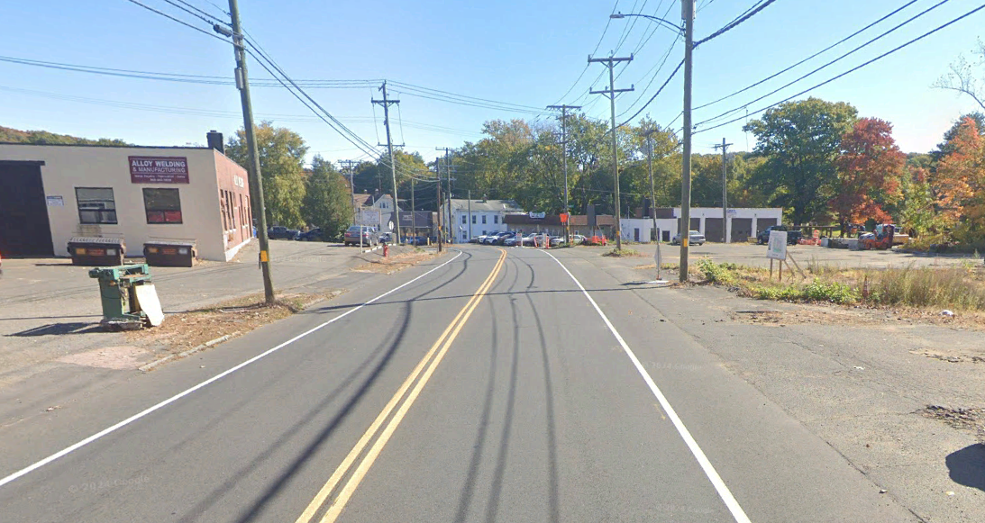
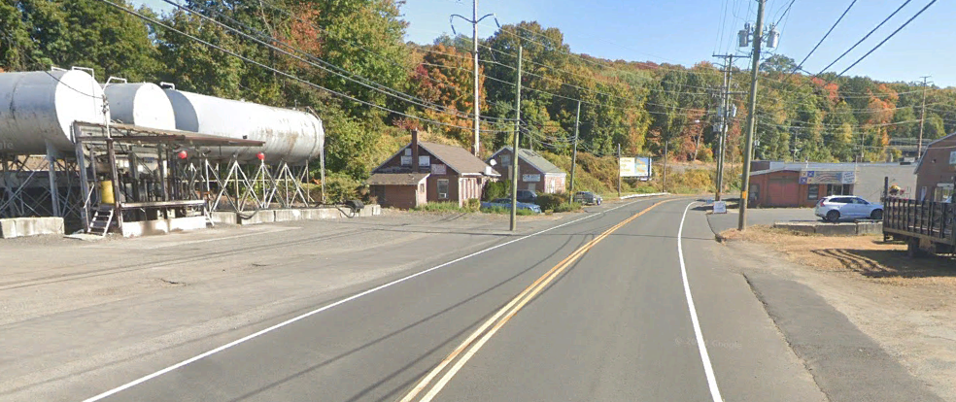
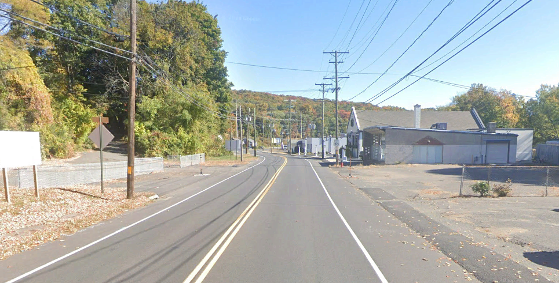
Existing Conditions
Wide Curb Cuts
Random Ingress and Egress
Low Aesthetic quality
No Formal Streetscape
Utility Poles on both sides of the street (some located in driveways)
Project No. 0017-0196

Slide 13
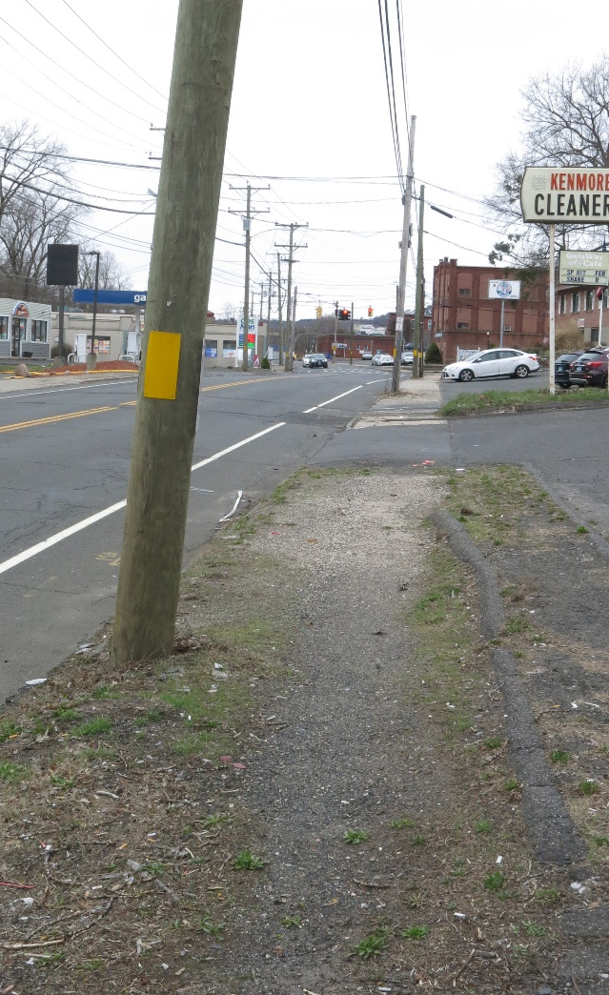
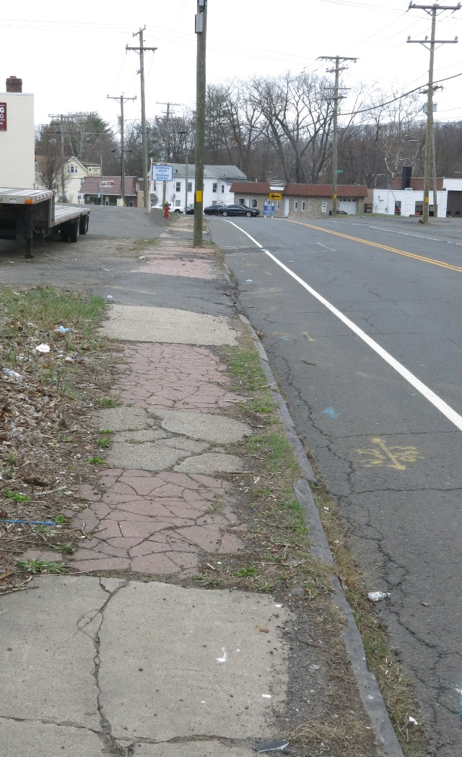
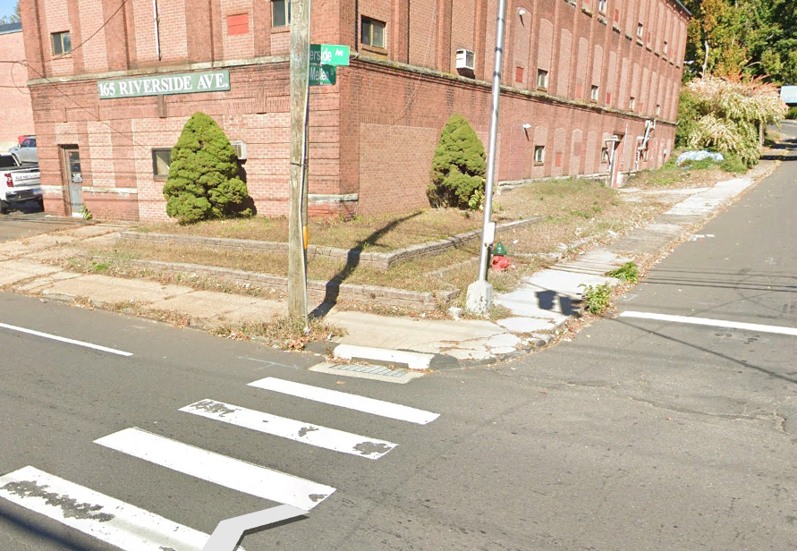
Existing Conditions
Pedestrian Accommodations
Disconnected and Poorly Developed
Poor Condition
Inconsistent and Infrequent Buffer
Scarcity of ADA-Compliant Curb Ramps
Project No. 0017-0196

Slide 14
Presentation Overview
PROJECT LOCATION
EXISTING CONDITIONS
SAFETY ANALYSIS
PROPOSED IMPROVEMENTS
DESIGN EXCEPCTIONS
Project No. 0017-0196

Slide 15
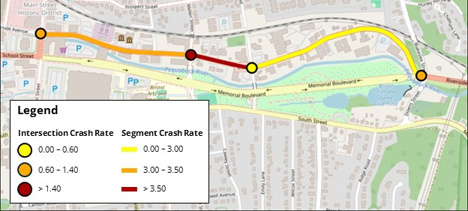

Safety Analysis
Crash Data
Crash Data Collected from Connecticut Crash Data Repository Traffic Safety Dashboard.
2017 – 2019, 2022, 2023
Calculated Crash Rate and Critical Crash Rate for each roadway segment and intersection.
All observed Crash Rates are below the Critical Crash Rate.
Crash Type | Number of Crashes | Percentage
Front to Rear | 64 | 41.8
Angle | 42 | 27.5
Fixed Object | 26 | 17.0
Time of Day | Number of Crashes | Percentage
Daylight | 108 | 70.6
Dark-Lighted | 38 | 24.7
N
5-Year Period
153 Crashes
0 Fatalities
2 Severe Injuries
Project No. 0017-0196

Slide 16
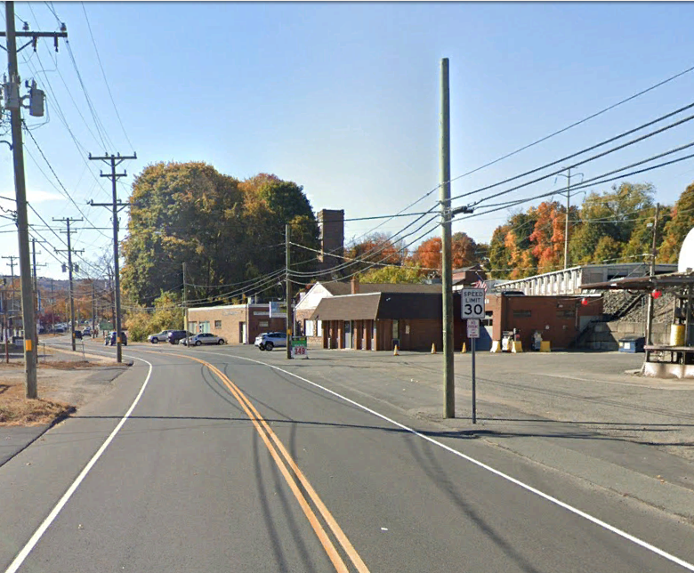
Safety Analysis
What does this Mean?
Crashes are below the expected average levels for the corridor
The leading crash types are logical based of the density of driveways along the corridor
Why are we seeing Fixed Object Crashes as a common crash type?
Existing Streetscape
Wide seas of pavement
Poorly defined edge of Road
Crash Type | Number of Crashes | Percentage
Front to Rear | 64 | 41.8
Angle | 42 | 27.5
Fixed Object | 26 | 17.0
Project No. 0017-0196

Slide 17
Presentation Overview
PROJECT LOCATION
EXISTING CONDITIONS
SAFETY ANALYSIS
PROPOSED IMPROVEMENTS
DESIGN EXCEPTIONS
Project No. 0017-0196

Slide 18
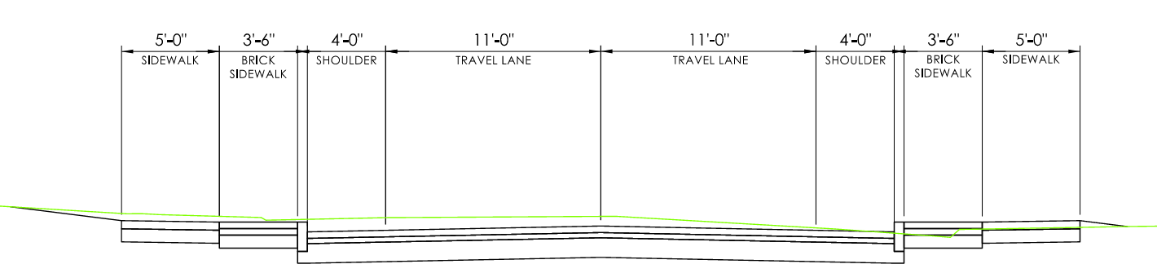
Proposed Improvements
Full Depth Reconstruction
Granite Stone Curbing
Standardization of Driveways
3.5’ Brick Sidewalk
5’ Sidewalks
Decorative Lighting
Pavement Structure
4” HMA S0.5
3” HMA S1.0
12” Subbase
Project No. 0017-0196

Slide 19
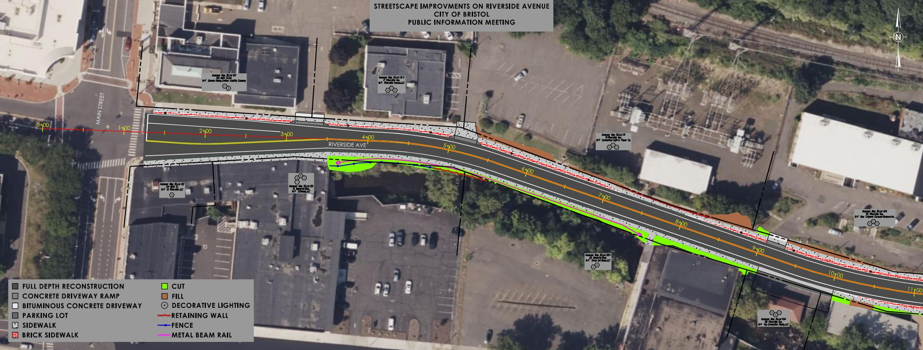
Project No. 0017-0196

Slide 20
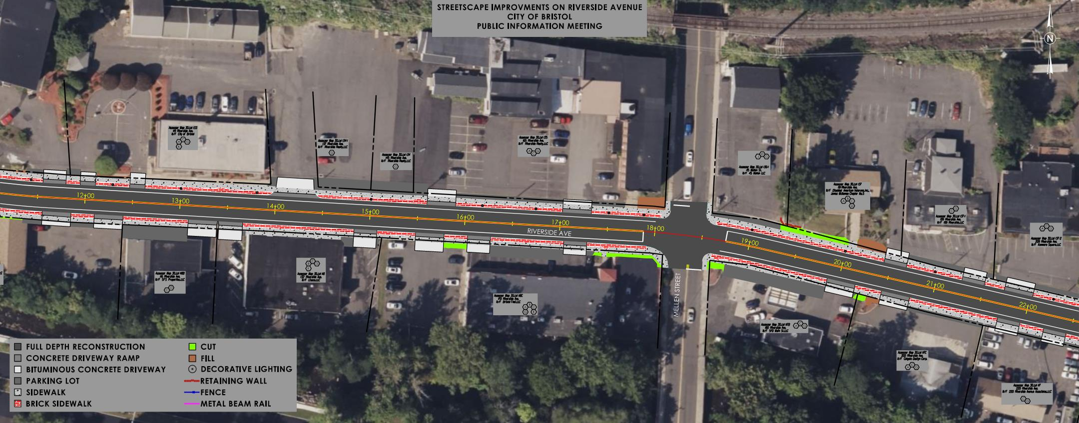
Project No. 0017-0196

Slide 21
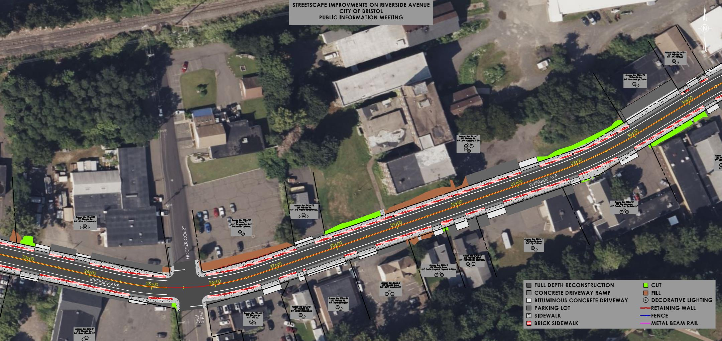
Project No. 0017-0196

Slide 22
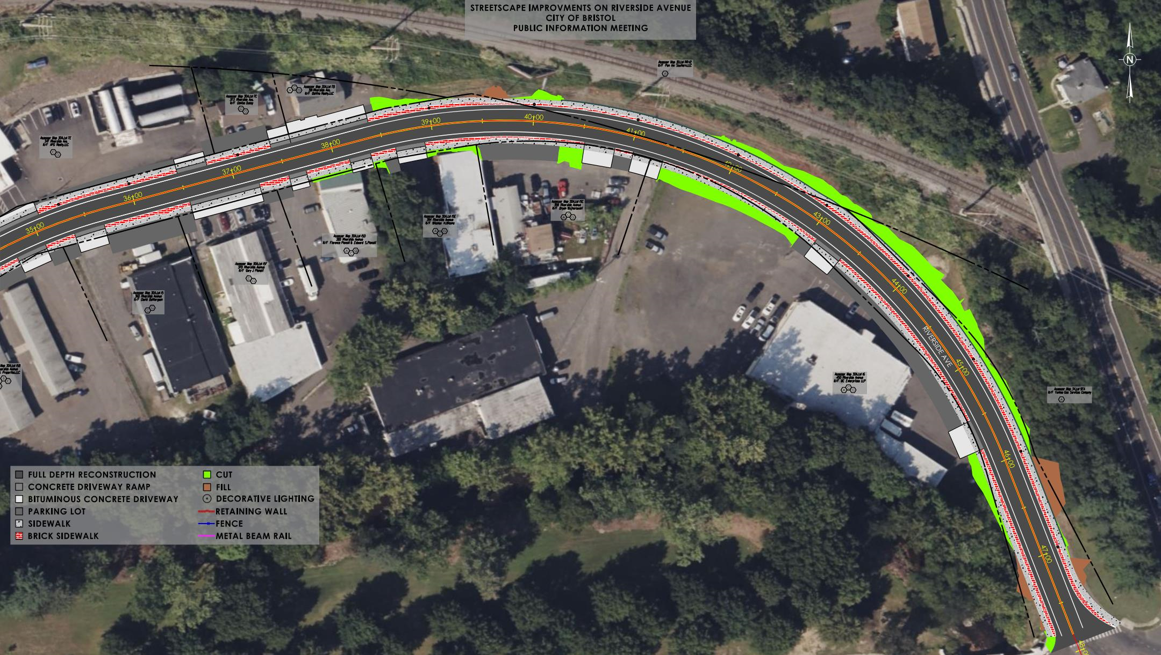
Project No. 0017-0196

Slide 23
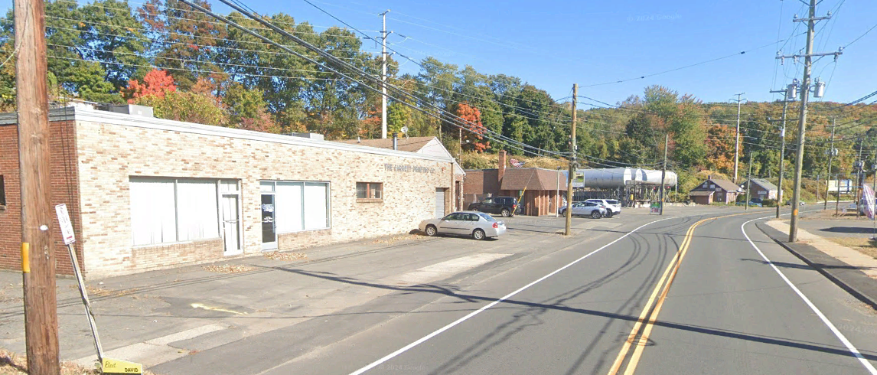
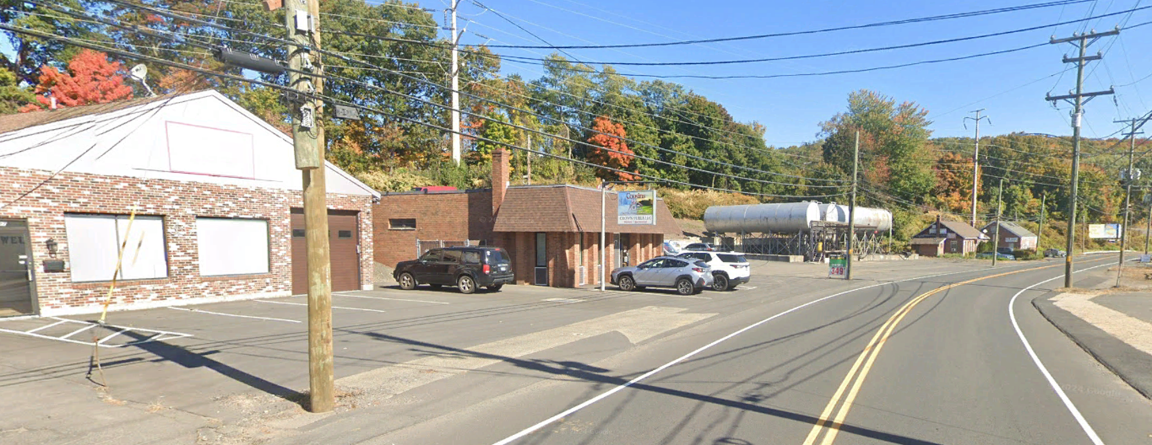
Proposed Improvements
N
N
337 Riverside Ave
347 Riverside Ave
331 Riverside Ave
Riverside Ave
Riverside Ave
Project No. 0017-0196

Slide 24
Proposed Improvements
N
337 Riverside Ave
347 Riverside Ave
Riverside Ave
Project No. 0017-0196

Slide 25
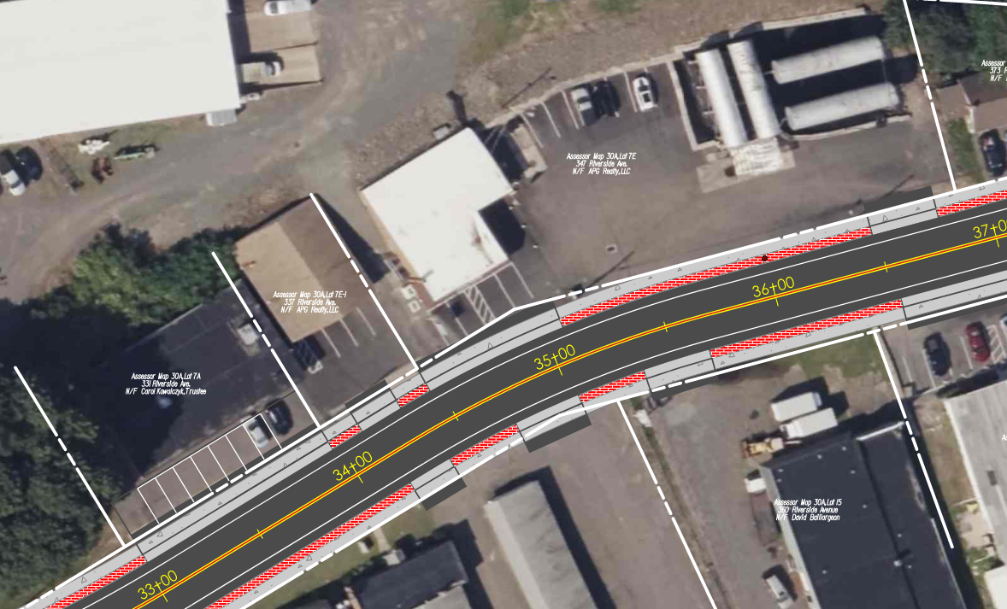
Proposed Improvements
347 Riverside Ave
337 Riverside Ave
331 Riverside Ave
Project No. 0017-0196

Slide 26
Presentation Overview
PROJECT LOCATION
EXISTING CONDITIONS
SAFETY ANALYSIS
PROPOSED IMPROVEMENTS
DESIGN EXCETPIONS
Project No. 0017-0196

Slide 27
Design Standards
Design Element | Design Standard | Existing Conditions | Proposed Design
Travel Lane Width | 10’ – 12’ | 12’ | 11’
Shoulder Width | 4’ – 8’ | 4’ –6’ | 4’
Cross Slope Travel Lane | 1.5% - 2.0% | 1.5% | 2.0%
Cross Slope Shoulder | 4.0% - 6.0% | 5.0% | 4.0%
Minimum Radius | 375’ | 275’ | 400’
Max Grade | 11.0% | 3.98% | 4.25%
Stopping Sight Distance | 250’ | 406’ | 320’
Superelevation Rate | 4.0% | <4.0% | 2.4%
Intersection Sight Distance | 390’ | Varies | Varies*
Clear Zone | To ROW line | 8’ | 9’
*Requires Design Exception
Project No. 0017-0196

Slide 28
ISD Design Exceptions
3 Intersections:
Route 72 & Warner Court
LT-Turn ISD: Matches Existing Condtion
Route 72 & Mellen Street
LT-Turn ISD: Improved from existing condition
RT-Turn ISD: Improved from Existing Condtion
Route 72 & East Street/Hooker Court
Sightline Easements
56 Proposed Driveways:
112 ISDs
73 Substandard ISDs at Driveways
Project No. 0017-0196

Slide 29
Route 72 & Warner Court
 | Turn Direction | Standard ISD (ft) | Design Speed | Existing ISD (ft) | Ex. ISD Speed (MPH) | Proposed ISD Speed (ft) | Proposed ISD Speed (MPH)
Warner Court | Left | 390 | 35 | 350 | 31 | 350 | 31
Field photos

Slide 30
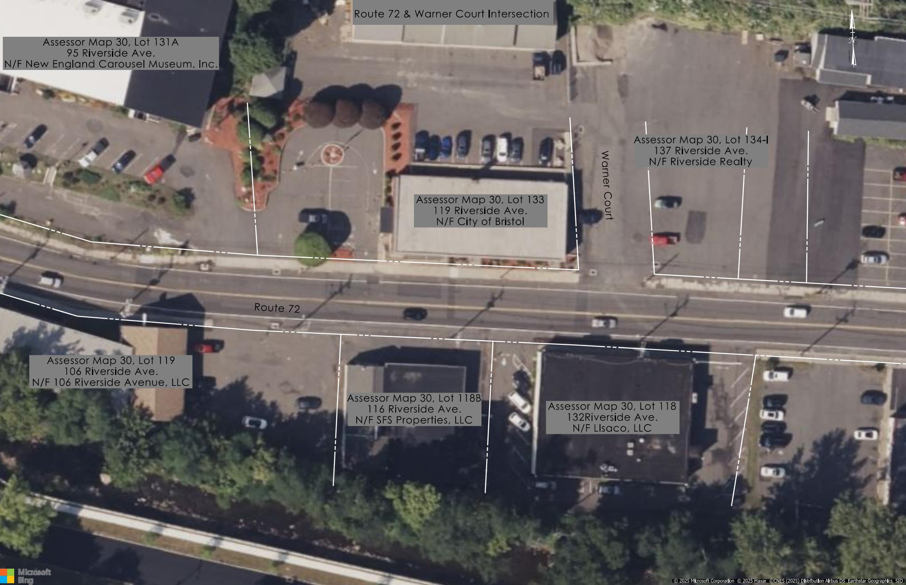

Slide 31
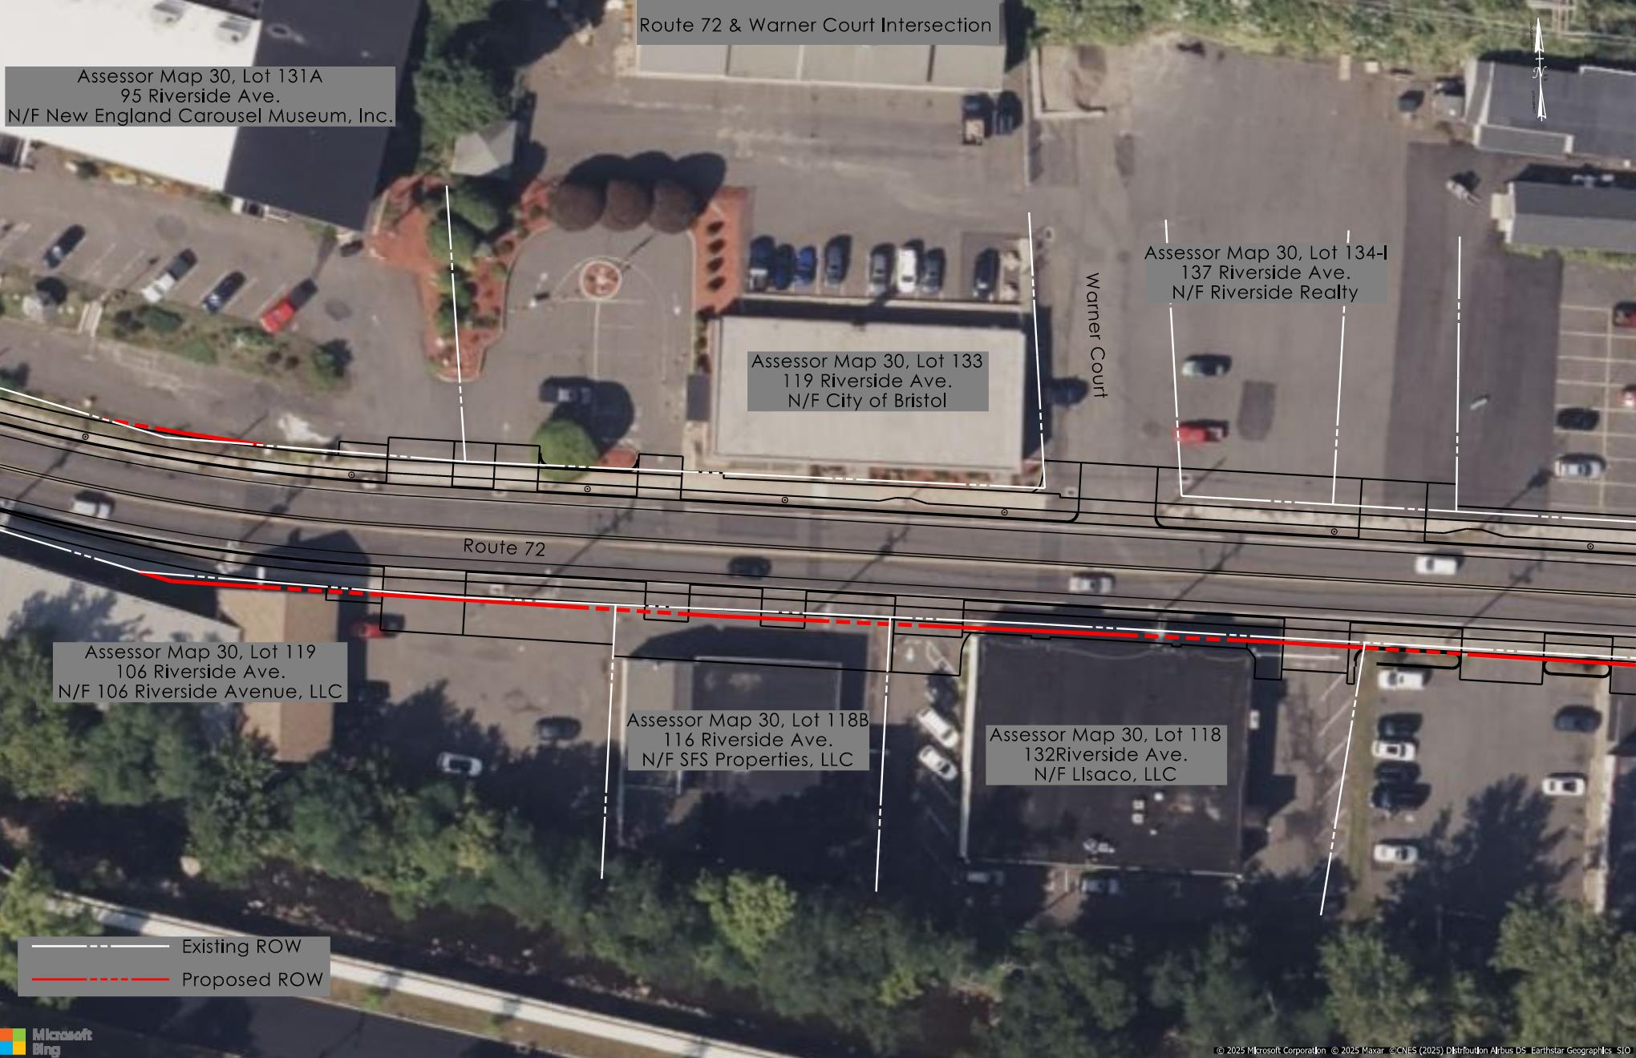

Slide 32
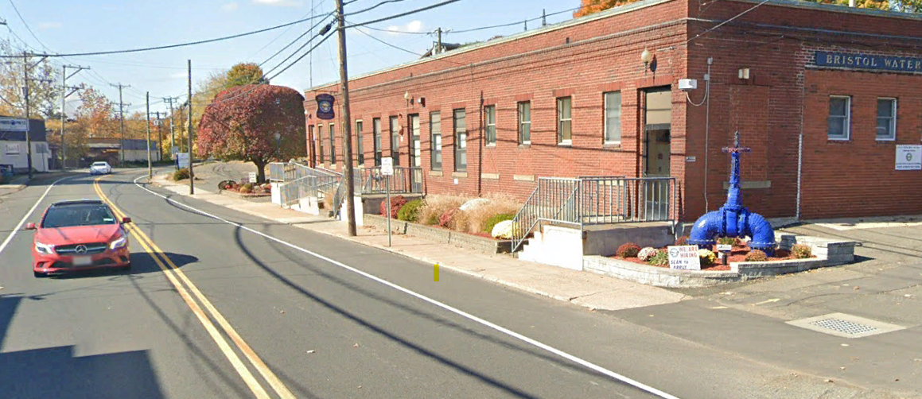
Route 72 & Warner Court

Slide 33
Route 72 & Mellen Street
 | Turn Direction | Standard ISD (ft) | Design Speed | Existing ISD (ft) | Ex. ISD Speed (MPH) | Proposed ISD Speed (ft) | Proposed ISD Speed (MPH)
Mellen Street | Left | 390 | 35 | 56 | <20 | 69 | <20
 | Right | 390 | 35 | 77 | <20 | 136 | <20
Field photos

Slide 34
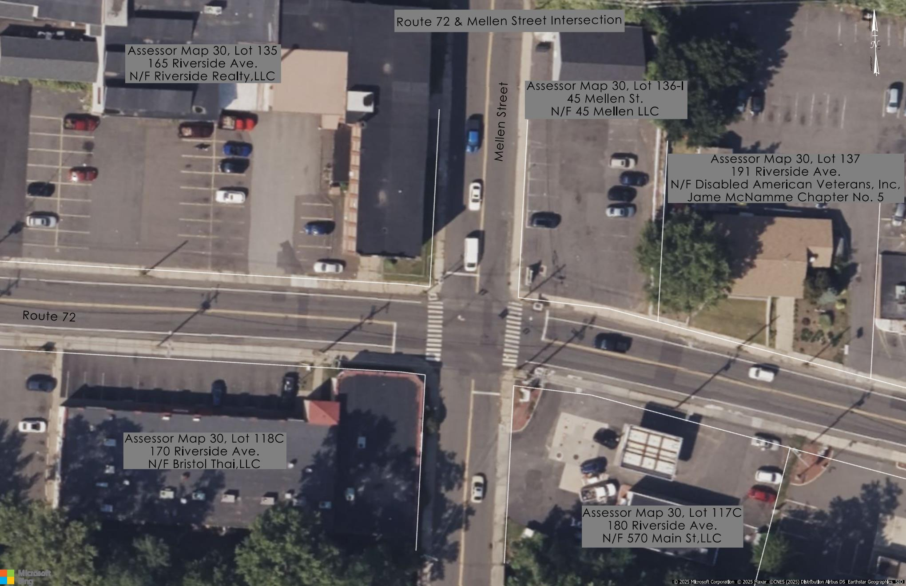

Slide 35
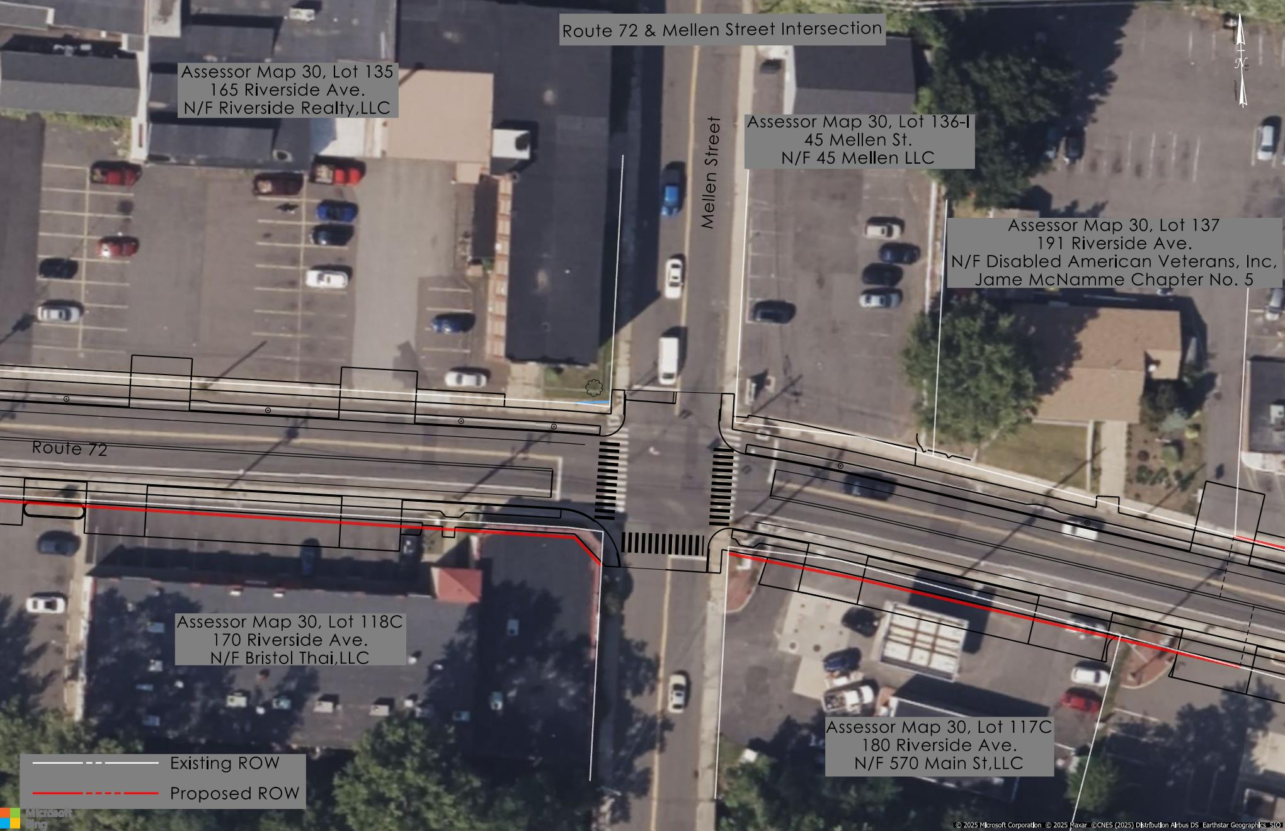

Slide 36
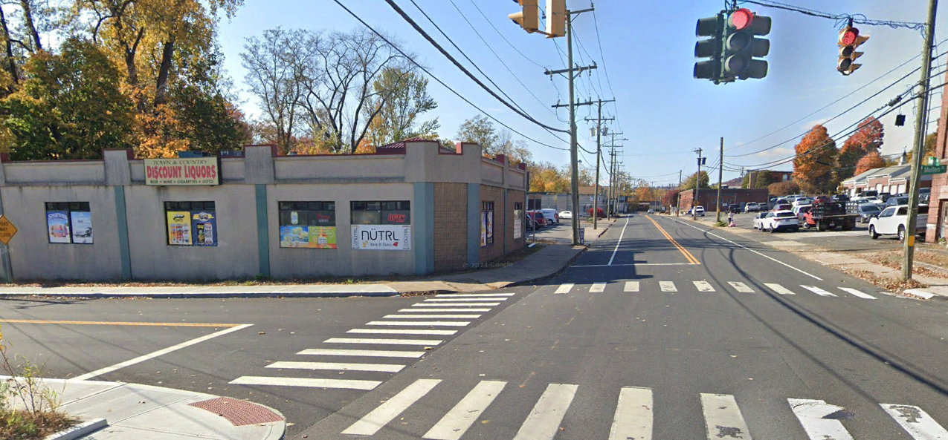

Slide 37
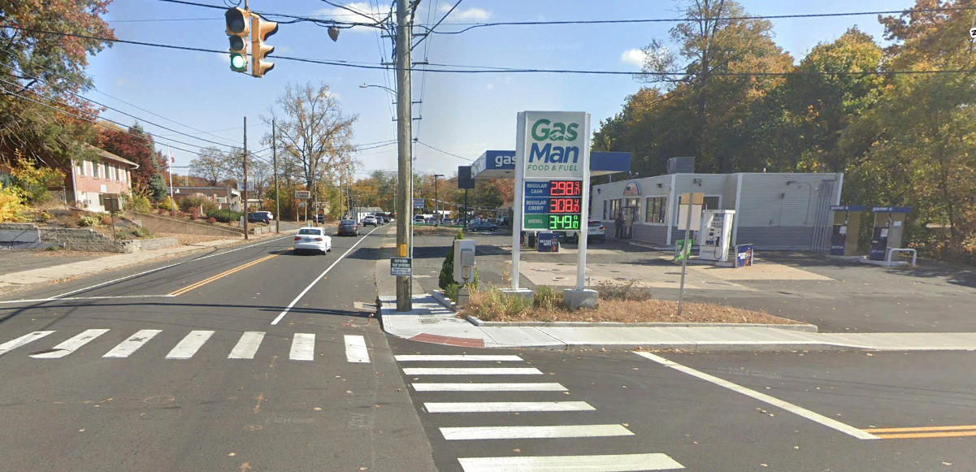

Slide 38
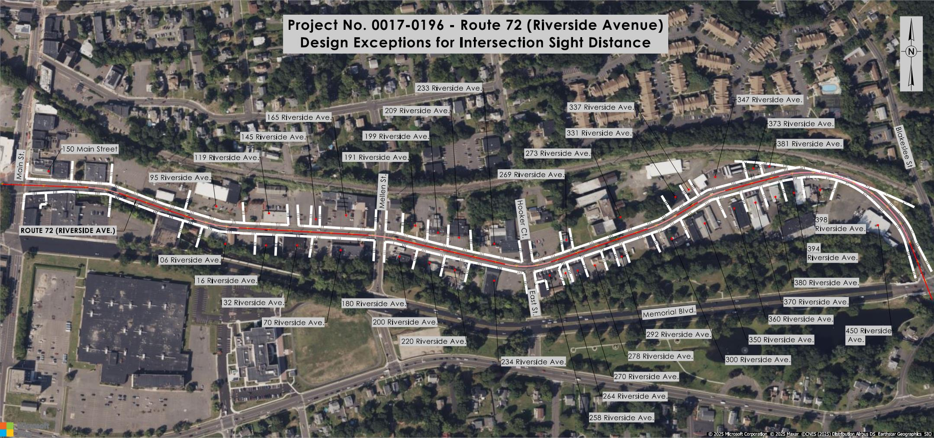
ISD Design Exceptions
Project No. 0017-0196

Slide 39

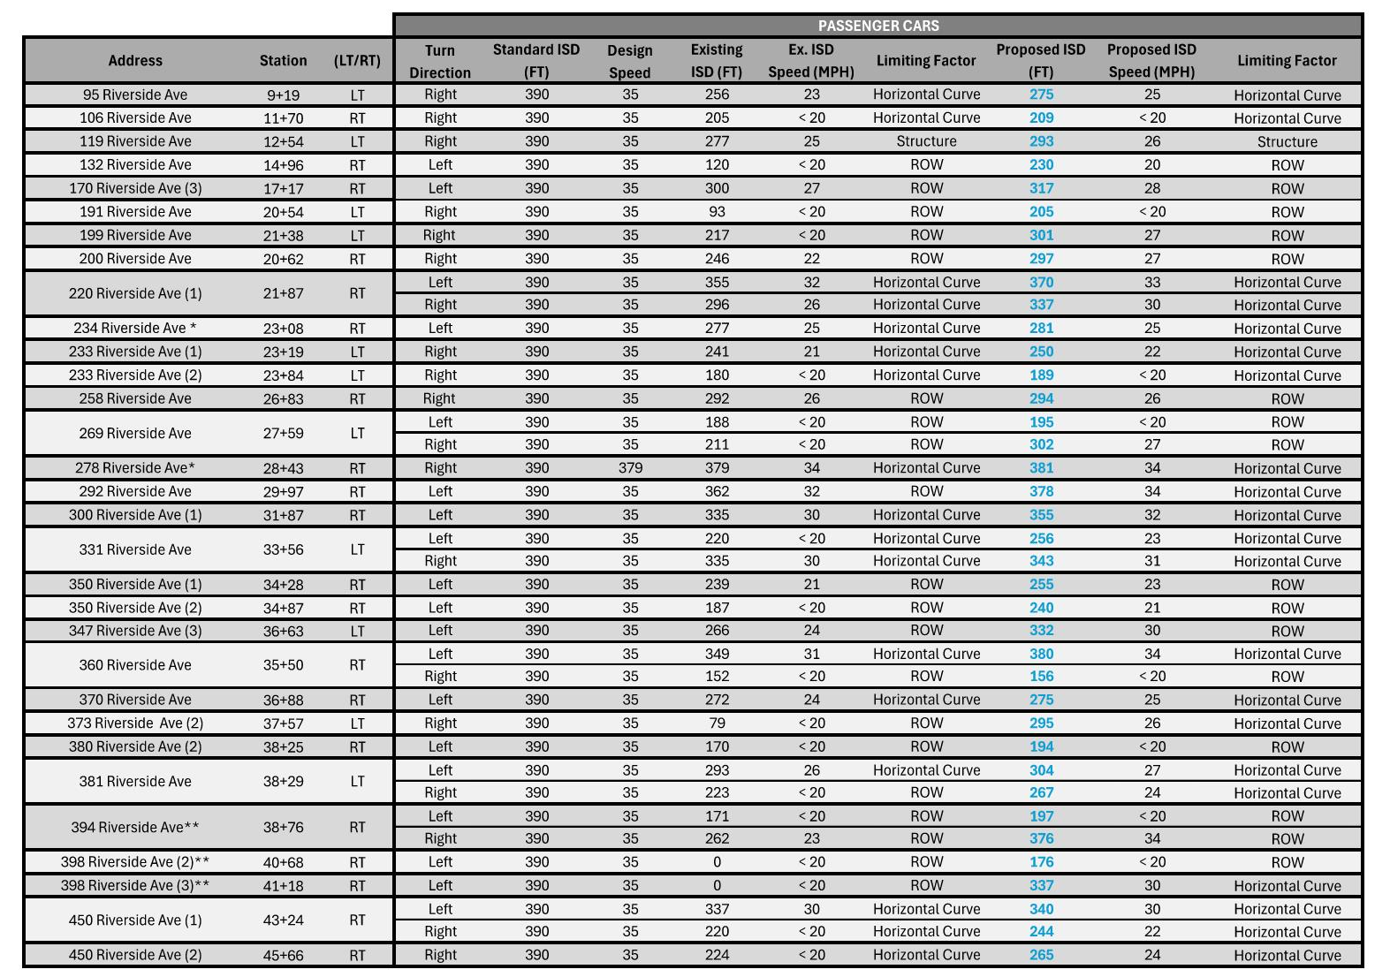
38 Driveway ISDs improved from existing conditions
Project No. 0017-0196

Slide 41
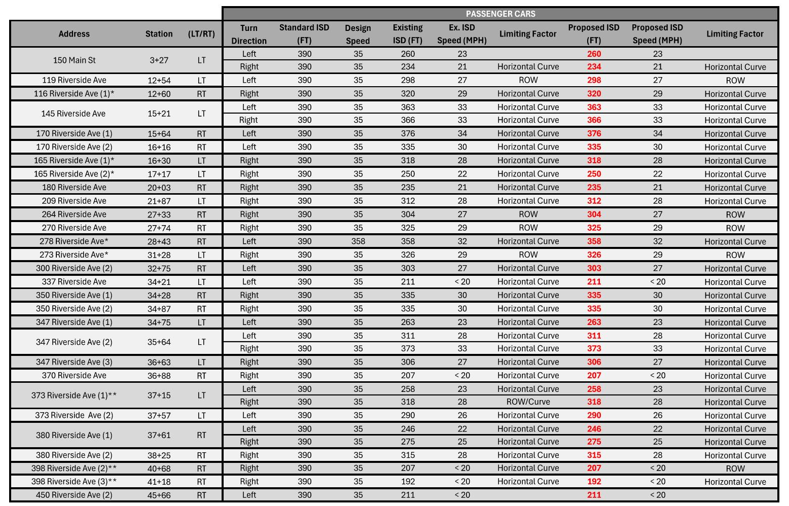
ISD Design Exceptions
34 Driveway ISDs match existing conditions
Project No. 0017-0196

Slide 43
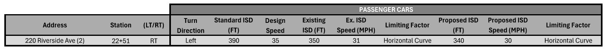
ISD Design Exceptions
1 intersection ISD value decreases from existing conditions
220 Riverside Avenue

Slide 44
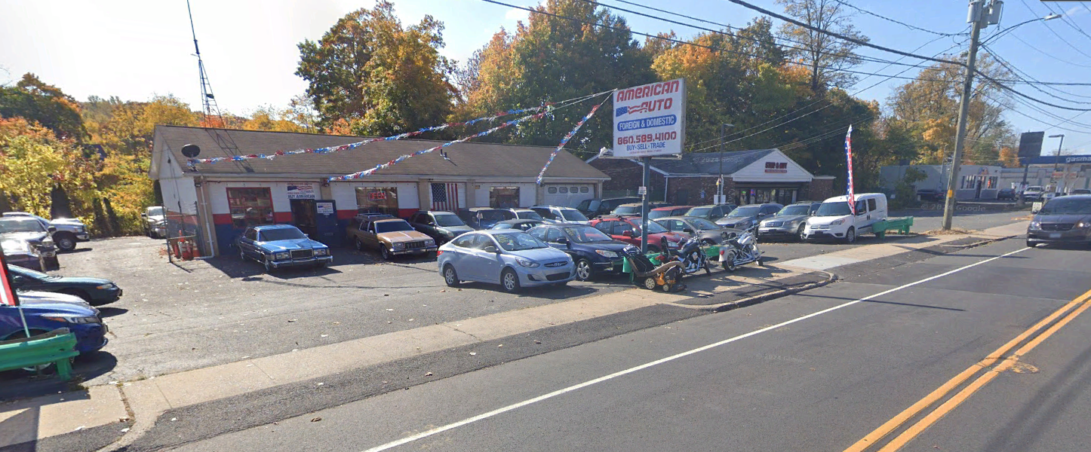
220 Riverside Avenue
Existing Driveway Configuration:
2 Aprons – 33’ & 34’ wide
16’ separation between them

Slide 45
220 Riverside Avenue
Proposed Driveway Configuration:
2 Aprons – 20’ wide
18’ from property line
44’ separation between them

Slide 46
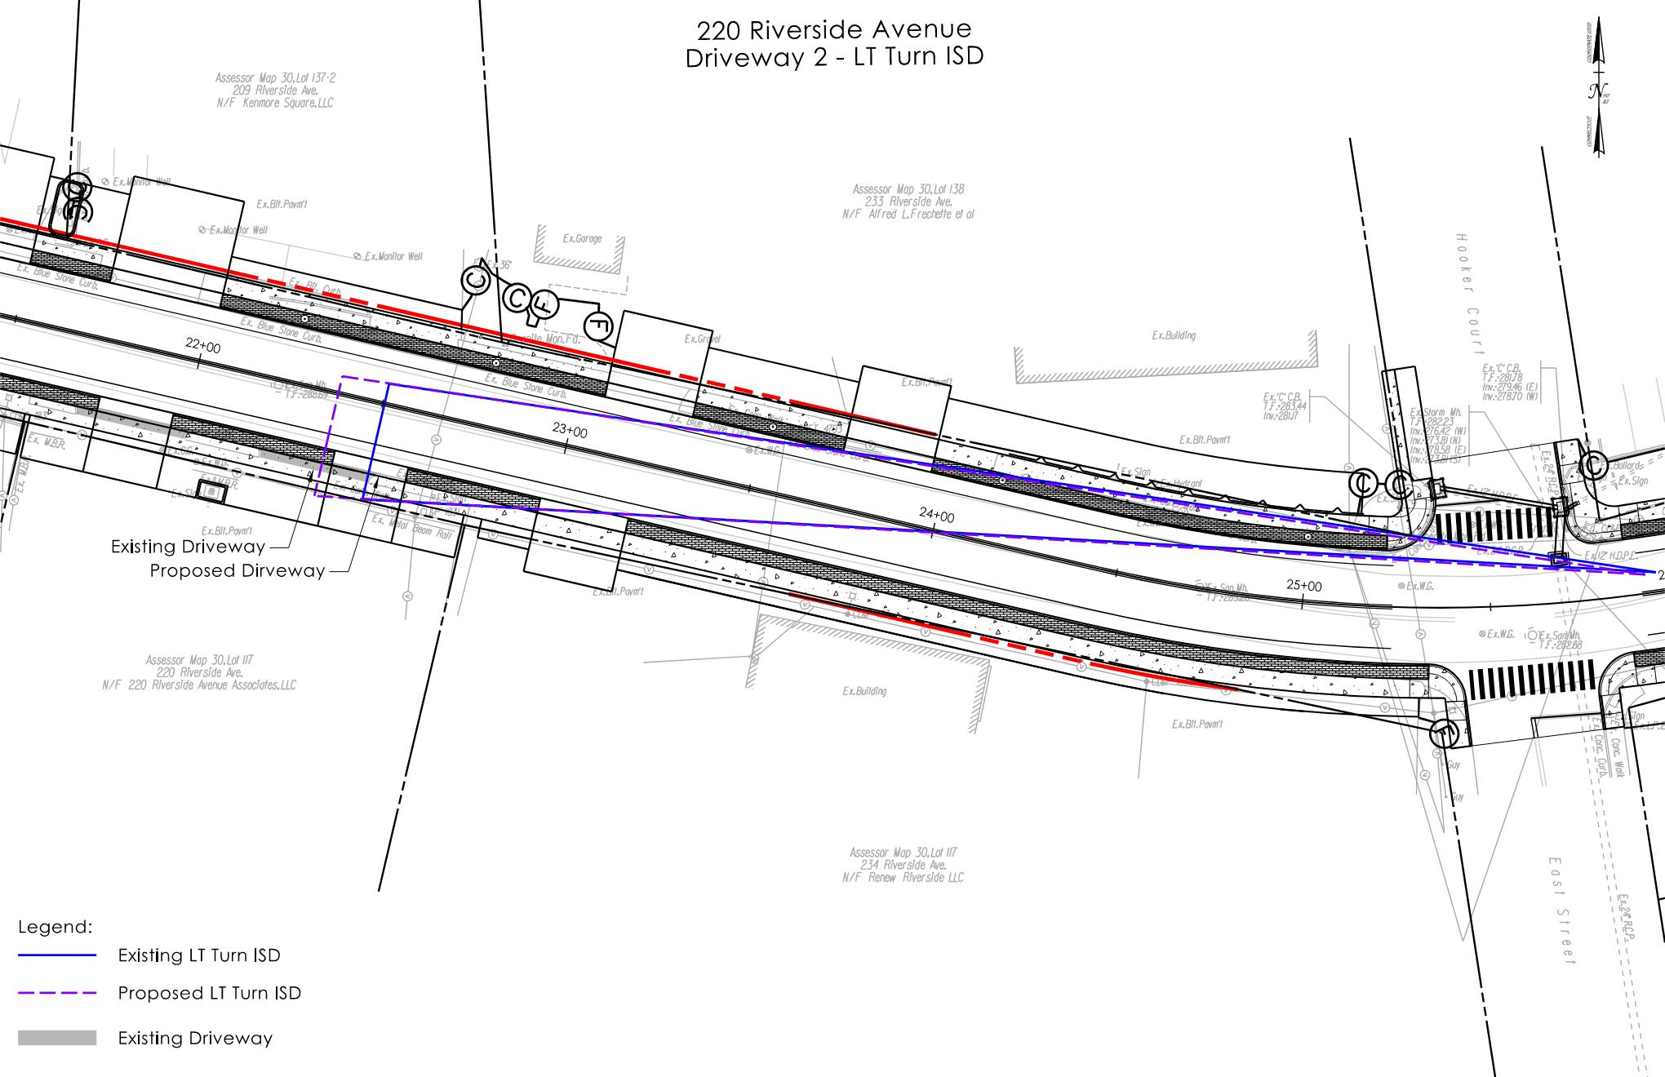

Slide 47
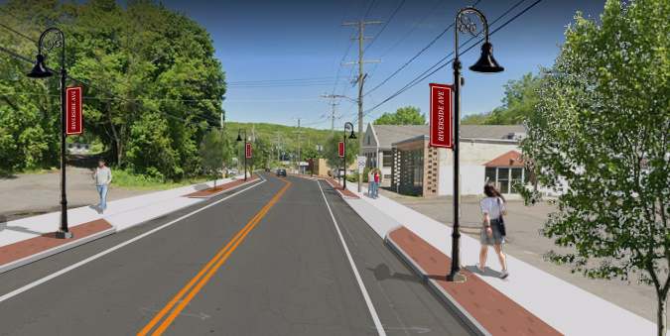
Recommendations
It is recommended that exceptions to design standards for ISDs be granted for this project
Justification:
Proposed Design
Improves existing substandard geometry
Standardizes roadway width
Improves Access Management
All ISD values match or are improved from existing condtion with exception of one location
No adverse effects to businesses along the corridor
Increased Impacts & cost
Property Acquisitions & sightline easements
Realignment of Route 72
Adverse effect to businesses along the corridor
Outside the scope of the project
Project No. 0017-0196

Slide 48
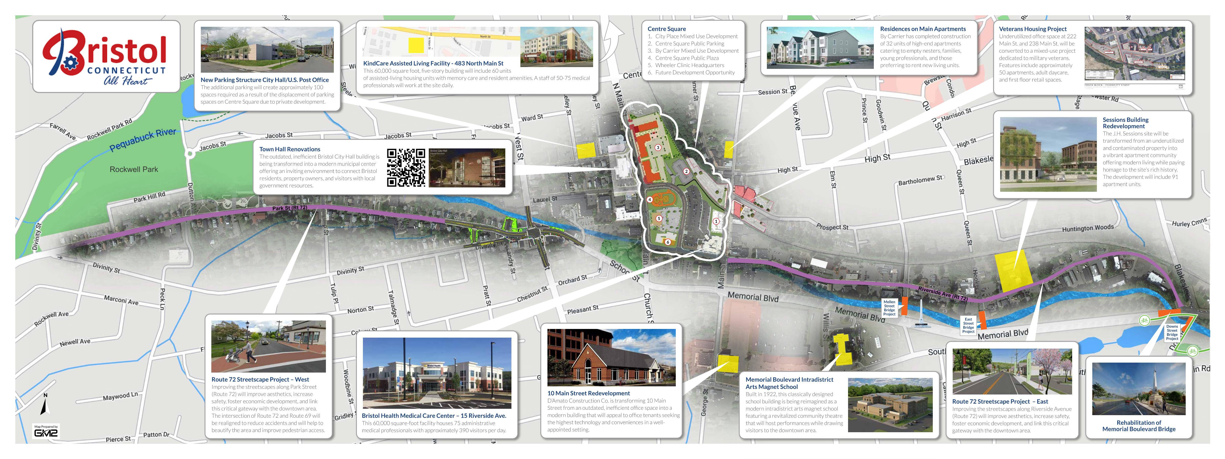
Route 72 Corridor
Project No. 0017-0196

Slide 49
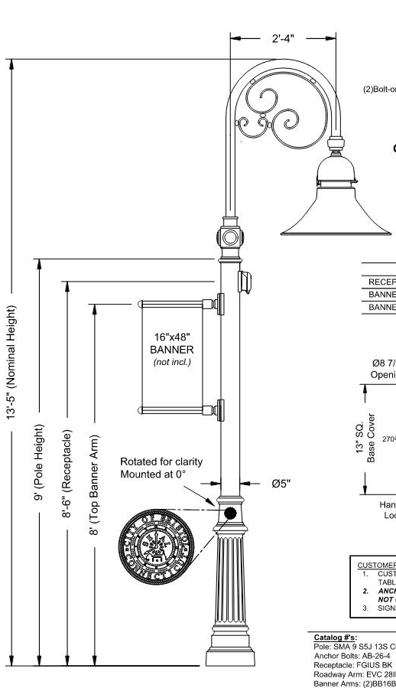
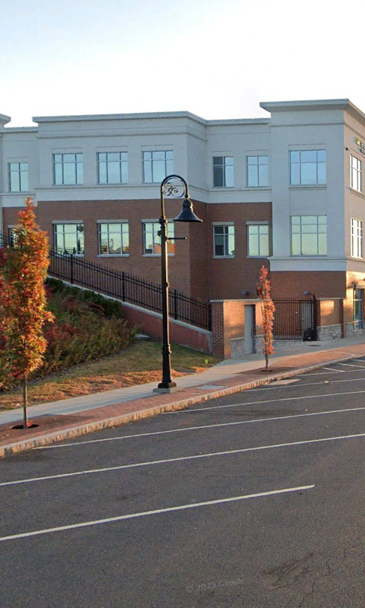
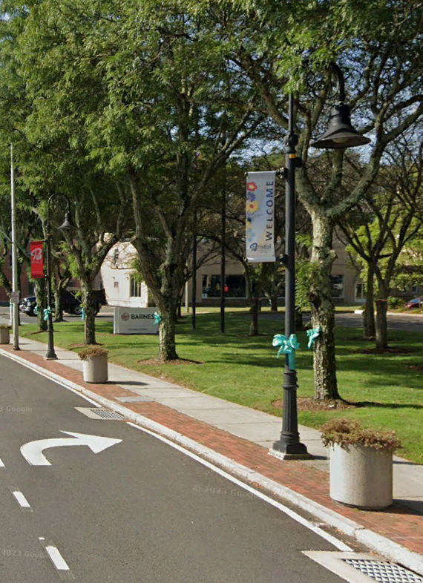
Proposed Improvements
Project No. 0017-0196

Slide 50
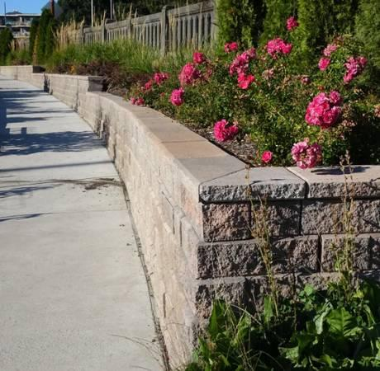
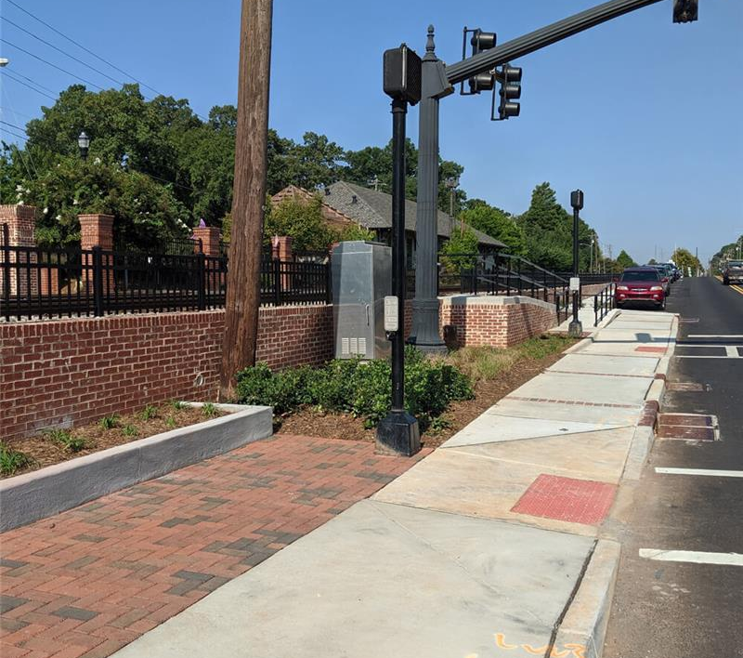
Proposed Improvements
Project No. 0017-0196

Slide 51
Bicycle Facilities
Bicycle Facilities are not Proposed under Project 0017-0196
Bristol partnered with Naugatuck Valley Council of Governments to conduct a study of potential downtown routing options to provide a safe, continuous connection between Rockwell Park in the west to Downtown, continuing east to Route 229.
Pequabuck River Trail Project will provide bike and pedestrian access from Rockwell Park to Memorial Boulevard and from Memorial Boulevard to Middle Street Trail.
Project No. 0017-0196

Slide 52
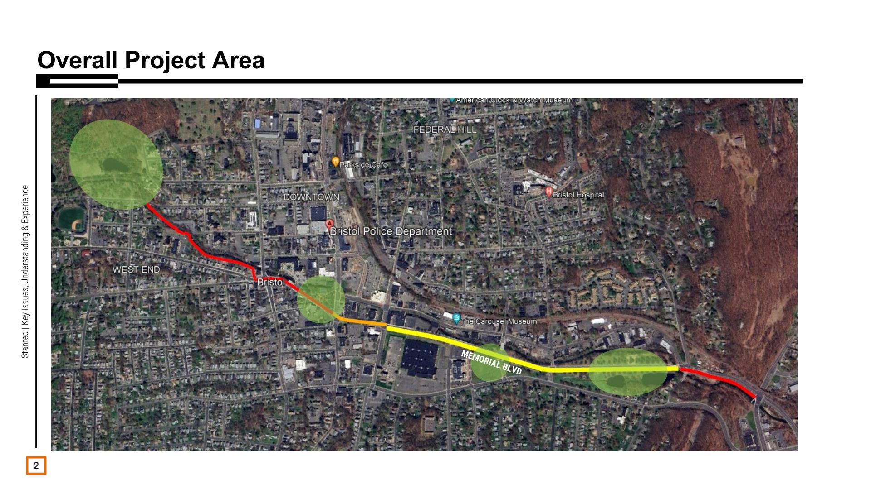
Project No. 0017-0196
Project No. 0017-0196

