Slide 1
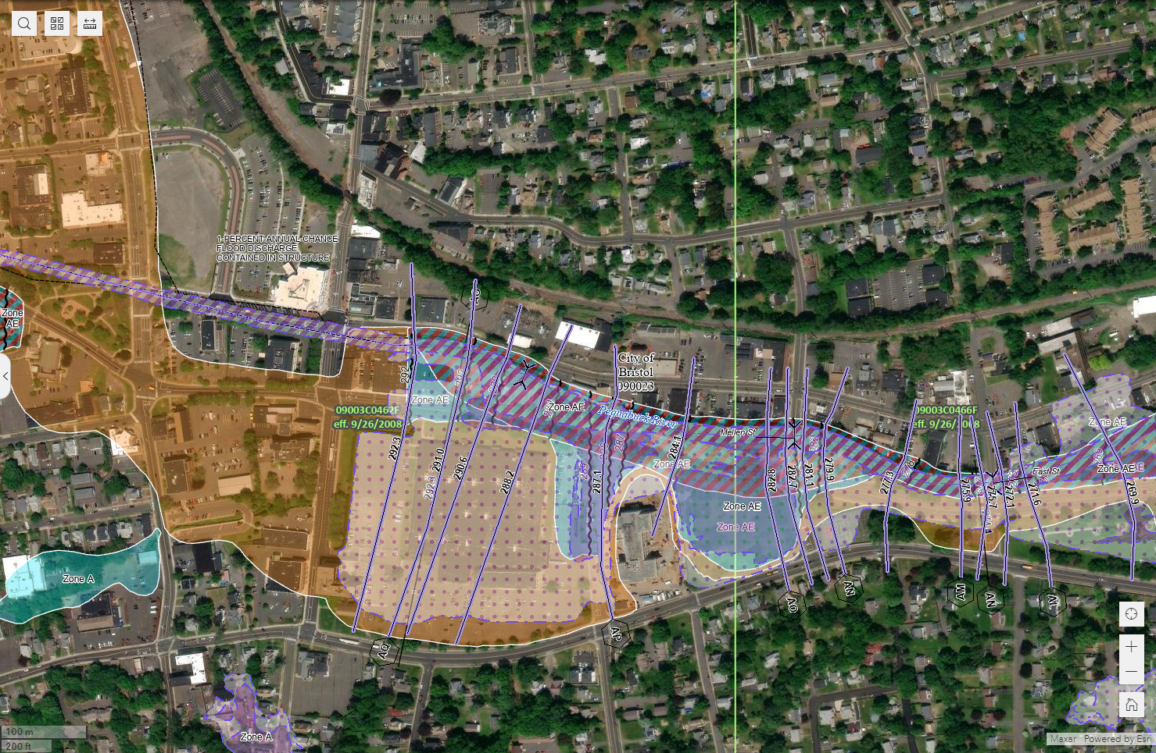

Slide 2
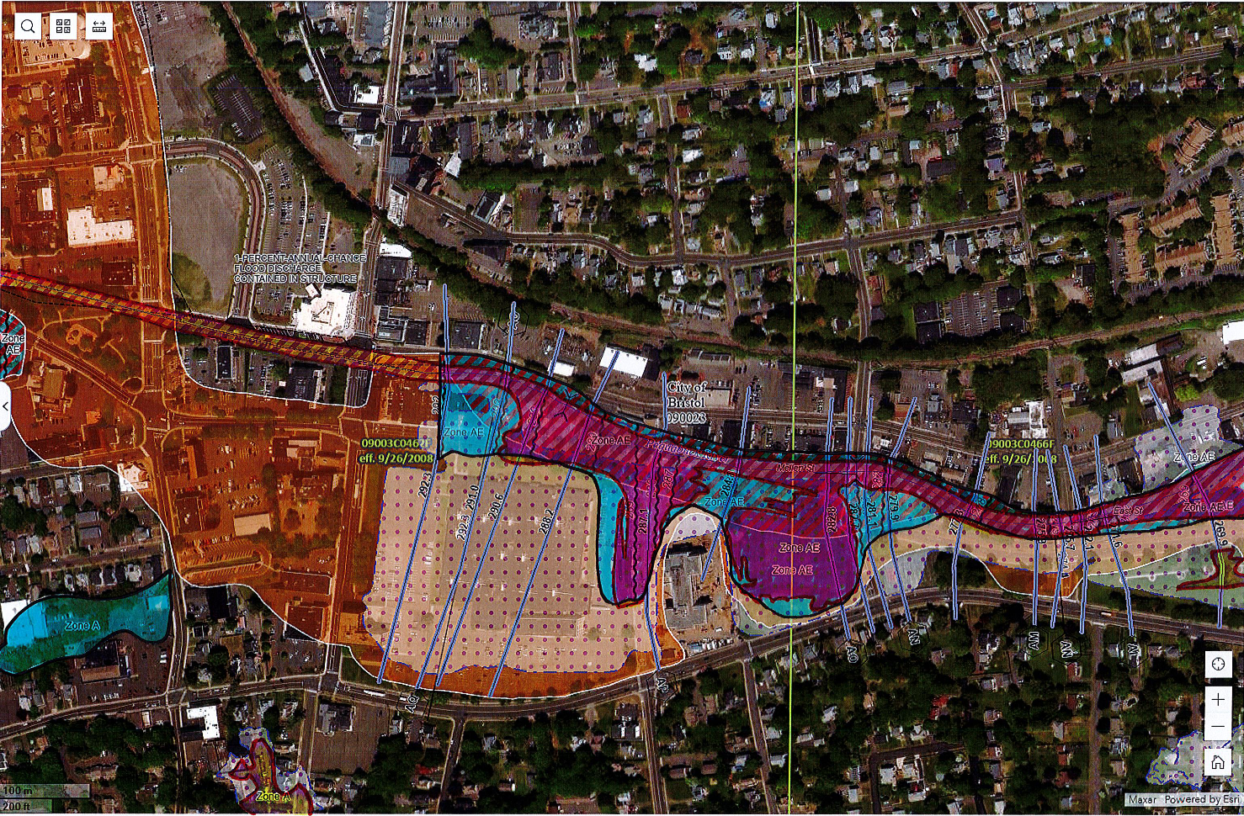
YELLOW: INCREASED FLOODPLAIN
RED: PROPOSED FLOODPLAIN
OVERLAPPING WITH OLD
BLUE: REDUCED FLOODPLAIN
REDUCE “ZONE A”
INCREASE “ZONE A”

Slide 3
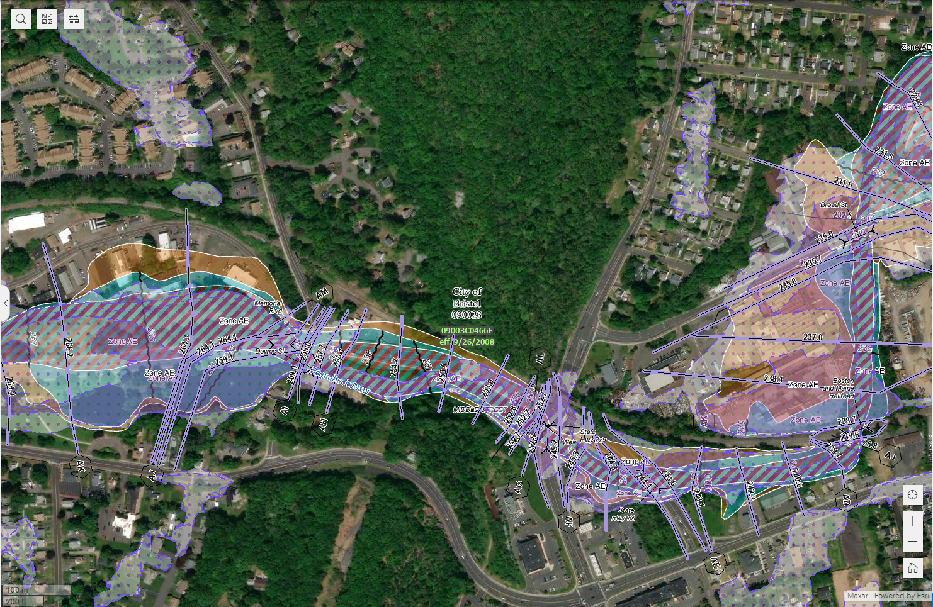

Slide 4
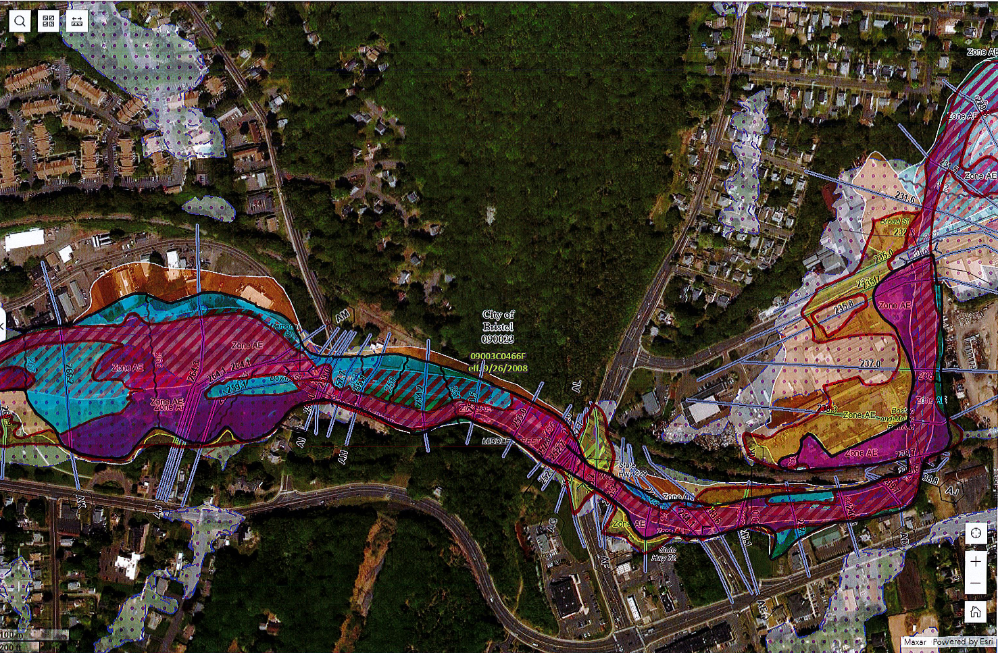
YELLOW: INCREASED FLOODPLAIN
RED: PROPOSED FLOODPLAIN
OVERLAPPING WITH OLD
BLUE: REDUCED FLOODPLAIN

Slide 5
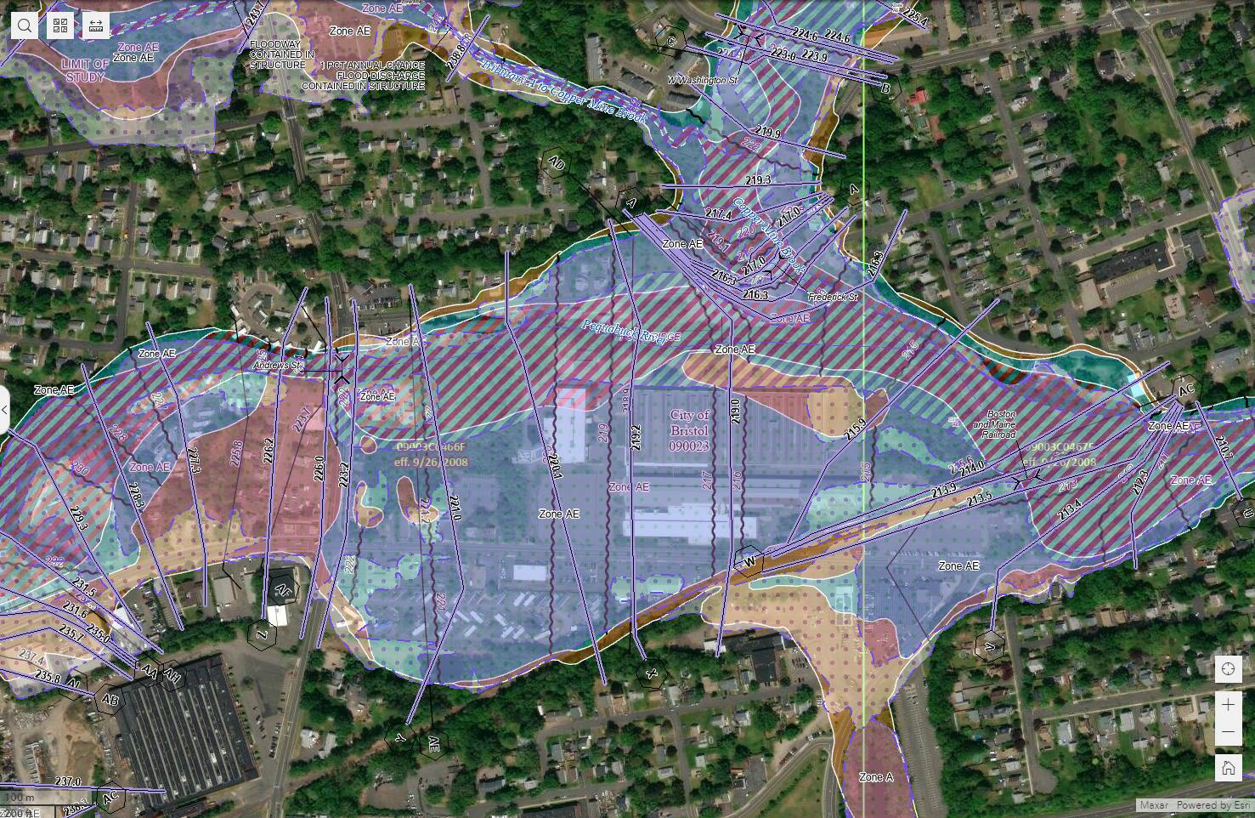

Slide 6
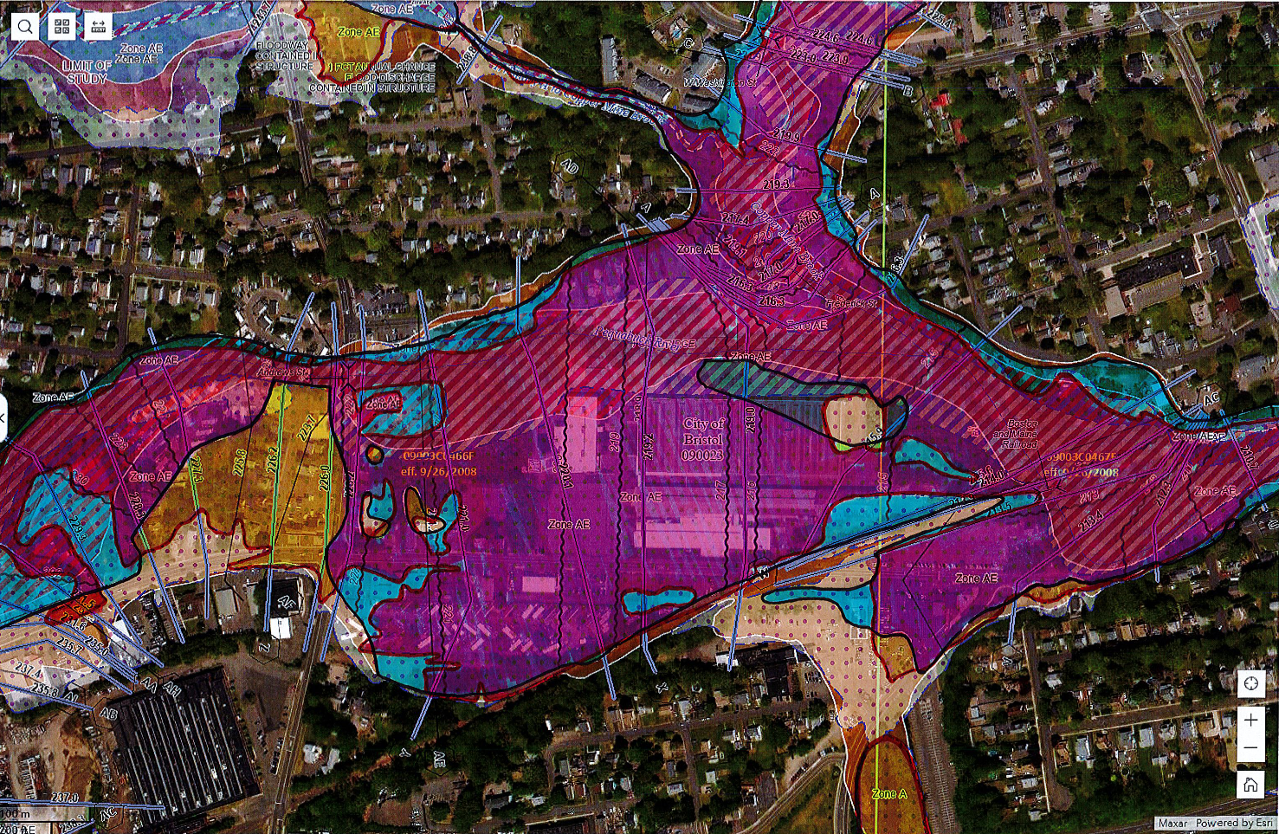
RED: PROPOSED FLOODPLAIN
OVERLAPPING WITH OLD
YELLOW: INCREASED FLOODPLAIN
BLUE: REDUCED FLOODPLAIN
INCREASE “ZONE A”

Slide 7
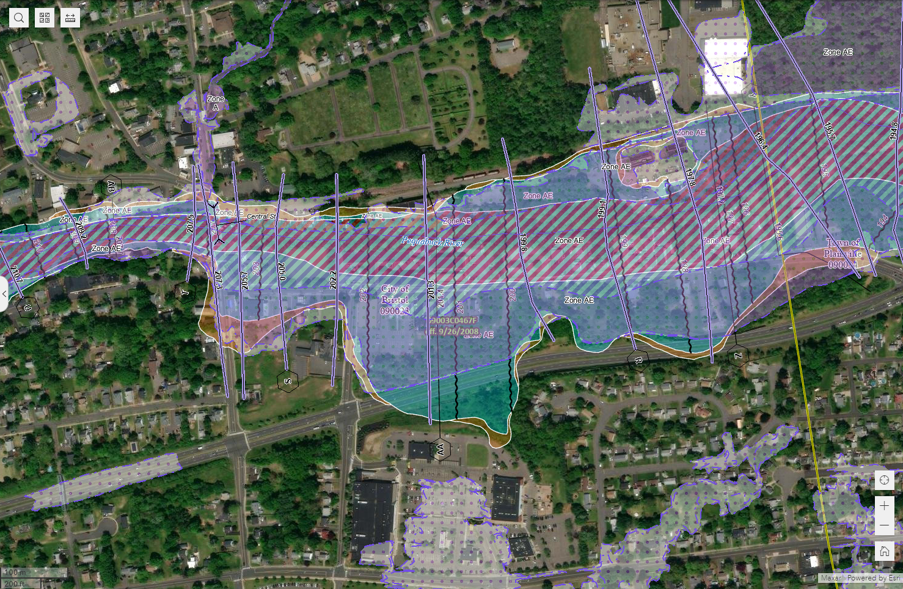

Slide 8
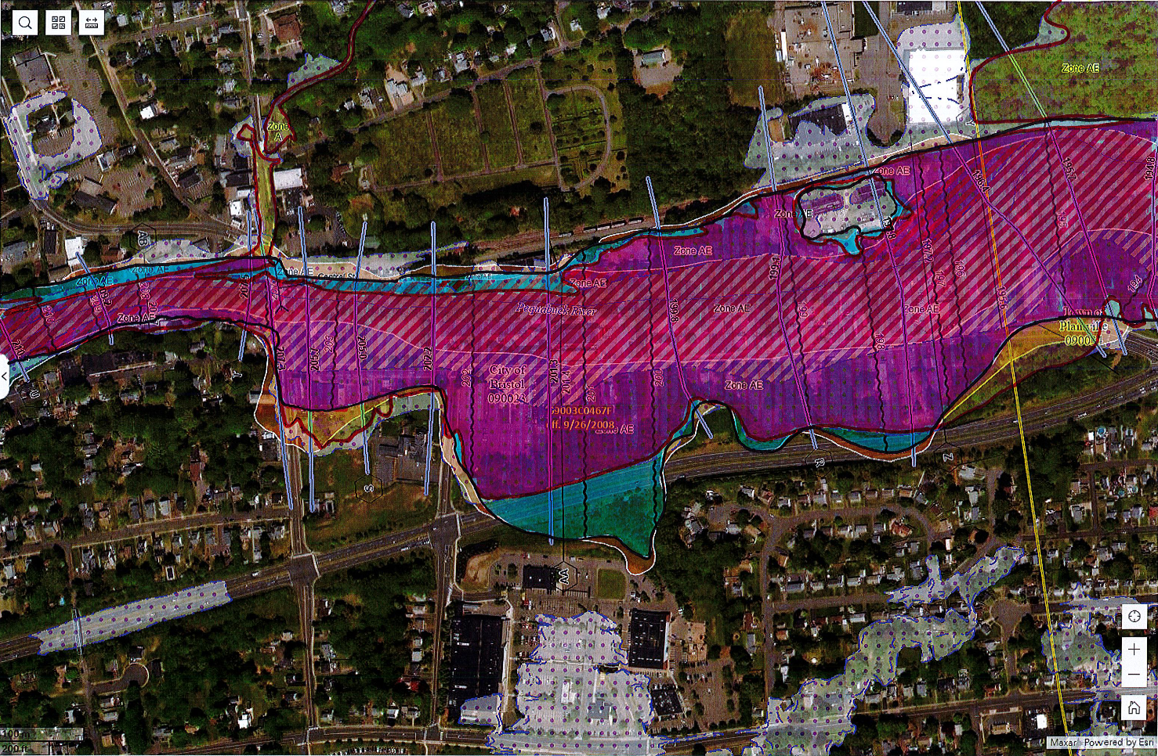
INCREASE “ZONE A”
YELLOW: INCREASED FLOODPLAIN
RED: PROPOSED FLOODPLAIN
OVERLAPPING WITH OLD
BLUE: REDUCED FLOODPLAIN

