Slide 1

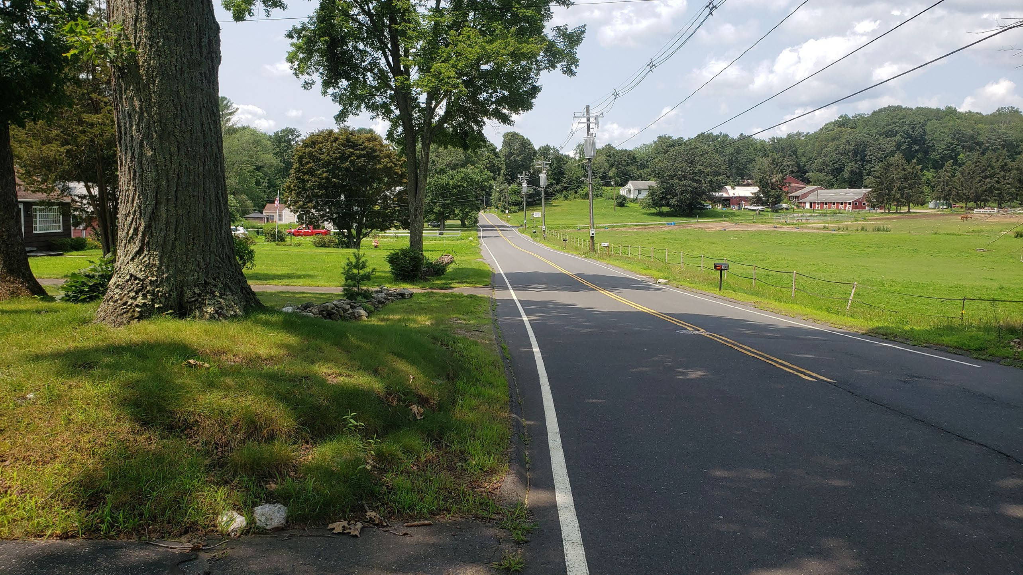

Installation of Sidewalks at Shrub Road
Public Information Meeting
July 14, 2022

Slide 2
Project Overview
Installation of approximately 5,200 feet of 5’ Concrete Sidewalk along North Side of Shrub Road and East Side of Jerome Avenue
Prefabricated Pedestrian Bridge at Freeman Hill Brook
  42’ – 6” Span
  10’ Width
  Precast Concrete Stub Abutments
Modular Retaining Walls
Driveway Reconstructions
  Provide positive drainage

Slide 3
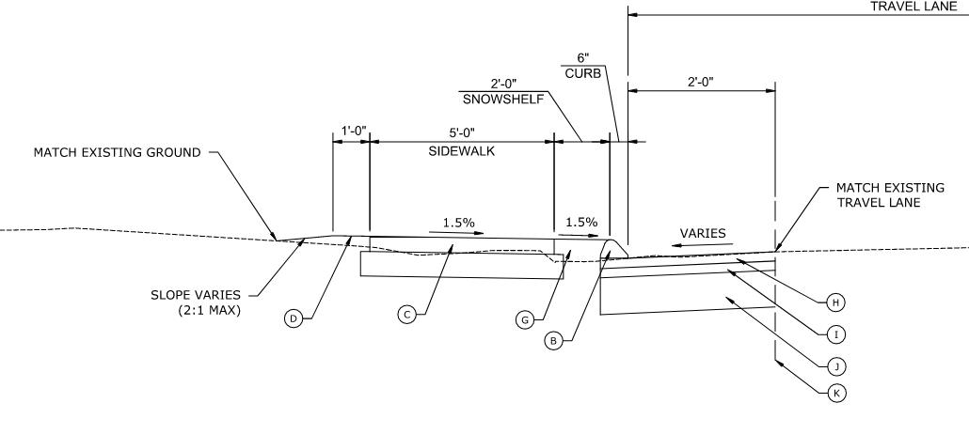
Typical Section Along Shrub Road

Slide 4
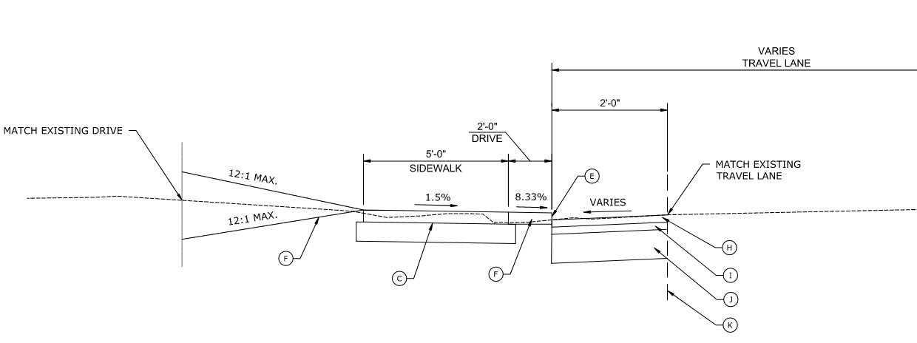
Typical Section at Driveway

Slide 5
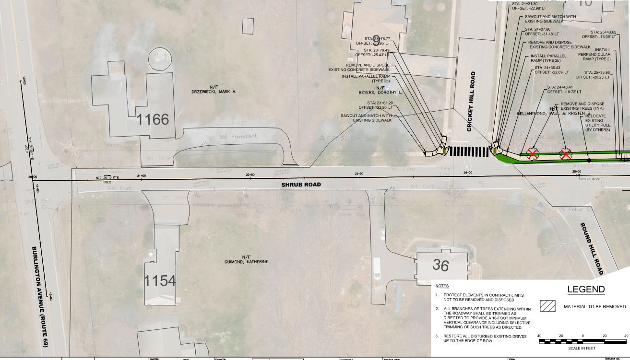
Sidewalk Plan-1

Slide 6
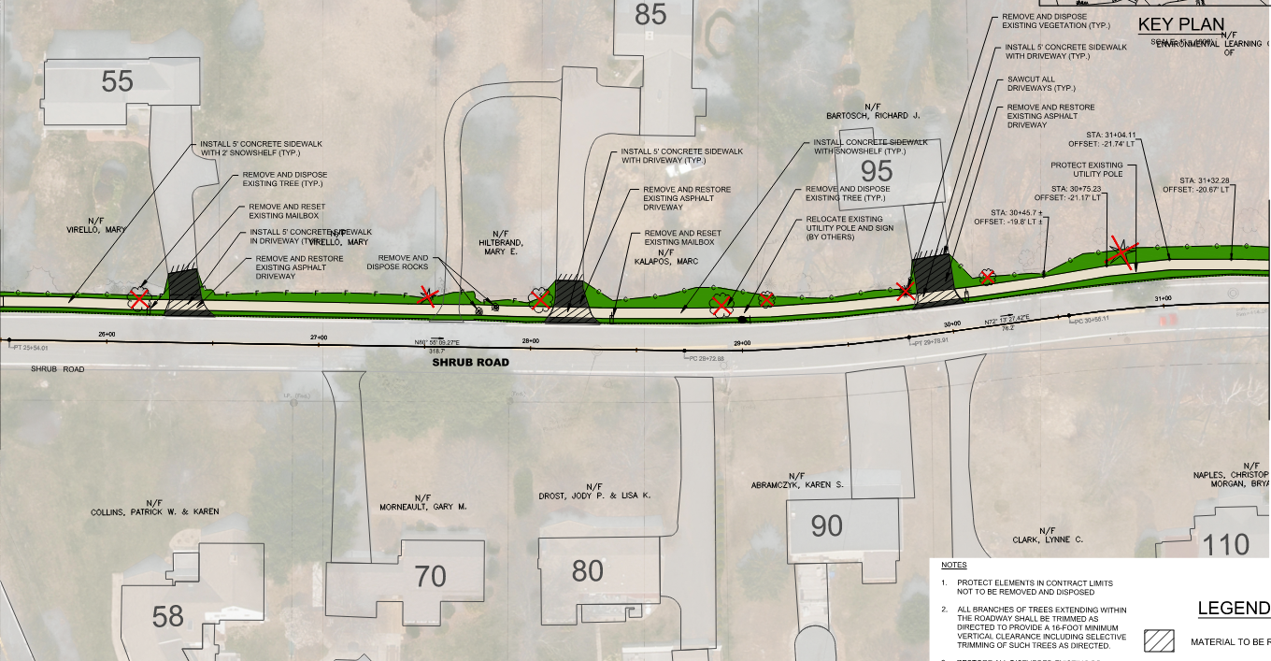
Sidewalk Plan – 2

Slide 7
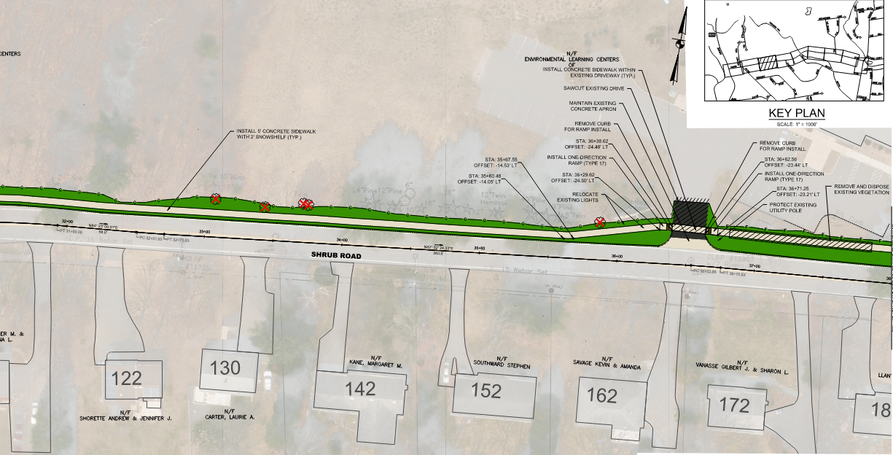
Sidewalk Plan - 3

Slide 8
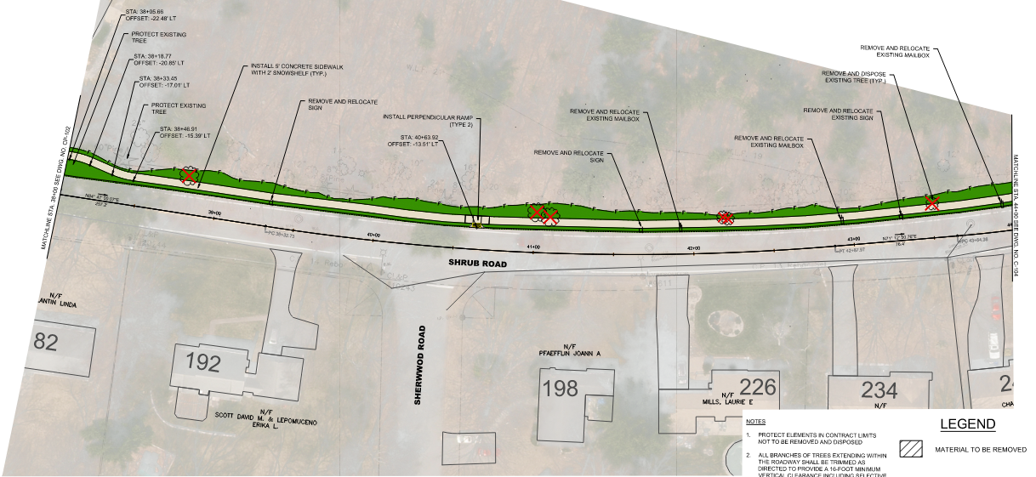
Sidewalk Plan - 4

Slide 9
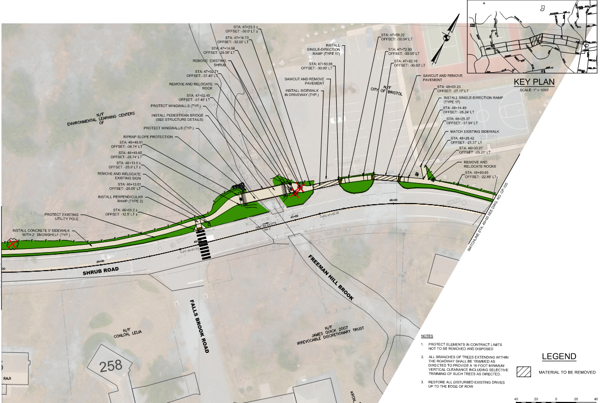
Sidewalk Plan - 5

Slide 10
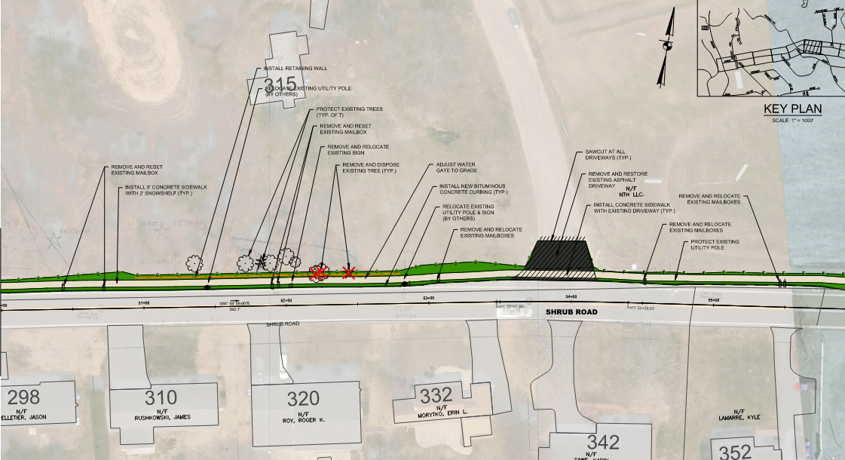
Sidewalk Plan - 6

Slide 11
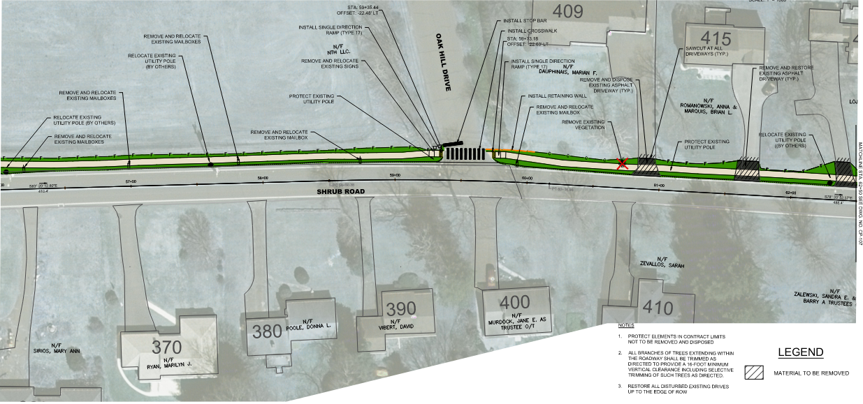
Sidewalk Plan - 7

Slide 12
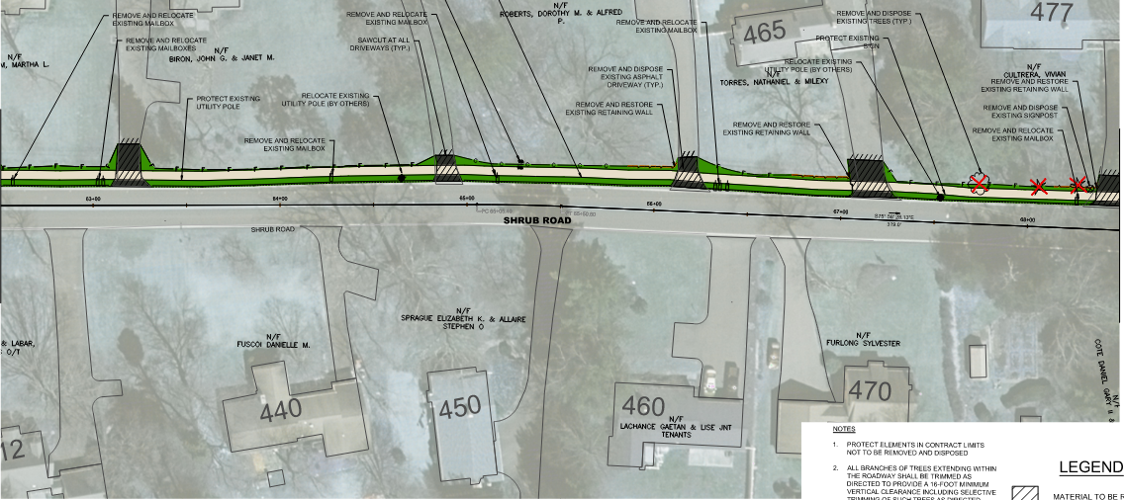
Sidewalk Plan - 8

Slide 13
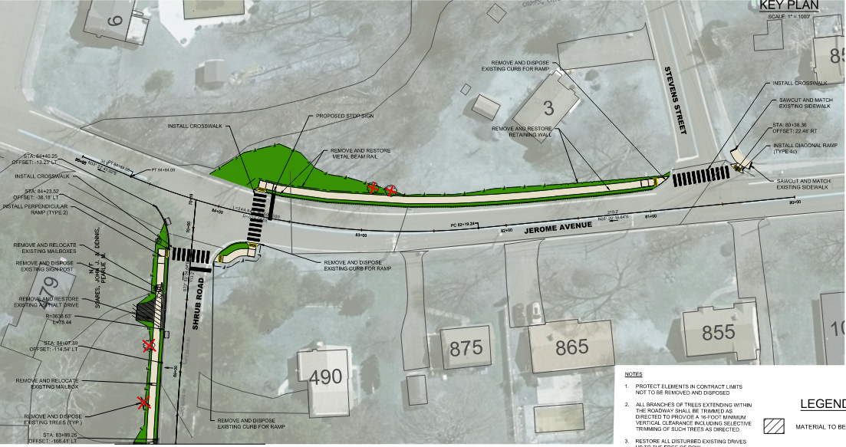
Sidewalk Plan - 9

Slide 14
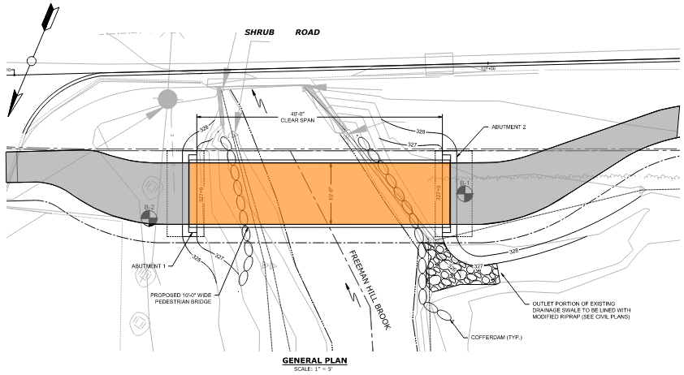
Pedestrian Bridge – General Plan

Slide 15
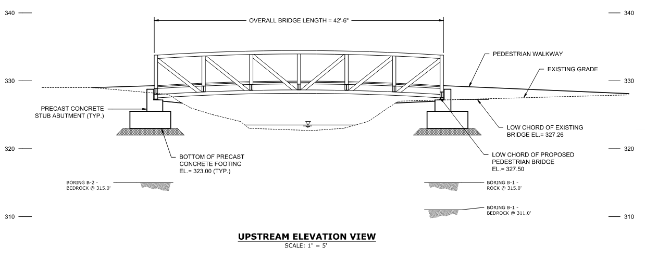
Pedestrian Bridge – Elevation

Slide 16
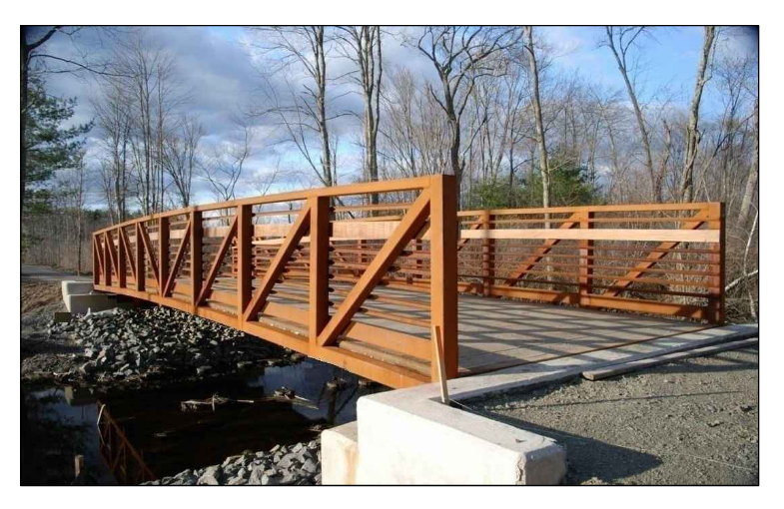
Pedestrian Bridge – Sample

Slide 17
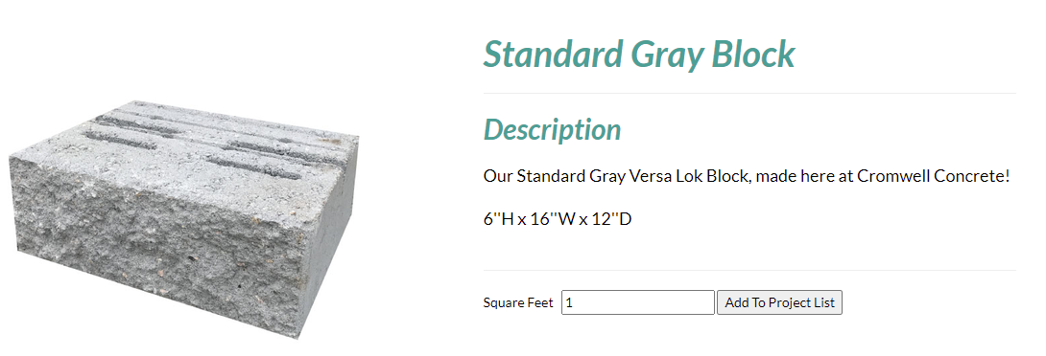
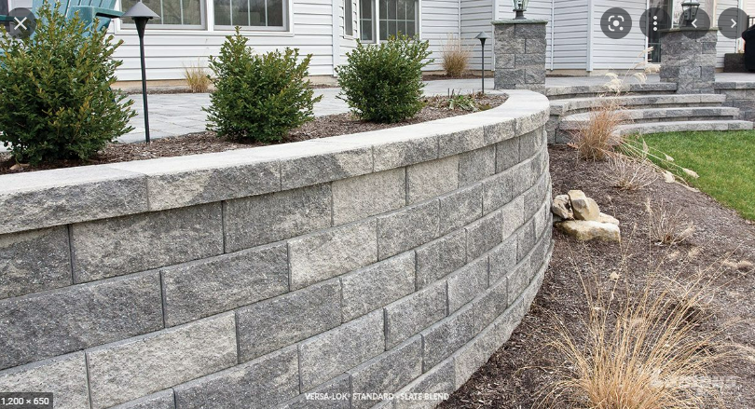
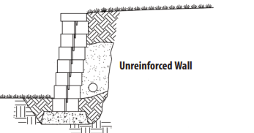
Retaining Walls – Versa Block

Slide 18
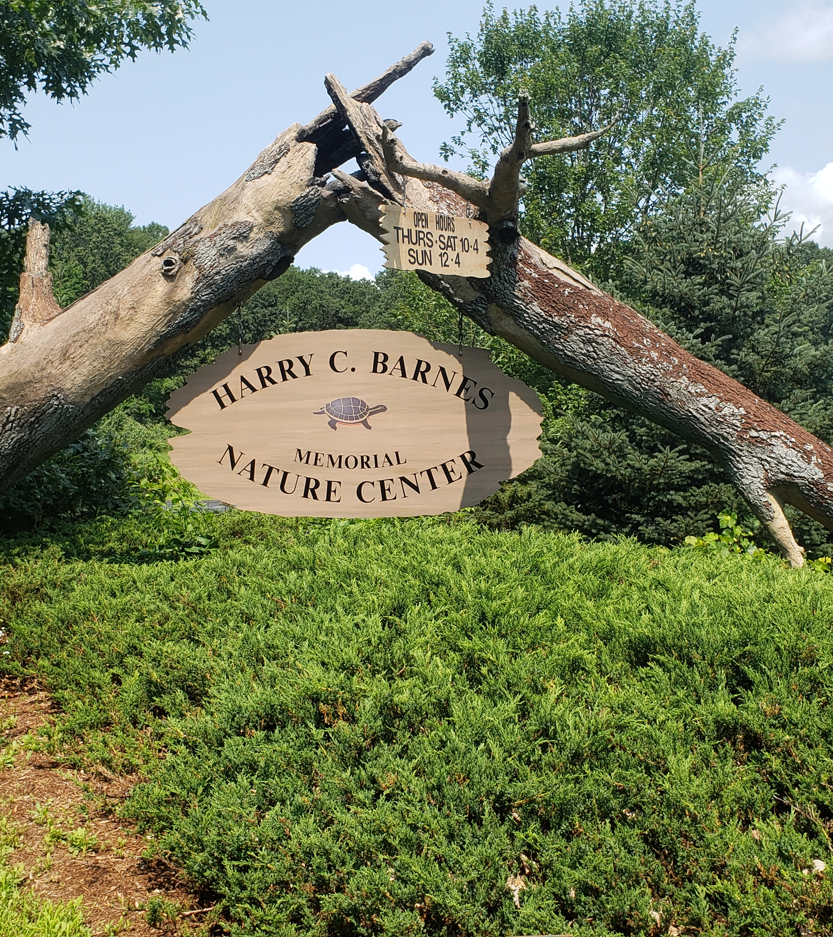
THANK YOU!

