Slide 1
Reconstruction of Wolcott Street
Public Informational Meeting
September 15, 2021

Slide 2
Presentation Outline
Introductions
Project Location
Purpose and Need of Project
Proposed Improvements
Right of Way (ROW)
Project Costs
Project Schedule
Q&A

Slide 3
Introductions

Slide 4


City of Bristol
Raymond Rogozinski, PE
Director of Public Works
Nancy Levesque, PE
City Engineer
Jason Morrocco
Project Manager

Slide 5

AI Engineers
Erik Jarboe, PE
Project Manager
DJ Logan, PE
Designer

Slide 6
Project Location

Slide 7
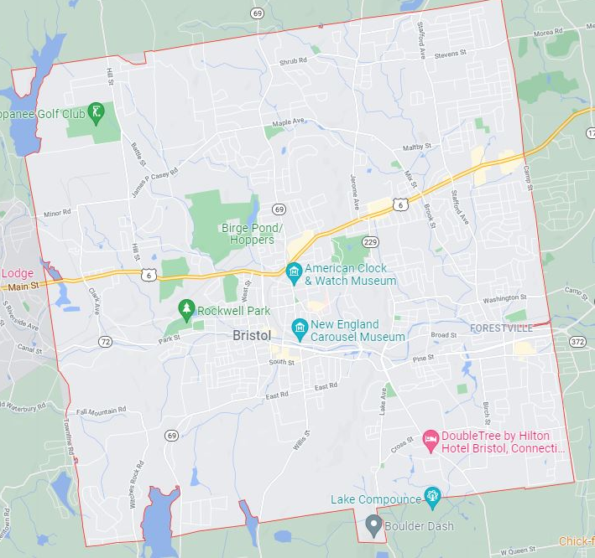
Project Location

Slide 8
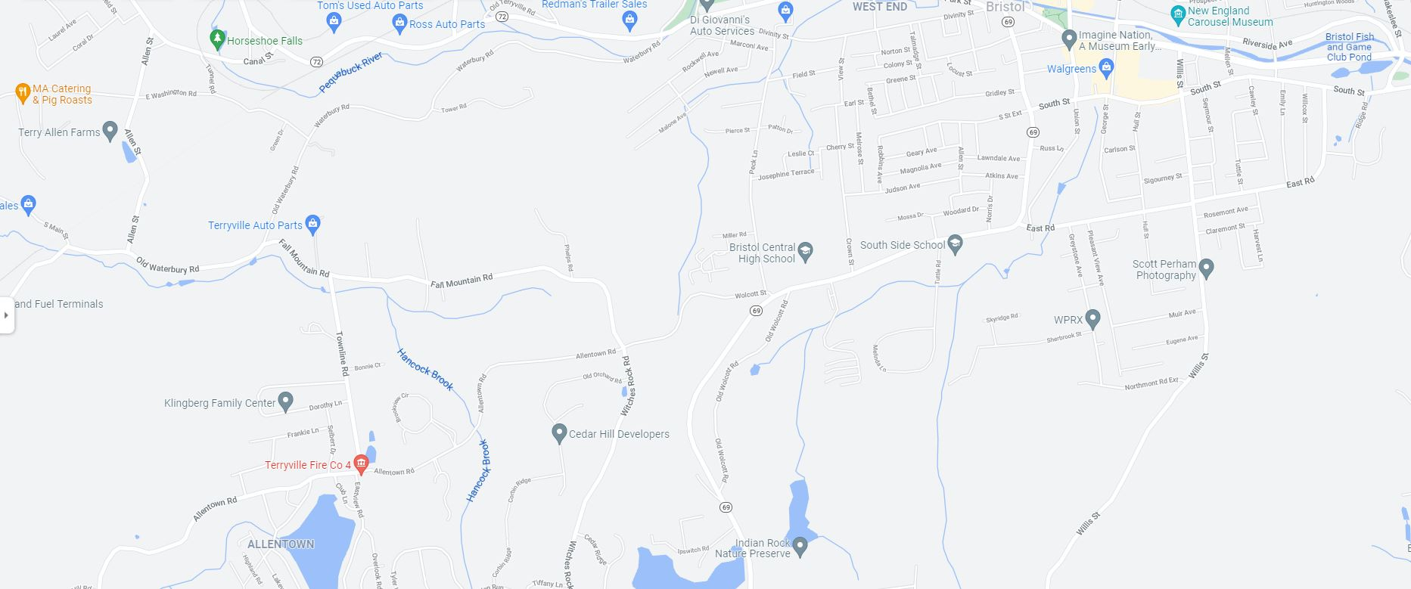
AI Engineers

Slide 9
Purpose & Need

Slide 10
Purpose & Need
Improve Safety
Reconstruct failed pavement structure
Upgrade Roadway Drainage
Construct Sidewalk
Rehabilitate existing culvert

Slide 11
Purpose & Need
Improve Safety
14 Reported Crashes from March 2018 – March 2021
2 Resulted in Personal Injury
1 Resulted in a Fatality

Slide 12
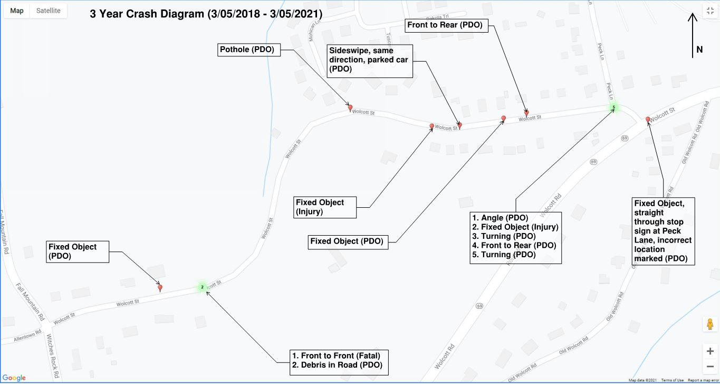

Slide 13
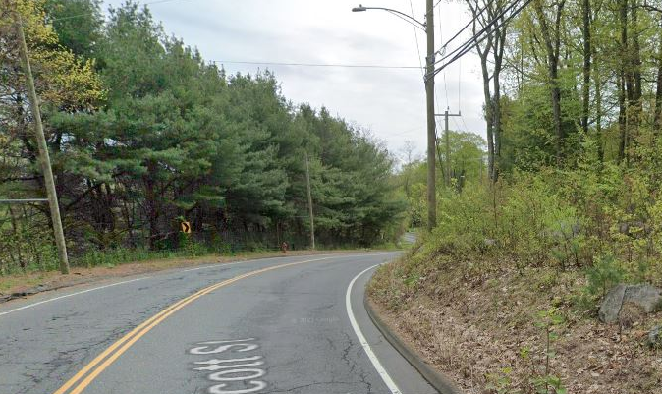
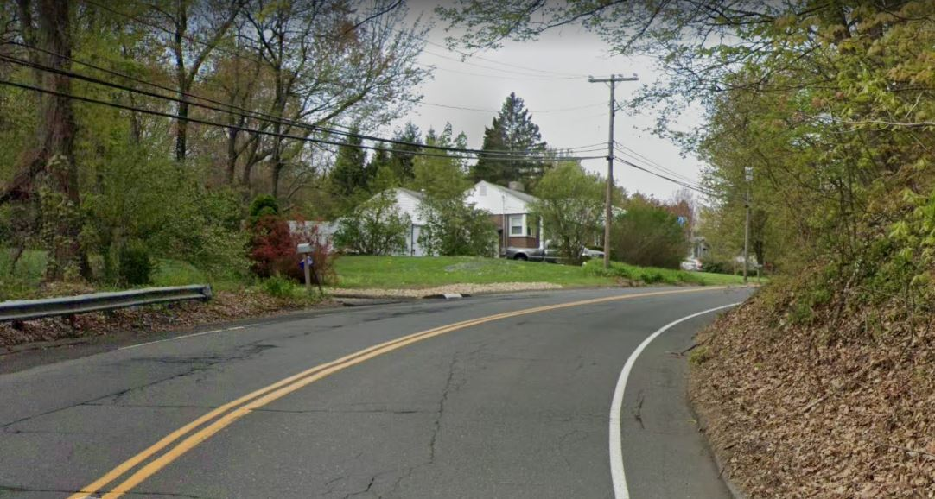
Purpose & Need
Improve Safety
Substandard Horizontal Curves
Substandard Sight Distance

Slide 14
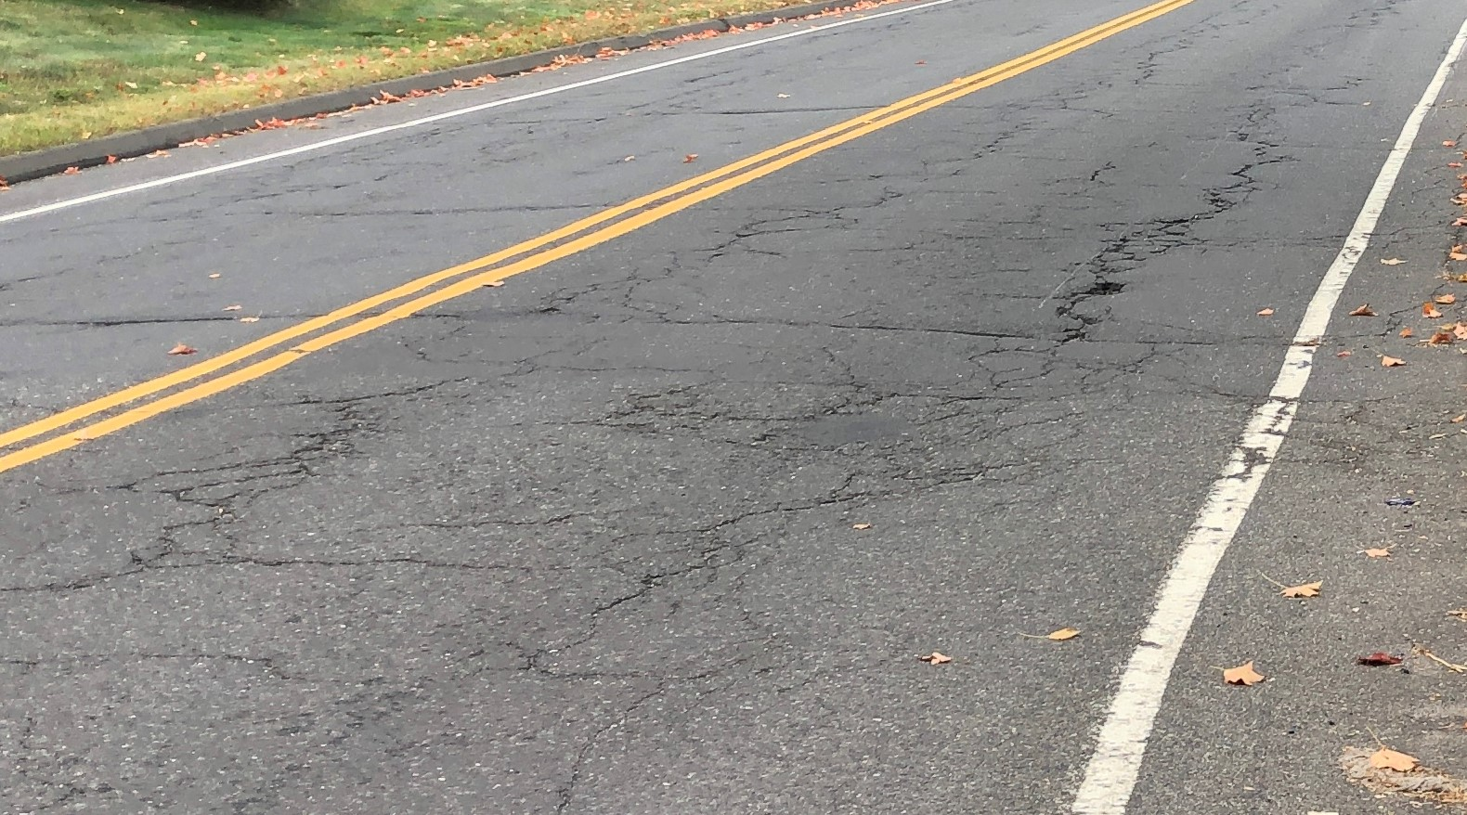
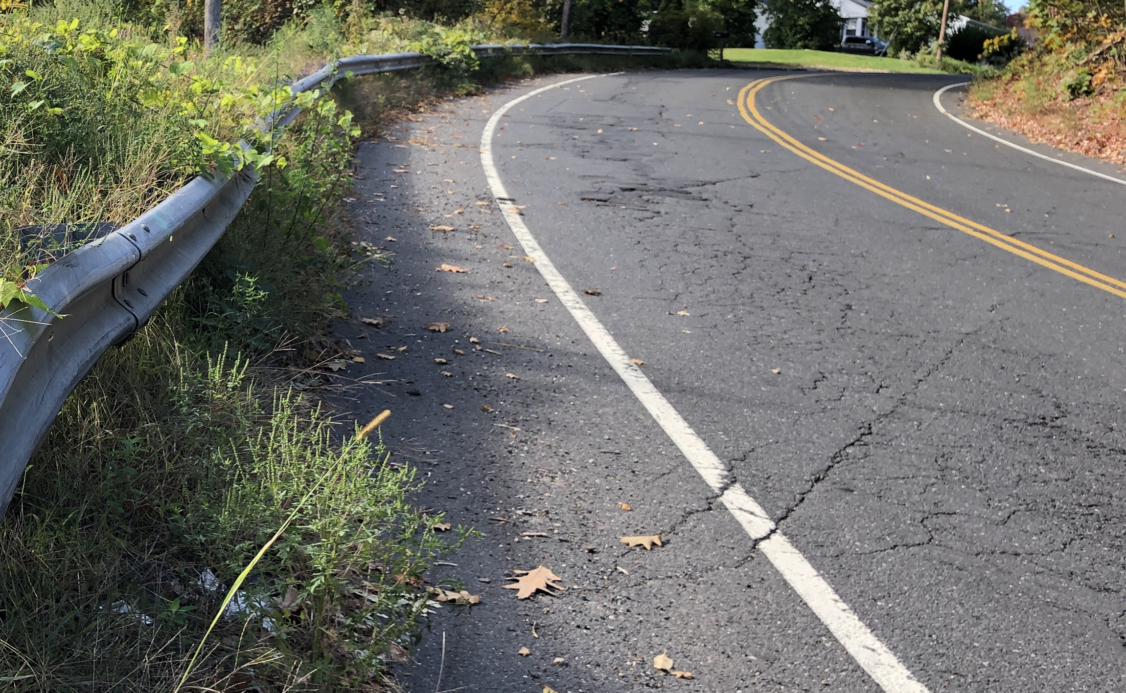
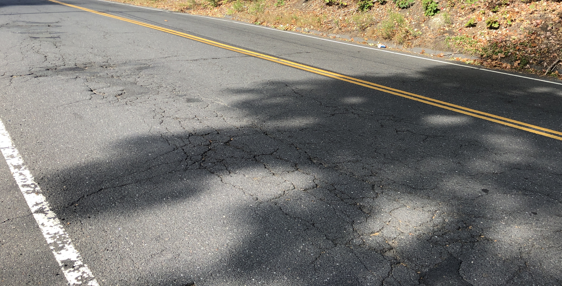
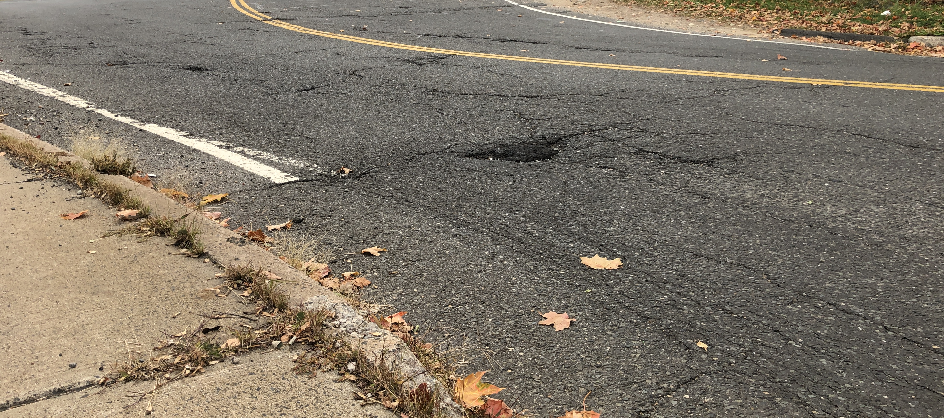
Purpose & Need
Reconstruct Failed Pavement Structure
Wheel Path Failure
Transverse Cracking
Longitudinal Cracking
Alligator Cracking
Saturated Subbase

Slide 15
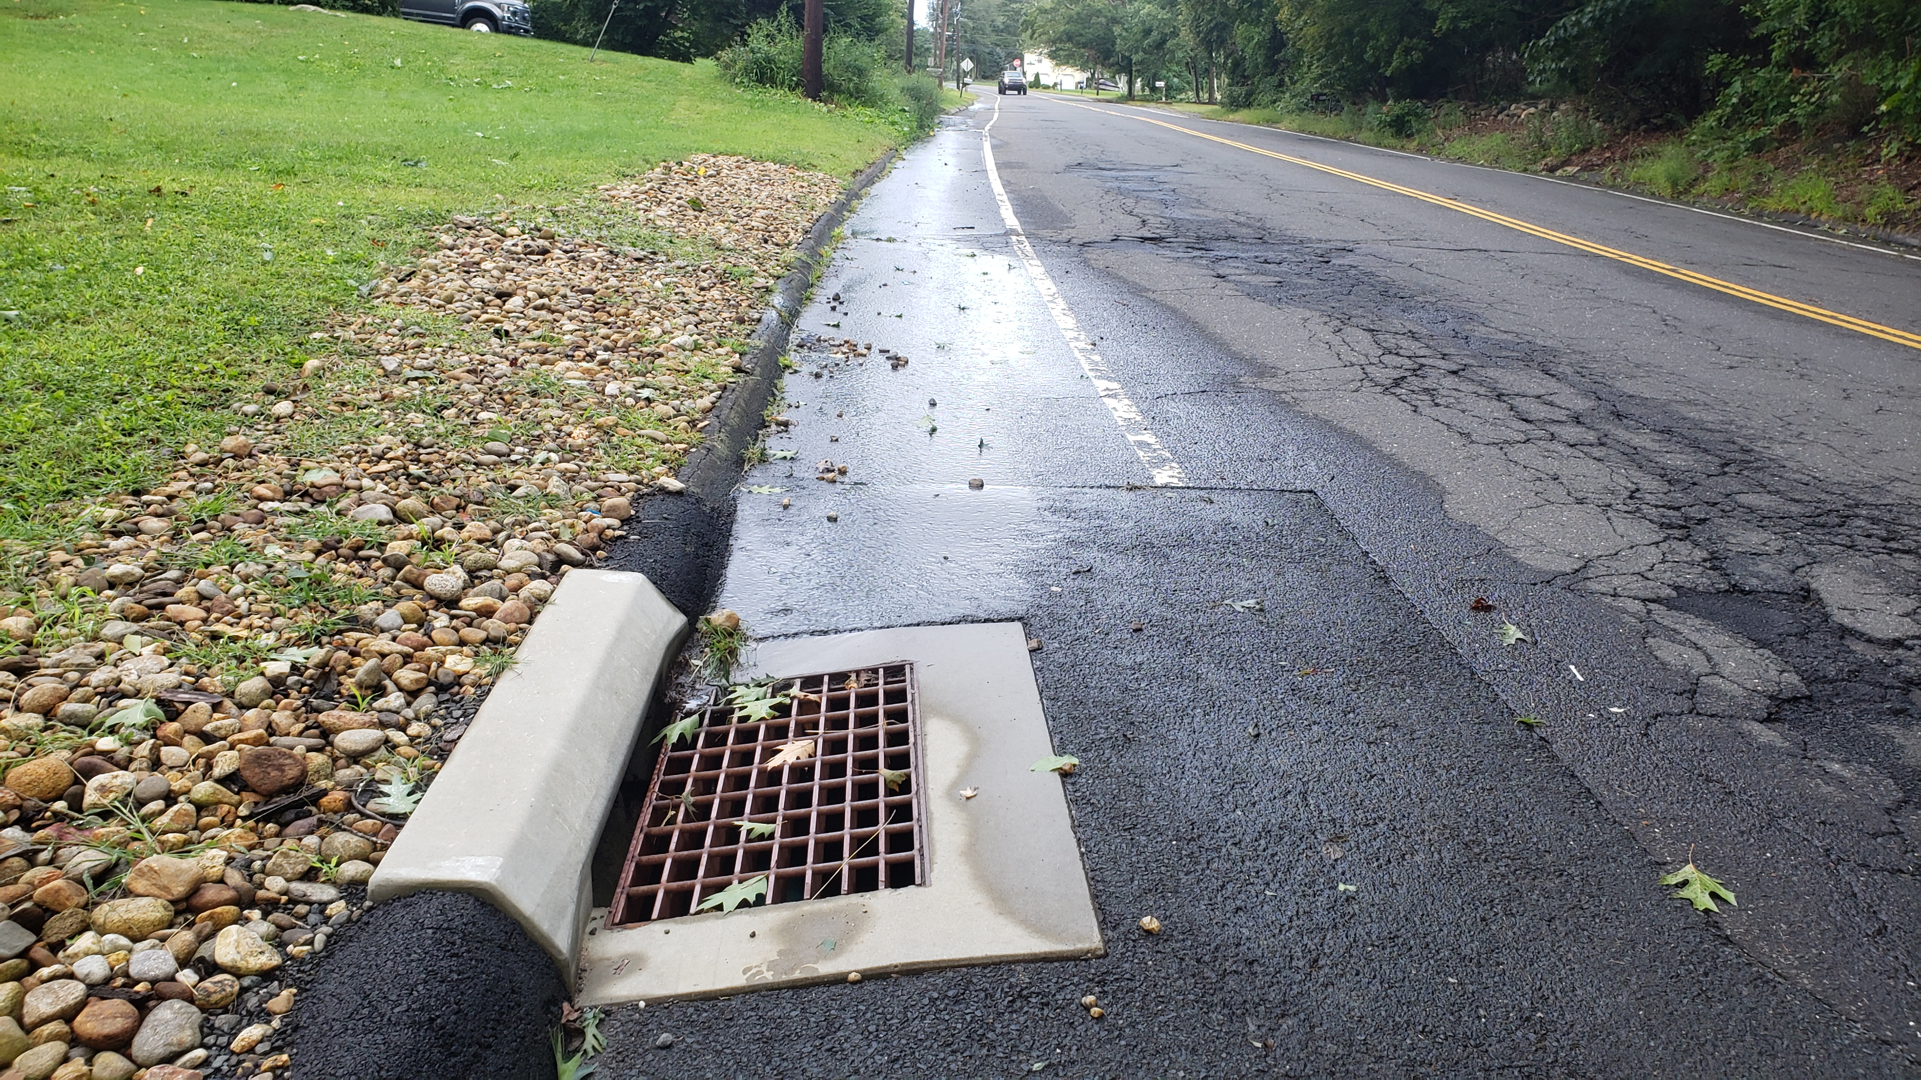
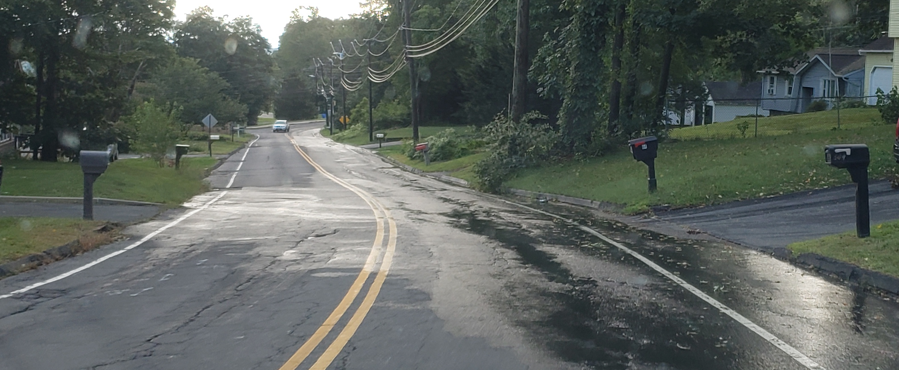
Purpose & Need
Upgrade Roadway Drainage
Groundwater issues
Poor surface water collection
Scour at existing outlet

Slide 16
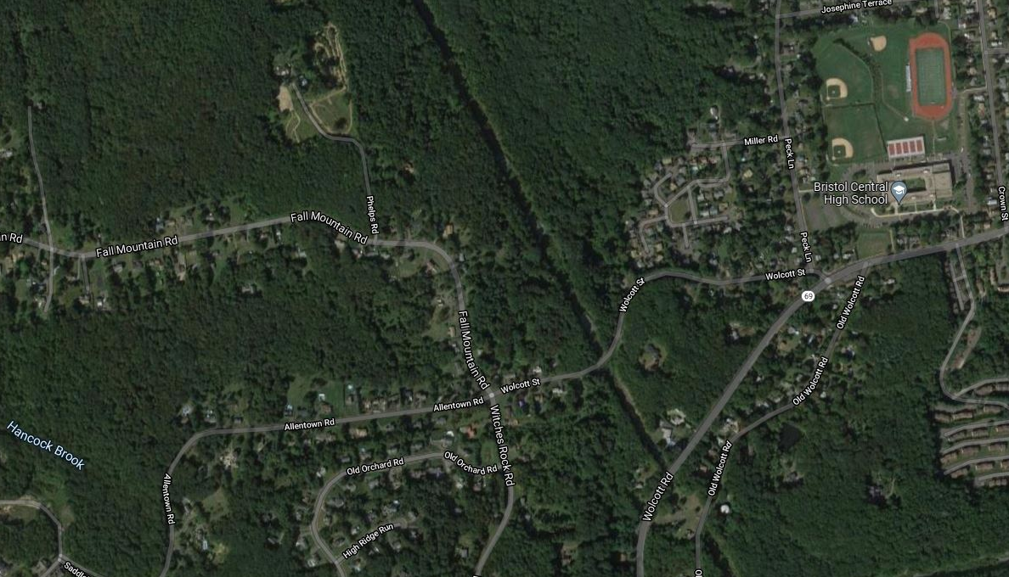
Purpose & Need
Construct Sidewalk
Poor pedestrian safety
Connect Neighborhoods to Bristol Central High

Slide 17
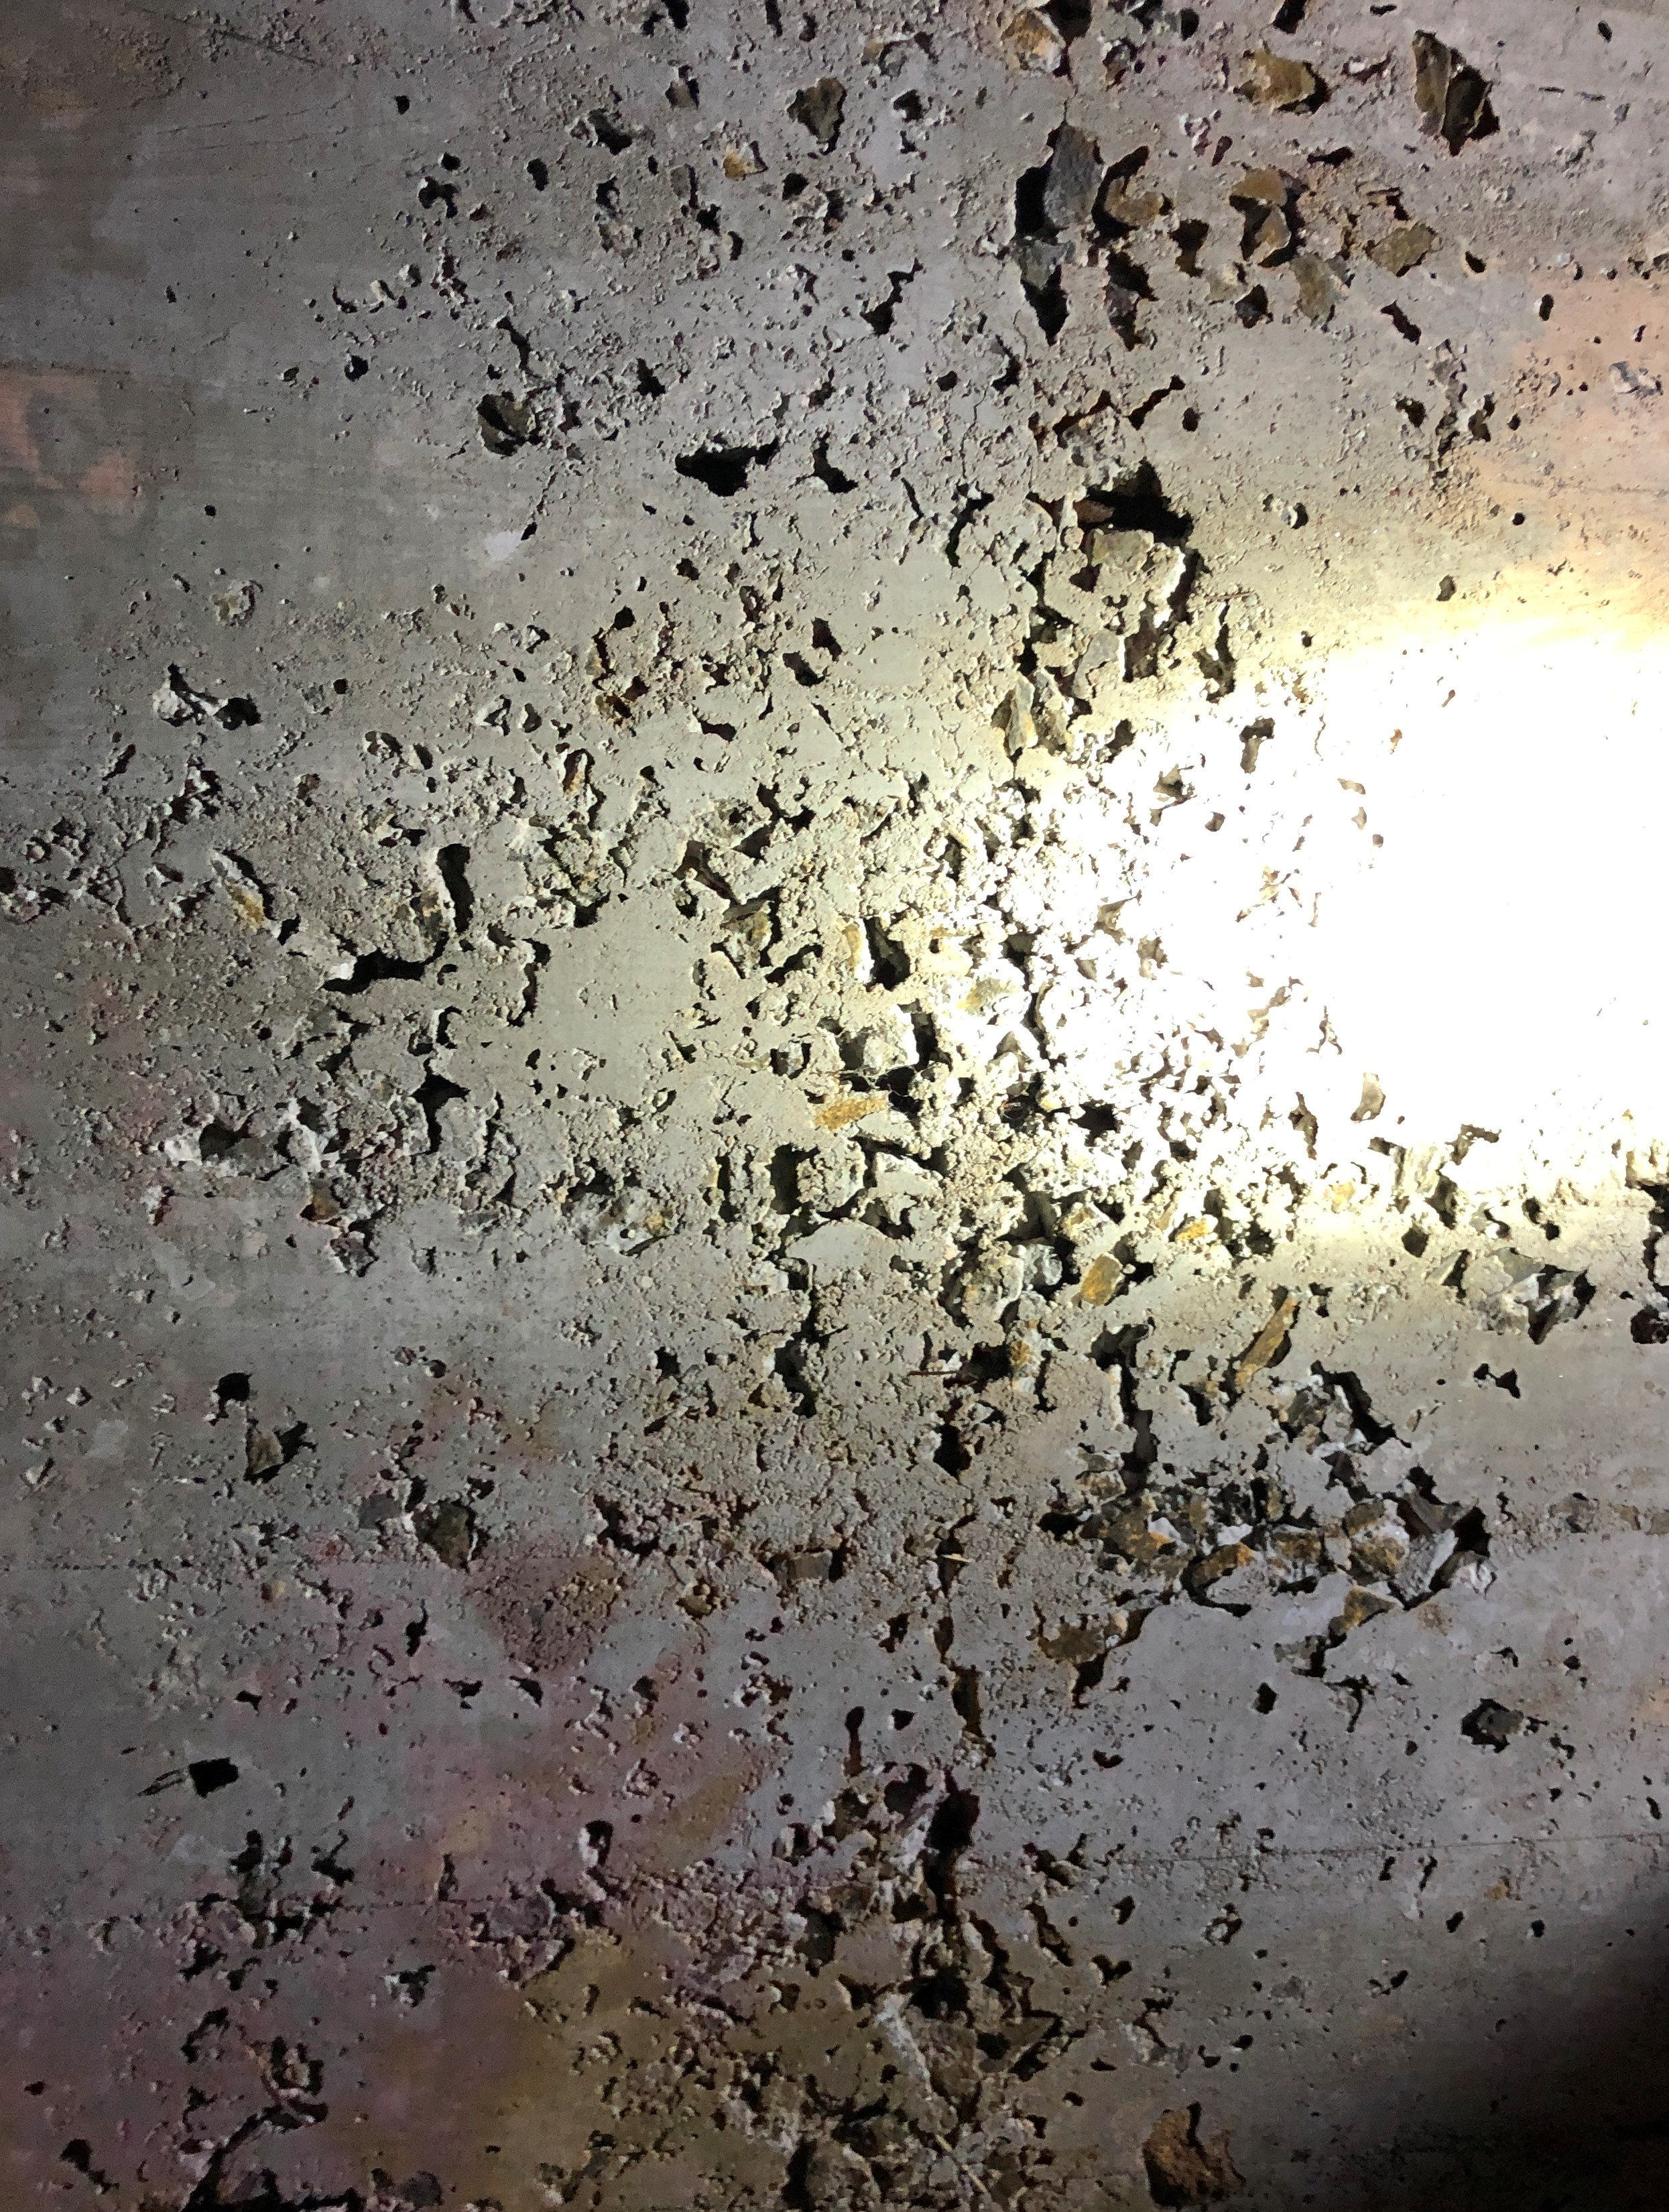
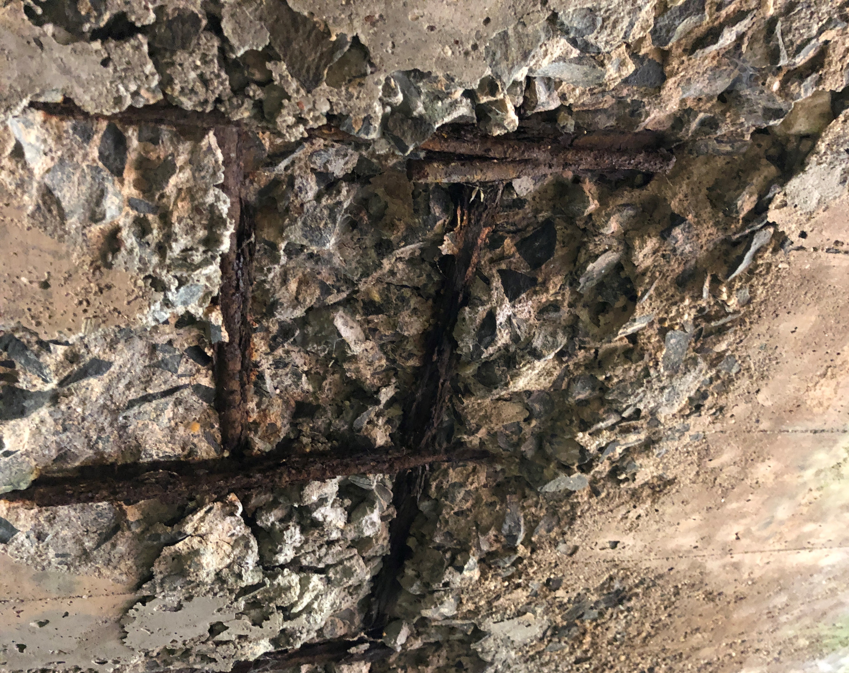
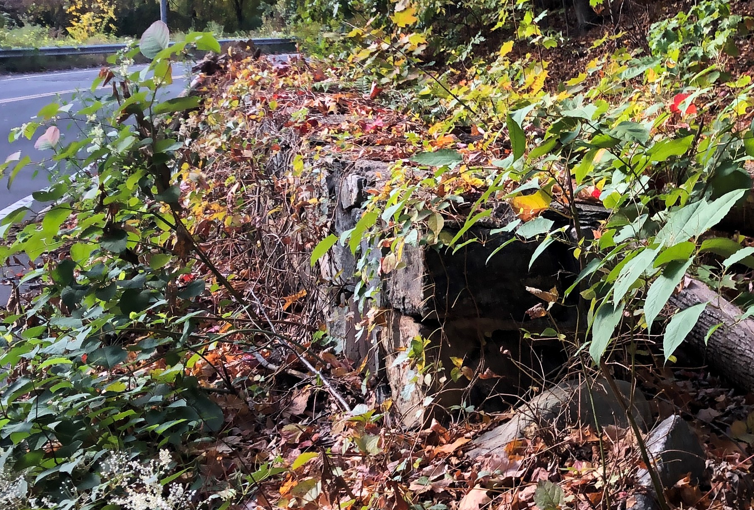
Purpose & Need
Rehabilitate Existing Culvert
Deteriorating Roof Slab
Existing Scour Concerns
Existing Parapets

Slide 18
Proposed Improvements

Slide 19
Proposed Improvements
Roadway Realignment
Sightline Improvements
Full Depth Reconstruction
Drainage Improvements
Sidewalk Construction
Culvert Rehabilitation

Slide 20
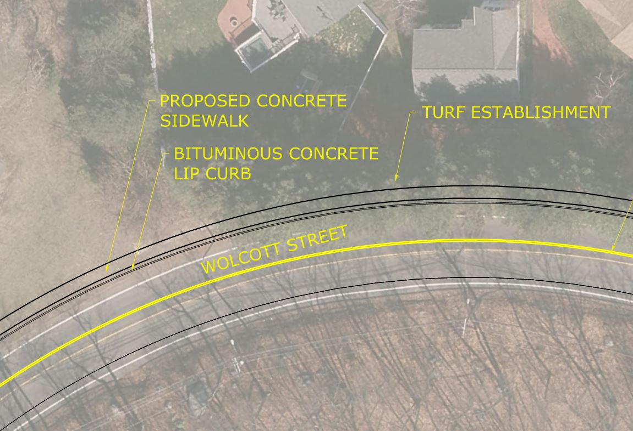
Proposed Improvements
Roadway Realignment
35 mph design speed
Appropriate superelevation

Slide 21
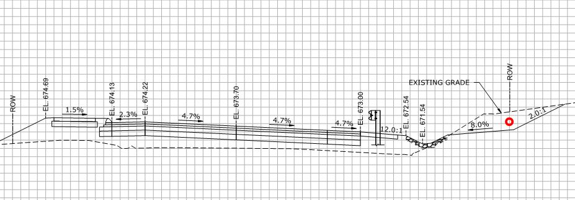
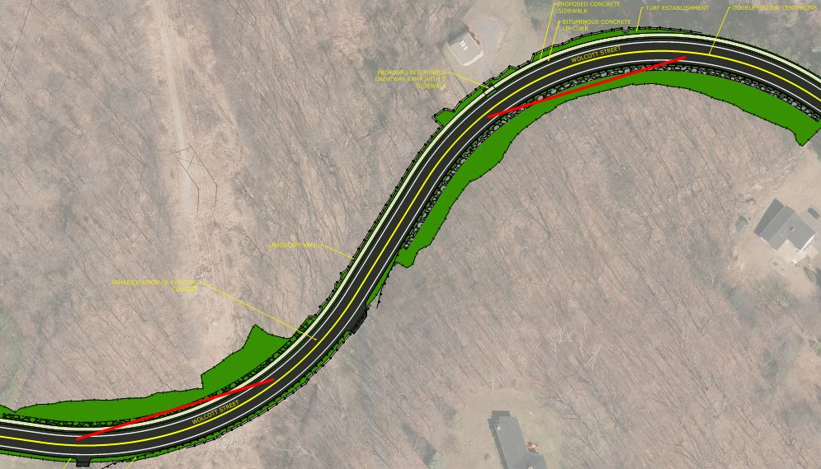
Proposed Improvements
Sightline Improvements

Slide 22
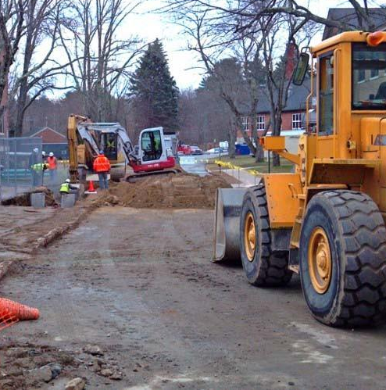
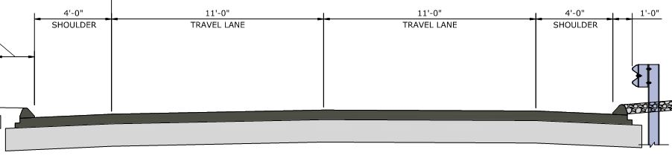
Proposed Improvements
Full Depth Reconstruction
5” Pavement
12” Base

Slide 23
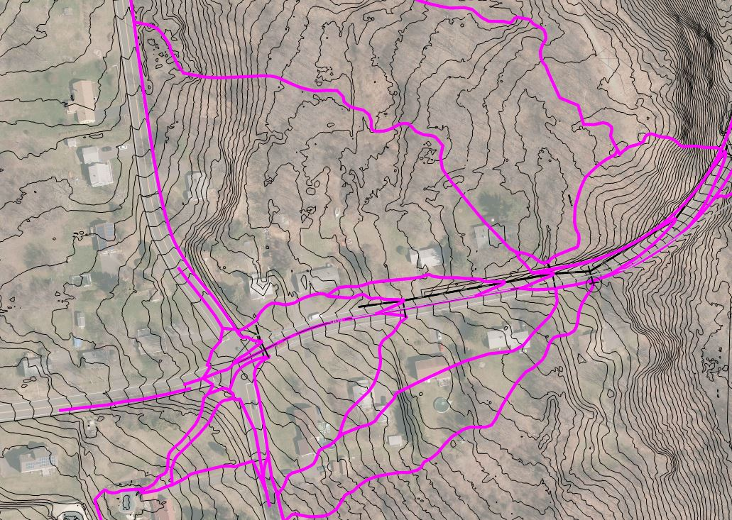
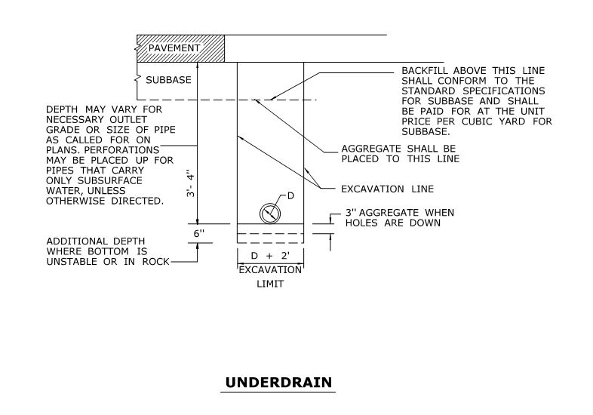
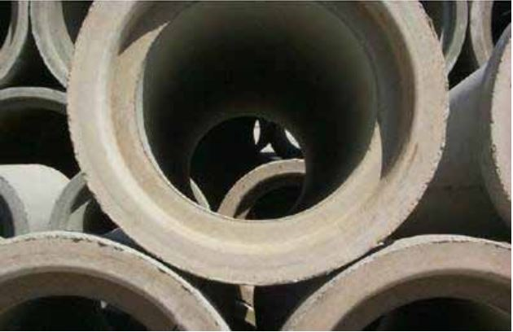
Proposed Improvements
Drainage Improvements

Slide 24
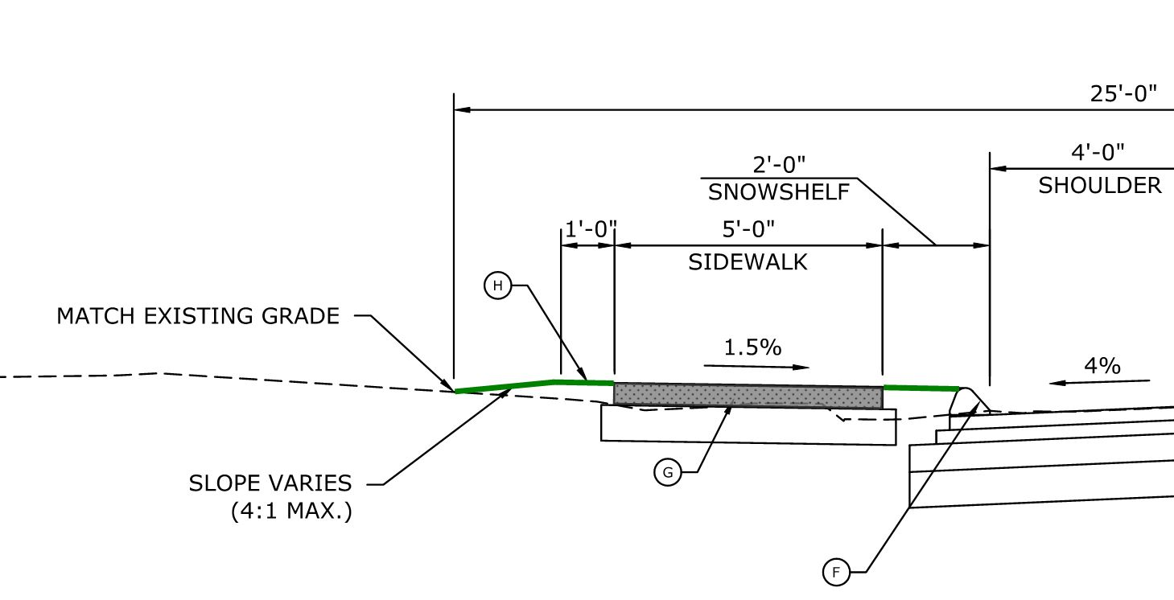
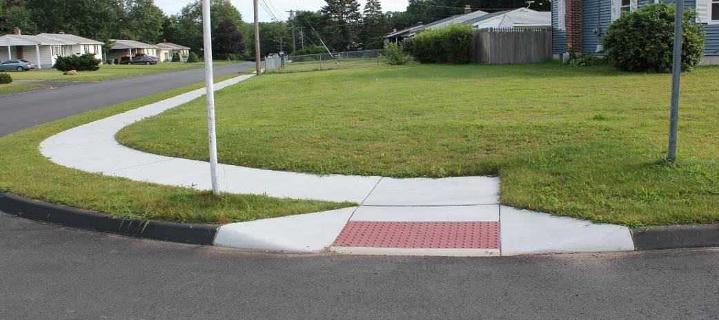
Proposed Improvements
Sidewalk Construction

Slide 25
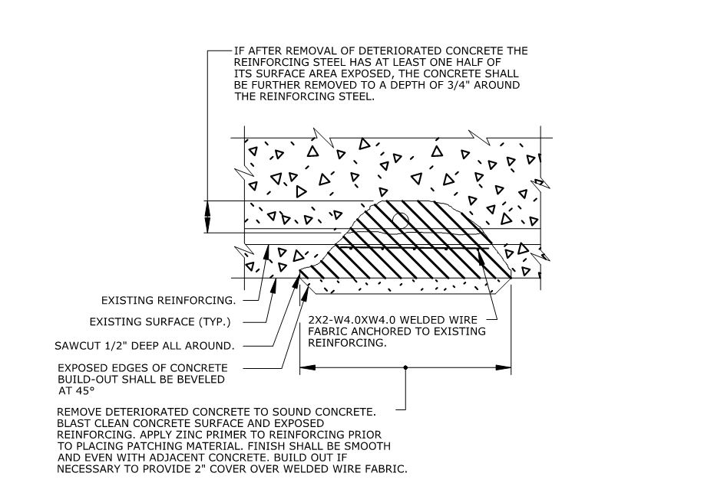
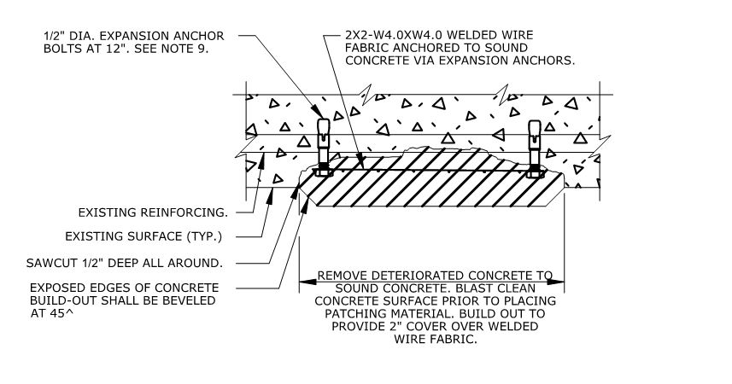
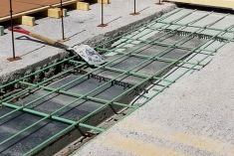
Proposed Improvements
Culvert Rehabilitation

Slide 26
Right of Way (ROW)

Slide 27
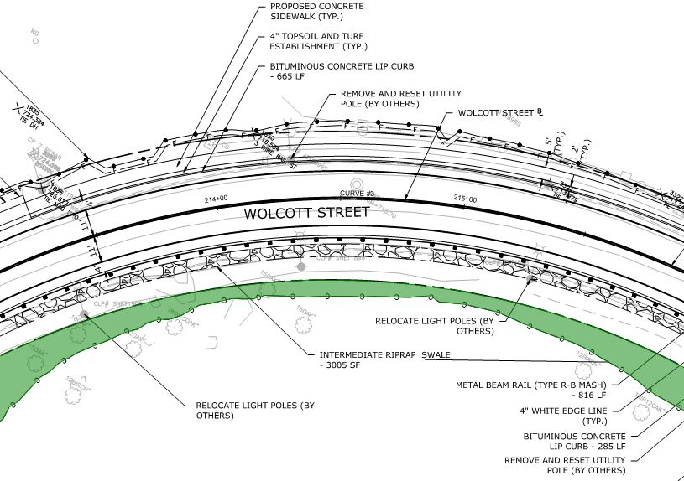
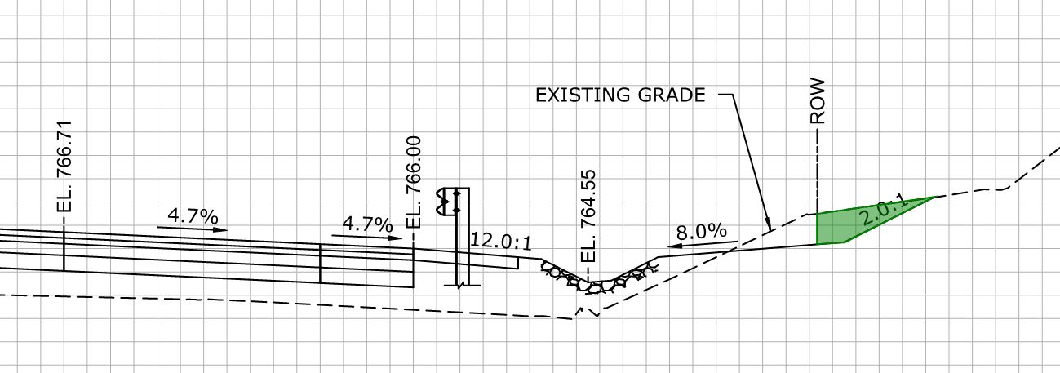
Right of Way (ROW)
Easement for the Safety of the Highway
Right to Grade
Sightline Easement

Slide 28
Right of Way (ROW)
CT DOT Office of Rights of Way
Just compensation
Federally regulated process
You will be contacted by ROW coordinator
Explanation of impacts
Explanation of assessment
Design team available
Time to review, obtain outside appraisal

Slide 29
Project Costs

Slide 30
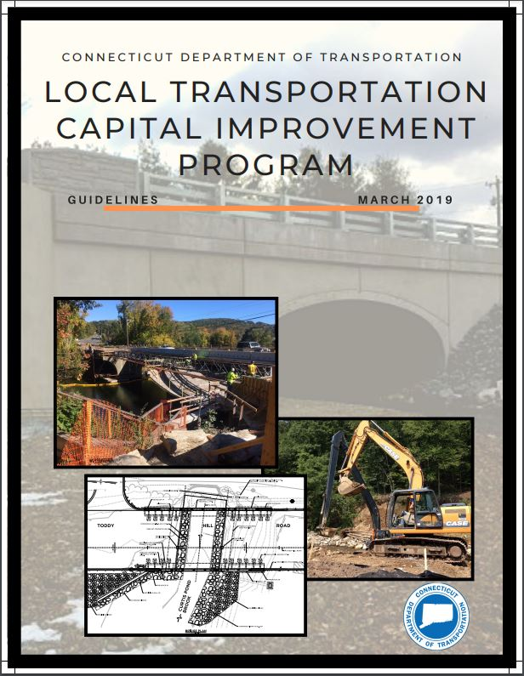
Project Costs
Design - $165,000
100% City Funds
Construction (est.) - $3,000,000
100% State Funds
Right of Way (est.) - $10,000
100% State Funds

Slide 31
Project Schedule

Slide 32
Project Schedule
Design Completion – January 2022
Construction – April through November 2022
Access maintained to all properties
Alternating one-way
Driving on gravel surface

Slide 33
Questions?

